Slide 1
RISK MANAGEMENT
Risk Management

Slide 2
RM Application Sequence
Phase I: Identification
Phase II: Quantification and analysis
Phase III: Action Plan (Mitigation)
Phase IV: Supervision and Evaluation
Risk Management

Slide 3
Identification
Review of background information and materials
Adjustment of standard questionnaire
Identification of relevant stakeholders
Interviews with stakeholders (Individual or focus groups)
Risk Management

Slide 4
Quantification and analysis
Analysis of probability (1-100%) and degree of impact (1- 5)
Tabulating results
Risk Matrix
Risk Management

Slide 5
Risk Matrix
Event
Probability
Impact
Product
Objective
Components
0 - 100%
1 -5
Development
SOCIO-ECONOMIC CONTEXT
Delays in rules approval process.
80%
4
320
Persists lack of interest in the program by
100%
5
500
Risk Management
Education Centers and Universities.
3
Instructors – Evaluators offer still
100%
5
500
Not enough
3
INSTITUTIONAL-ORGANIZATIONAL-
FINANCIAL
FENCAPUTUR’s lack of institutional capacity to
100%
5
500
Become a competencies certification entity .
1
EXECUTION
Lack of coordination between SubEAs continues
100%
5
500
SUSTAINABILITY
Program lacks a Sustainability Plan
100%
5
500%

Slide 6
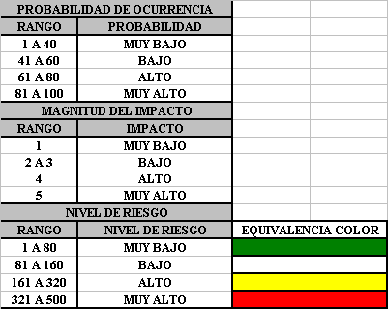
Measurement parameters
Risk Management

Slide 7
Action Plan (Mitigation)
Meeting with the EA and stakeholders to agree on results of the risk assessment.
Identify activities to mitigate risks.
Risk Management

Slide 8
Monitoring and Evaluation
Activities to mitigate risks are incorporated into PEP and AOP.
Their execution and results are documented in the Progress Report (PR) and PPMR.
Risk Management

Slide 9
Thank you!!!
Risk Management

