Slide 1

“la Caixa”
www.lacaixa.es
REMITTANCES AND ACCESS TO FINANCIAL SERVICES
BEST PRACTICES
Madrid
June 6, 2007

Slide 2


“la Caixa”, a leader institution in the
New Residents market
WHO WE ARE AND WHERE WE ARE
7,4 % of the total number of “la Caixa” clients
are new residents
1 of each 3 new clients is a new resident
From Spain to other countries: 500 million Euros in monthly remittances
Out of which...
70 million Euros from “la Caixa”
Active Clients:
715.000
(New Residents)

Slide 3
In 2006....”la Caixa”.....
Sent more than 1 million remittances
Issued over 620.000 cards to New Residents
Gave 3 out of 10 new mortgages to New Residents

Slide 4

7,4% of “la Caixa” clients are New Residents
Divided by Countries....
41%
33%
6%
20%
Latin America
Rest of countries
Eastern Europe
Africa

Slide 5
“la Caixa’s” STRATEGY: FOUR MAIN PILLARS
Service (above all, a savings bank committed to serving individuals and families)
Adaptation to our customers’ needs
Cutting edge banking technology (use of alternative delivery channels)
Integration: remittance as the entry point (“bancarizar”)
we want to “bank” new resident customers by moving them up the financial value chain as quickly and as effectively as possible

Slide 6
REMITTANCES MAIN DESTINATIONS
UKRAINE
ROMANIA
BULGARIA
CHINA
CUBA
MOROCCO
DOMINICAN REP.
SENEGAL
PHILIPINNES
COLOMBIA
ECUADOR
PERU
BRAZIL
ARGENTINA

Slide 7





Multi Channel....
Remittances sent through 4 different channels....
Branch
ATM
Mobile phone
Internet

Slide 8

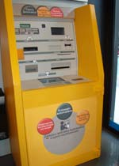

ATM CHANNEL
30% of the remittances are sent through ATM’s
Over 7.000 ATM’s
throughout Spain
24 / 7
“Just in 2 clicks”

Slide 9

International Transfer Card

Slide 10

EXAMPLE OF PERSONALIZED CARDS

Slide 11
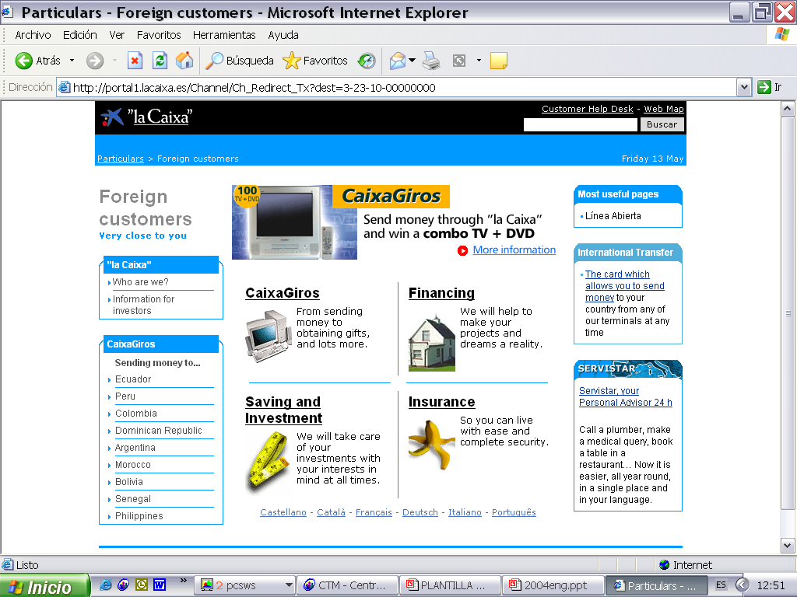
Internet Channel
On-line banking (e-la Caixa)

Slide 12
Mobile Phone Channel
1
GIRO 1000 PAPA
Esborrar Enviar
Enviar a: 7020
Esborrar Enviar
Customer sends SMS message to 7020
REQUEST FOR REMITTANCE
2
“la Caixa” answers with SMS message confirming the transfer
“la Caixa”. Ha enviado 1.000 DOL.USA (766 euros) a PAPA.
Opcions Enrere
Llegir Enrere
RESPONSE

Slide 13
Remittances divided by CHANNEL
Branch
ATM
Internet

Slide 14
MOVING FORWARD
We take one step forward
  A new line of activity
  A specific customer segment
New residents
  Not as an “outsider” group
  In an integrated way
  In an inclusive way

Slide 15
MOVING FORWARD
How do you achieve this internally?
  Senior management commitment
  Head Office sensitivity
  Organization’s adaptation
  Non-national employees
  Product development
  Focused marketing

Slide 16
SOME FINAL CONCLUSIONS
  “Product laboratory”: continued new products and services development
  An ongoing effort to cover all the new residents financial needs throughout their “life-cycle” (arrival, stabilization, normalization and full integration)
“THIRD GENERATION PRODUCTS & SERVICES”

Slide 17

FULL RANGE OF PRODUCTS FOR NEW RESIDENTS:
  Remittances
  All types of cards
  Special savings accounts
  Payroll Services
  Telephone Cards
  Specially designed insurances
  Consumer loans
  House financing (home & host countries)
  Micro-lending programs

Slide 18
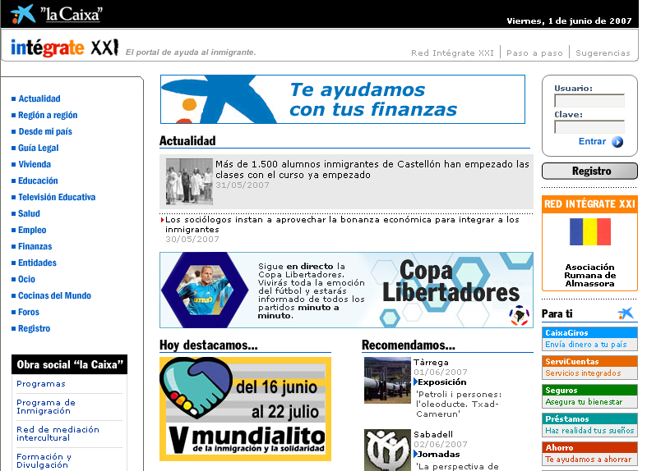

Slide 19
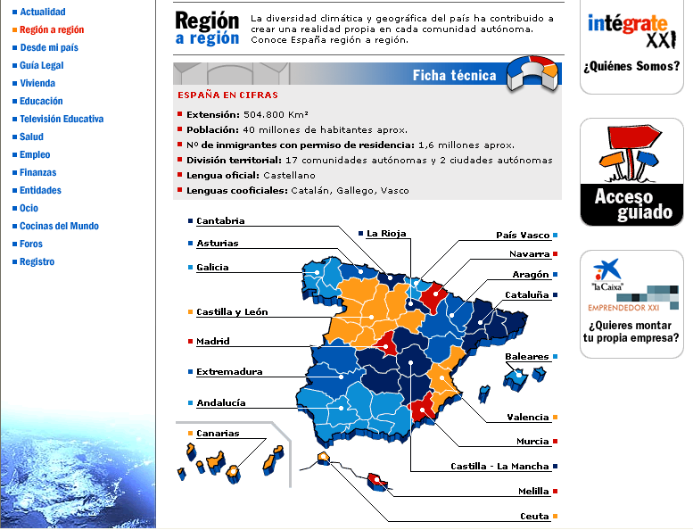

Slide 20
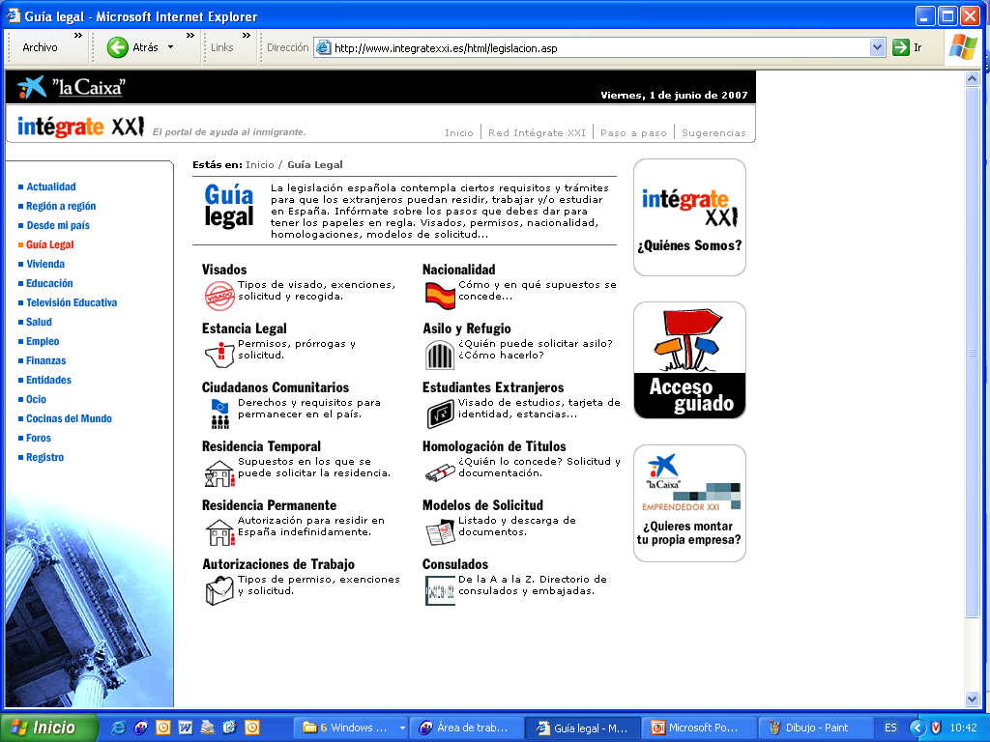

Slide 21
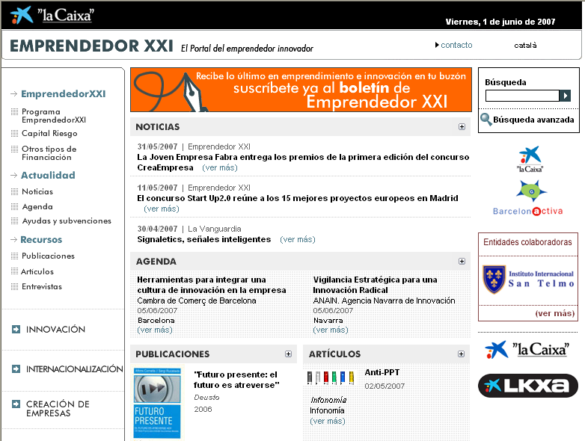

Slide 22
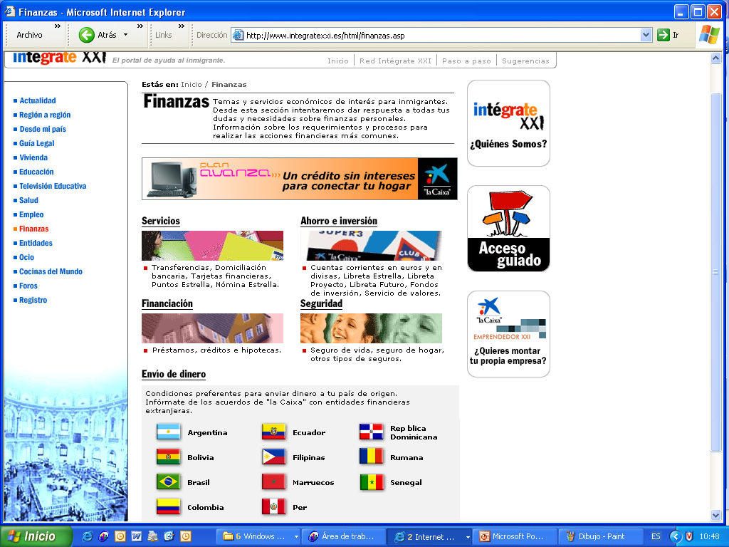

Slide 23
“la Caixa”
www.lacaixa.es
REMITTANCES AND ACCESS TO FINANCIAL SERVICES
BEST PRACTICES
Madrid
June 6, 2007

