Slide 1
Public Opinion Study of Remittance Recipients in Brazil
April – May 2004

Slide 2
I. Demographics of Remittance Recipients (RR’s) Gender

Slide 3
Age

Slide 4
Education

Slide 5
Household Annual Income (in US dollars)

Slide 6
Country of Remittance Senders
*Portugal, Italy, England, Spain, Germany and France
**Canada, Argentina, Australia and Chile

Slide 7
Relationship of Remittance Senders

Slide 8
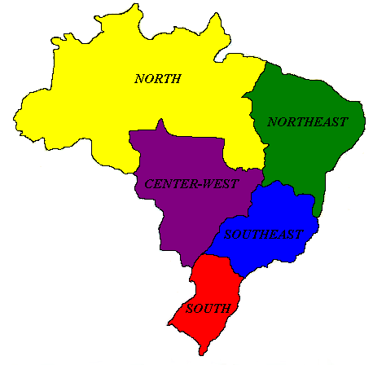
Regions of Brazil

Slide 9
Remittance Recipients by Regions of Brazil

Slide 10
States and Cities with Concentrations of Remittance Recipients
Southeast
Sao Paolo
Atibaia
Cafelandia
Embu
Jaguaruna
Mogi das Cruces
Presidente Prudente
Rio Claro
Sao Paolo
Rio de Janeiro
Nova Friburgo
Petropolis
Rio de Janeiro
Southeast
Minas Gerais
Belo Horizonte
Caratinga
Governador Valadares
Pescador
South
Parana
Curitiba
Lapa
Maringa
Pato Branco
Prudentopolis
South
Santa Catarina
Blumenau
Cocal do Sol
Criciuma
Florianopolis
Gaspar
Joinville
Santo Antonio do Pontal
Sideropolis
Rio Grande do Sul
Sao Leopoldo

Slide 11
How frequently do you communicate with this family member by telephone or the Internet?

Slide 12
Do you have a bank account?

Slide 13
II. Major Findings
The IDB study indicates that approximately 1.3 million Brazilians receive remittances from their relatives living outside of Brazil on a regular basis.
This IDB estimate is based on a Brazilian adult population of 110 million (IBGE – Brazil Census 2000) and poll results which show that 1.2% of Brazilian adults receive remittances regularly from abroad.

Slide 14
II. Major Findings (cont’d.)
The average Brazilian RR receives 9.7 remittances annually.
The average Brazilian RR receives $428 with each remittance.
This IDB study estimates that Brazilians receive approximately $5.4 billion in remittances annually.

Slide 15
How frequently does this family member send you money?

Slide 16
For how many years has this family member been sending you money?

Slide 17
How much money – on average – do you receive with each remittance?

Slide 18
How much money – on average – do you receive with each remittance?

Slide 19
How is the remittance sent?

Slide 20
Over the last two years, has the remittance increased, decreased, or stayed the same?

Slide 21
Has your life improved as a result of receiving remittances?

Slide 22
Usage of Remittances

Slide 23
Are you thinking about leaving Brazil?

Slide 24
III. Methodology
The results and findings in this report are based on:
1) 2,000 door-to-door interviews conducted in Brazil during April of 2004. This sample was designed to be representative of the Brazilian adult population.
2) 1,500 telephone interviews conducted in Brazilian cities with a high concentration of remittance recipients during May of 2004.

