Slide 1
Productivity and Human Capital: Missing Incentives and Coalitions
Ben Ross Schneider
Department of Political Science
Massachusetts Institute of Technology

Slide 2
Politics of institutional change
Not just North assumption that inefficient institutions are maintained by powerful beneficiaries
Powerful relative to what?
Pro-productivity coalition that is missing
Requires prior examination of topography of economic agents
Vale versus Samsung
Vale faces little competitive pressure
Trains own workers
Students need not acquire skills

Slide 3
Labor Markets in Latin America
 | LME | Latin America | CME
Union density | 28 | 15 | 45
Labor market regulation | .33 | .53 | .51
Job tenure (median years) | 5.0 | 3.0 | 7.4
Informal economy | 13 | 40 | 17
Weak unions
No alternative plant-level intermediation
High regulation
Short tenure
Large informal sector

Slide 4
Incentives to invest in Human capital
Percentages of Employees of Selected Business Groups in Brazil with Primary, Secondary, and Tertiary Education, 2005–6
 | Sector | Primary | Secondary | Tertiary
Labor-intensive
Camargo Corrêa | Diversified | 58 | 33 | 9
Andrade Gutierrez | Diversified | 62 | 24 | 14
Sadia | Meatpacking | 58 | 36 | 6
Perdigão | Meatpacking | 47 | 42 | 11
Capital intensive
Gerdau | Steel | 12 | 68 | 19
Votorantim (only cellulose) | Pulp and paper | 10 | 54 | 36
Services
Unibanco | Banking | 2 | 50 | 48
Bradesco | Banking | — | 17 | 82
Itausa | Banking | — | 53 | 46
Telemar | Telecom | — | 25 | 72
High turnover
Movement among sectors
Low skill expansion
Service sector
Raw materials

Slide 5
Politics of investment in training and education
Vale story
Vale trains workers, so governments do not
Large firms train workers, so students have fewer incentives to study
Families fewer incentives to make political demands

Slide 6
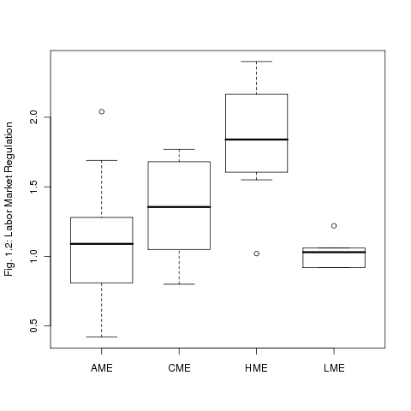
Anomaly of labor regulation
Labor regulation high by international standards
Labor regulation was least reformed of 10 dimensions of Washington consensus
2 usual explanations
residual labor power, especially when reform enacted by labor based parties
Regulations are optional, and constitute a progressive tax on profitable firms
Key: bold line is median, box is 25-75th percentile. AME – Southeast Asia; HME – Latin America; CME – Europe; LME -- Anglo

Slide 7
High severance pay protects investment in skills
3rd possibility is that big business does not oppose high severance pay
Big business has had power to push through a lot of reforms, so why wouldn’t it be able to with labor
If firms invest in training, then how can they protect that investment from poaching?
High severance pay ties worker to firm and protects investment in skills
Shift focus from blocking/obstacle, to preferences

