Slide 1


New Approaches to Manage Knowledge
Innovation and Knowledge Management Unit (IKM)
SUBREGIONAL MEETING WITH MIF SPECIALISTS
Kingston, Jamaica
May 3-4, 2007
Joaquim Tres
JTres@iadb.org
Notes:
Title and speakers changed in the agenda
Title implies that MIF has managed K before having a strategy document

Slide 2
Session Plan
Mission and activites of the IKM Unit
IKM Innovation Method
New Approaches to Knowledge Management
New Partnerships Initiative
Surfing the New MIF Website
Open Discussion
Innovation and Knowledge Management Unit (IKM)
Notes:
2 and 3 refer to the title of the presentation “New Approaches to Knowledge Management

Slide 3
Mission
To facilitate the application of innovative initiatives to MIF’s development goals
To manage MIF-generated knowledge in order to leverage the Fund as an agent of change
Activities
Innovation and Knowledge Management Unit (IKM)
Develops new thematic areas by designing innovative projects based on international best practices, lessons learned and regional demand;
Provides applied knowledge to other Units for mainstreaming into MIF project pipeline;
Leads the identification, organization and dissemination of knowledge generated by the MIF community, and
Identifies and fosters institutional partnerships
  to establish mutually beneficial sharing of expertise and knowledge,
  to increase co-financing opportunities. Nurturing partner executing agencies via learning communities (networks, clusters)

Slide 4
Innovation Briefs: Considerations (1)
What they are
Electronic compilation of relevant information to design and develop MIF projects within a given thematic area.
E-discussions with MIF specialists and outside experts using the new website section on New Ideas.
Innovation
Before and during the process of the IBs
To facilitate transfer of IBs, IKM will always:
  (i) bring in specialists from other MIF operational units into the projects it leads, and/or
  (ii) encourage MIF Specialists and the Country Offices to lead IKM pilot projects.
IKM will test different approaches and methodologies in the pilot projects it leads to maximize learning opportunities.
IKM will give priority to depth and quality over speed.

Slide 5
Innovation Briefs: Considerations (2)
After the process of the IBs
IKM stops leading the design and development of new pilot projects although it becomes advisor to the other MIF operational units.
The IB is submitted for approval to the MIF Policy POC.
The IB is formally presented to the MIF personnel (both at headquarters and country offices) and transferred in electronic format.
Innovation

Slide 6
Innovation Briefs on…
2007:
Competitiveness of family-owned businesses
Female entrepreneurship
Promotion industrial cooperatives
Financial sector self-regulation
2008:
Financing of human capital
Anticorruption
Cultural industries
Intellectual property
Enterprise failure and start-ups
Innovation

Slide 7
What do we expect from the COFs?
Referring new thematic areas;
Assessing feasibility of areas and in the institutional mapping in their countries;
LEADING projects within approved IBs,
LEADING the Innovation Cycle,
PARTICIPATE in the E-discussions,
Innovation

Slide 8
Resources? The PAI
Consultancy facility available from Spain to:
  Promote innovation in MIF’s activities, leading to new projects.
  Identify, organize, disseminate success stories that can be replicated and upscaled.
Funding: 1,250,000 Euros, with an average of 60,000 Euros for each consultancy.
Innovation

Slide 9
Establishes that the MIF will share knowledge that assists the private sector
Operations may be directed at sharing knowledge and lessons learned from its initiatives
MIF development impact may be measured by its ability to publicly disseminate lessons learned and project results
Why Manage Knowledge at the MIF? (1)
The New Mandate
Knowledge Management

Slide 10
“The issue today is to organize the area of knowledge because is where we are going to make a difference in the long run and maintain our comparative advantage”
Knowledge Management
President Luis Alberto Moreno
Challenges for 2007
2006, Year of Initiatives at the IADB

Slide 11
Over 1000 operations approved, including PDA,
440 completed projects
1.2 billion approved and similar amount mobilized
800 Executing Agencies
14 clusters and 5 networks that have potential to be fully engaged in knowledge-sharing
New MIF Partners, including donors and HEI
Why Manage Knowledge at the MIF? (2)
The MIF Record
Knowledge Management
Notes:
These figures can be done at country level to see whether you really need to manage knowledge carfefully and in a systematic way.
Some of you have just joined your COF. Use the website to see how many projects you have, read the project documents and can do this slide

Slide 12
MIF projects were themselves a means of K transfer.
Why Manage Knowledge at the MIF? (2)
When preparing Initiative we realized that:
MIF had a huge wealth of K sitting at EA, COF and HQ, but often not connected and shared.
Knowledge Management
Learning was taking place in a more individual and less systematic way as it was desired.
KM activities didn’t have the replication and upscaling focus, but that is the main challenge in MIF II.

Slide 13
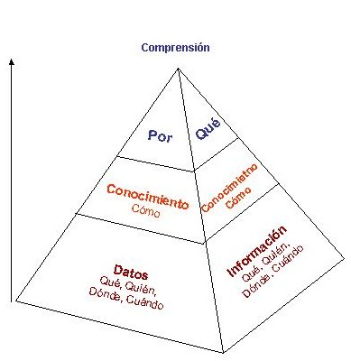
Interested in the top of this pyramid but
Knowledge Management
We nned to be selective from the bottom

Slide 14
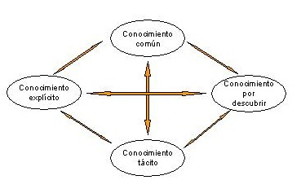
MIF’S Knowledge Management Initiative
What are We Trying to Achieve?
Take knowledge from where it is to where is most needed
Knowledge Management

Slide 15
K2Practice
The MIF KM Initiative
Knowledge Management
Notes:
Repository is where the infortmation is stored and managed. We use several from the Bank and have our own tool that also allows us to translate Bank topics into MIF ones an manage the website. It is the MIF Admin Tool.
Thematic analysis to replicate or upscale. We will do 4 of these in 2007 cofinanced with Spain, but will be actively seeking new partnerships.
Learning Communities at the base of the KM system, to which we now turn in more detail because we have chosen a people centered KM strategy rather than a codification one

Slide 16
How are we going to work?
MIF Learning Communities
Take knowledge from where it is to where is most needed
Voluntary participation
Horizontal, but with leadership
Focus on sharing or creating new knowledge from a common learning agenda
Both duration and objectives are set
MIF is not creating a new structure but giving a learning focus to existing arquitecture
Knowledge Management

Slide 17
What Has Been Done So Far?
Organizational change:
  Office of the Deputy Manager for Strategy and Dev Effectiveness
  IKM Unit
Outcomes:
  Concept Paper, May 2006
  K2Practice presented to Donors
  Criteria to select areas of study
  Dissemination tools(e.g. 1KM Dispatch)
  Development of MIF website (client-oriented, community of change agents, participation)
  Methodology for Learning Guides
  Development of Learning Guides (Value Chains & Entrepreneurship
  Monografías FOMIN/MIF Occasional Papers (Remittances CR-Nicaragua)
Knowledge Management

Slide 18
What Has Been Done so Far?
Examples of activities undertaken (cont.)
Development of a New Program to Promote Knowledge Management via MIF Learning Communities:
  This builds on the MIF Partners in Innovation Program (please see 1KM Dispatch # 6, January 2007)
Knowledge Management
Resources:
  Budget & Programa de Apoyo a la Innovación (PAI)

Slide 19
What can role of COF be?
Promote Learning Communities for a particular thematic area/ country
Disseminate information on country activities etc via the MIF website
Contribute to the repository of information on the web
  Identification of lessons learned
  Identification of success stories
Propose other activities/products because knowledge management should be responsive to the needs of the organization
Knowledge Management

Slide 20
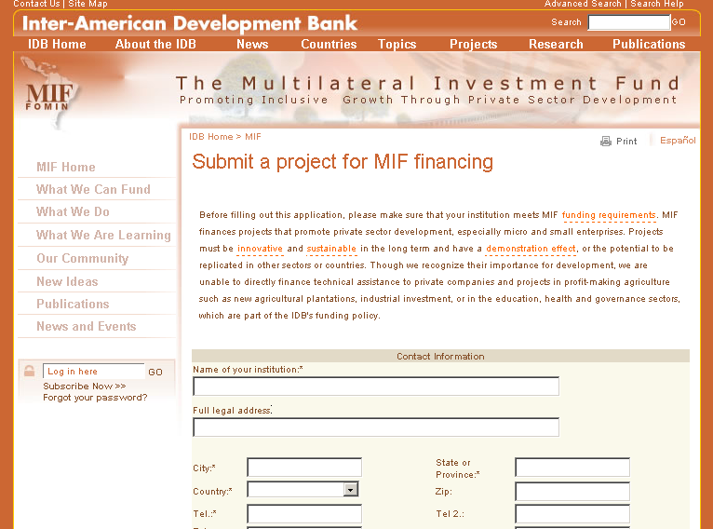
New MIF website and its tools

Slide 21
PARTNERSHIPS INITIATIVE
A Response to MIF’s Strategic Priorities
Rationale
Focus on knowledge-sharing, development effectiveness, and efficiency rather than simply the number of projects approved
MIF II has brought new donors with new priorities
Broadened mandate to include poverty reduction
MIF commitment to becoming a learning organization
This initiative is to provide a framework within the MIF for what we do with partners.
Partners Initiative

Slide 22
Objectives
To increase the number and the impact of innovative MIF projects in LAC
To expand and enrich MIF’s own experiences gained from financing projects in LAC by tapping into the wealth of expertise and knowledge in international development institutions
Partners Initiative
To more effectively leverage MIF project funding resources by increasing co-financing opportunities with a growing list of partners.
To attract more funding to the region to take to scale and replicate successful MIF projects.

Slide 23
Approach
Two target groups:
  Donor Agencies, other dev. institutions, NGOs, financial institutions.
  Collaboration already taking place – USAID, DFID, SIDA, Korea, Spain – but now in the context of a general strategy.
Partners Initiative
  Executing agencies of MIF projects – MIF has worked with over 800 since its inception.
  Some steps in partnering have been taken – Clusters (more MIF-driven) and Partners in Innovation Program (networks take the lead).

Slide 24
Role of Country Offices
A. Executing Agencies
· Help update the database of MIF partner executing agencies once a year
· Help MIF expand outreach to partner executing agencies at the country level
· Identify potential “national networks” of executing agencies for participation in new “MIF Networks” program
· Help to market new program to promote KM through Learning Communities, provide input into the evaluation of proposals and supervise the new projects approved for funding under the program
Partners Initiative
B. Donor Agencies (Bilateral, private foundations,…)
· Help identify possible partner institutions for MIF at the country level in LAC

Slide 25
Thank you!!!
Your Comments?
Partners Initiative

