Slide 1
LINKING REMITTANCES AND HOUSING FINANCE Washington, February 14th, de 2008

Slide 2
Linking Remittances and Housing Finance in Cooperativa Salcajá
47% of the members’ investments and 32% of loan requests are for housing.
These credits are administered according to the Cooperative Credit Regulations, the available resources, financial discipline, the strategic plan of the Cooperative, the payment capacity of the client, and including real guarantees. The default rate for this line of credit is 5.11%.

Slide 3
Linking Remittances and Housing Finance in Cooperativa Salcajá
Remittance services began in 2001
By December 2007, operations had reached 26 million USD
In 2006 and 2007 2,788 housing loans were disbursed.

Slide 4
Linking Remittances and Housing Finance in Cooperativa Salcajá
Studies between 2006 -2007 with remittances recipients show:
The average remittance received is between US$200 and US$300; 70% of remittances are received from 1-3 months
99% of the recipients owns a house but crowded; 70% a concrete house; 25% an adobe house. 97% have energy and water services; 53% sewage, telephone and paved streets. Property rights not clear.

Slide 5
COOPERATIVA SALCAJÁ, R. L
2007
PORTFOLIO
ITEM | Approved Credits | In Quetzales | In US Dollars | Percentage
Approved credits | 4,546 | 137,711,493 | 18,119,933
Housing Credits | 1,439 | 64,218,403 | 8,449,790 | 46.63%
Linked to remittances | 720 | 32,109,202 | 4,224,895 | 50.00%

Slide 6
Constraints for granting housing credit to migrants
Legal and economic:
Title in the name of the migrant. Wife or relative cannot use it to mortgage and take out a loan.
Title under the wife or relative’s name, but in many cases, they do not have payment capacity.

Slide 7
What to do?
Migrant provides power of attorney, and process through embassy and consulates.
Proof of remittances to demonstrate payment capacity.
Wife or relative receive the remittance and pay the loan.

Slide 8
“More than remittances” project (Technological Platform)
On Line services:
Direct dispatch of the remittance to the sender’s account in Salcajá
Remote management of the account:
Account to account transfers
Housing Credit payments
Utilities payments: Energy, telephone, etc.
ATM Withdrawals in Guatemala and USA.

Slide 9
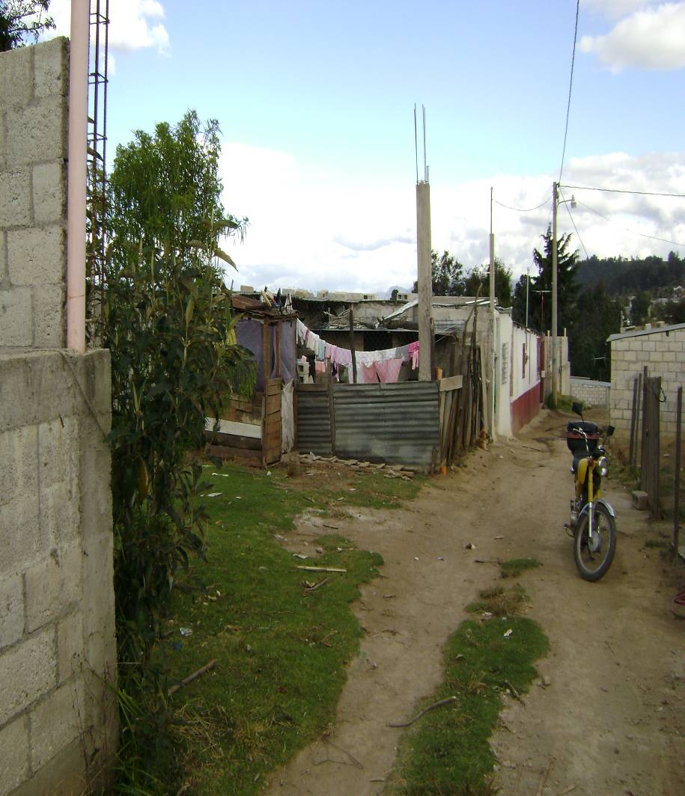
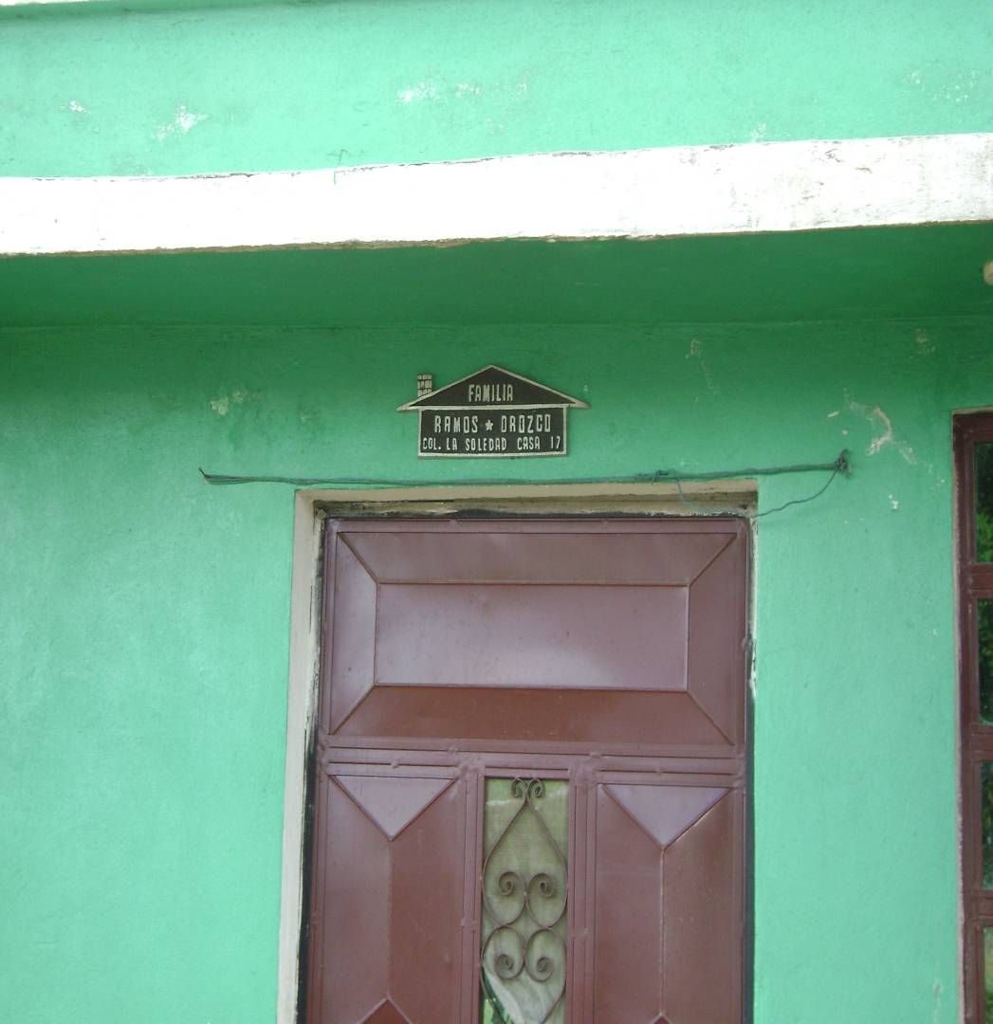
Housing Program, Cooperativa Salcajá, R. L.

Slide 10
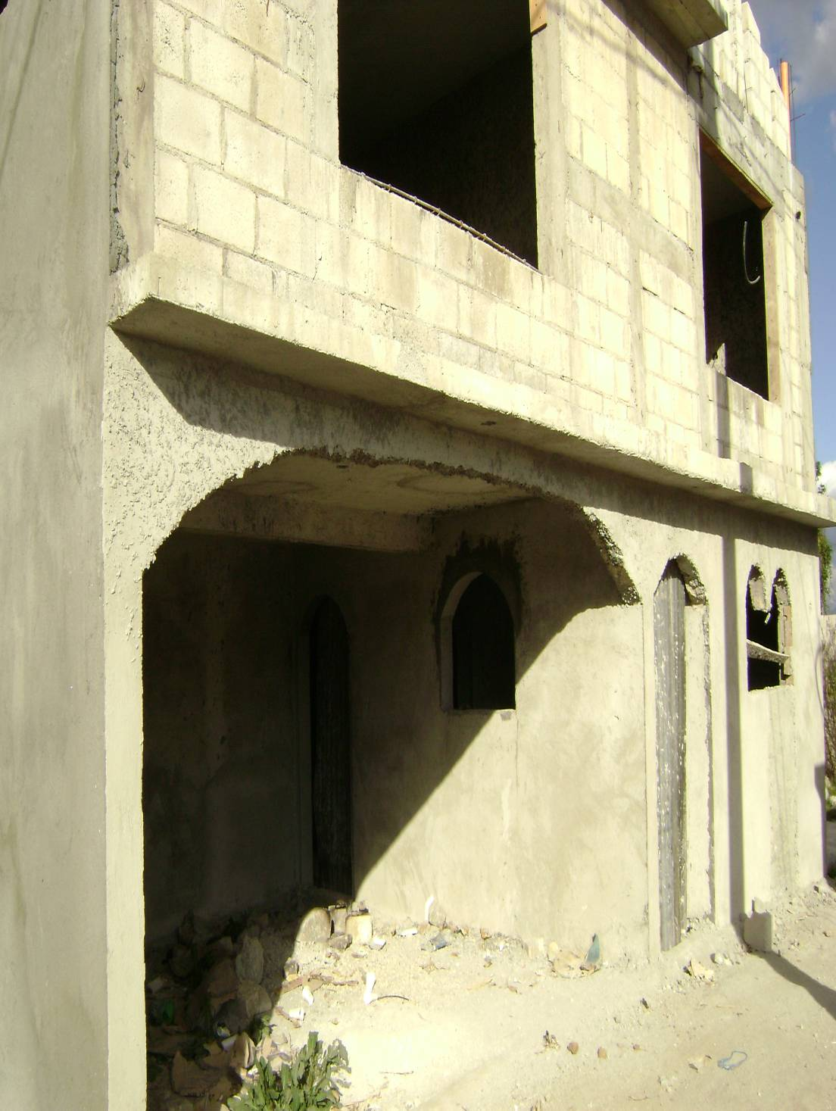
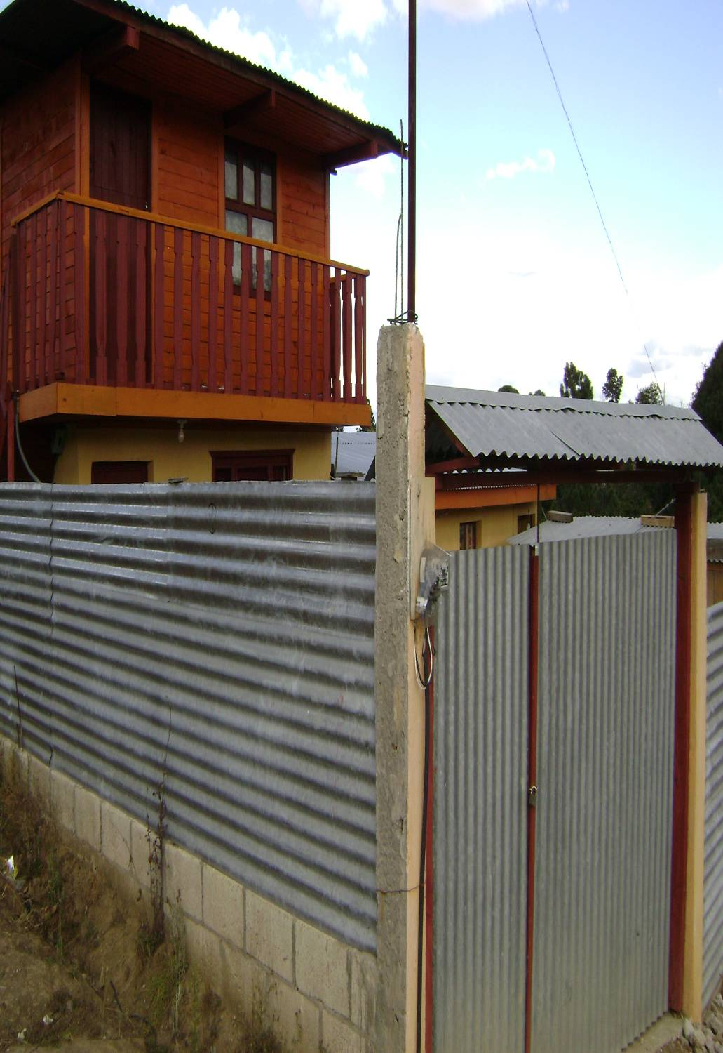

Slide 11
MUCHAS
GRACIAS
Víctor Manuel Rosal González
Presidente Comité de Proyectos
Cooperativa Salcajá, R. L.
Salcajá, Quetzaltenango, Guatemala
Teléfono (502) 7768-9020
Correo: vrosal@coopesalcaja.com

