Slide 1


Linking Remittances Flows
to Housing
Experience:
“Su Casita - México”
Feb. 14th, 2008
Washington, DC.

Slide 2
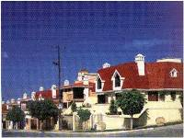
HIPOTECARIA SU CASITA
Su Casita: The largest private mortgage Sofol in Mexico.
Founded in 1994, Su Casita has made reality the dreams of over 400,000 families by helping them to buy a home.
We manage the second largest mortgage portfolio in the country, valued at over $4 billion dollars.
In the last 4 years, we have experienced over 40% growth per year.
Su Casita is the main MBS issuer in Mexico.
Debt Issuance & Institutional
Funding

Slide 3
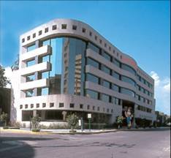
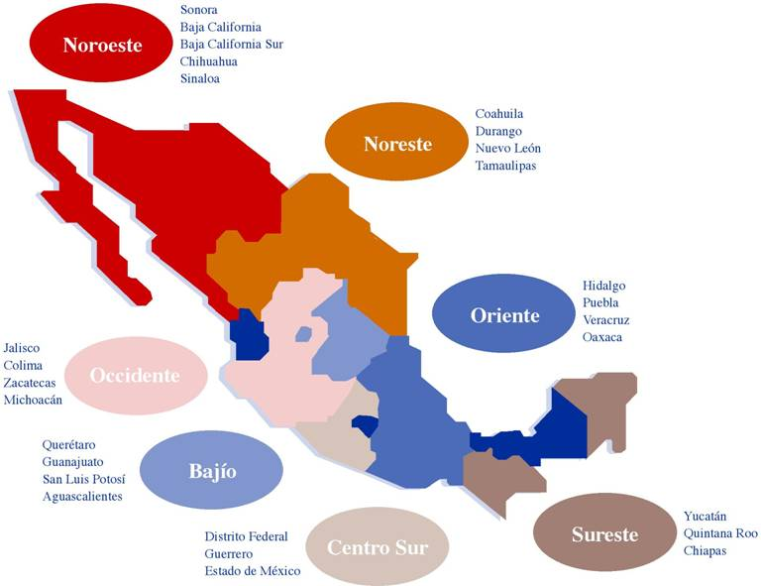
HIPOTECARIA SU CASITA
Su Casita currently operates 180 offices throughout Mexico.
Su Casita has now 4 offices in the US, in cities with large Mexican population: Chicago, Denver and Dallas
Our plans are to open Los Angeles and Houston during 2008.

Slide 4
Mexicans in the US
and
Remittances

Slide 5


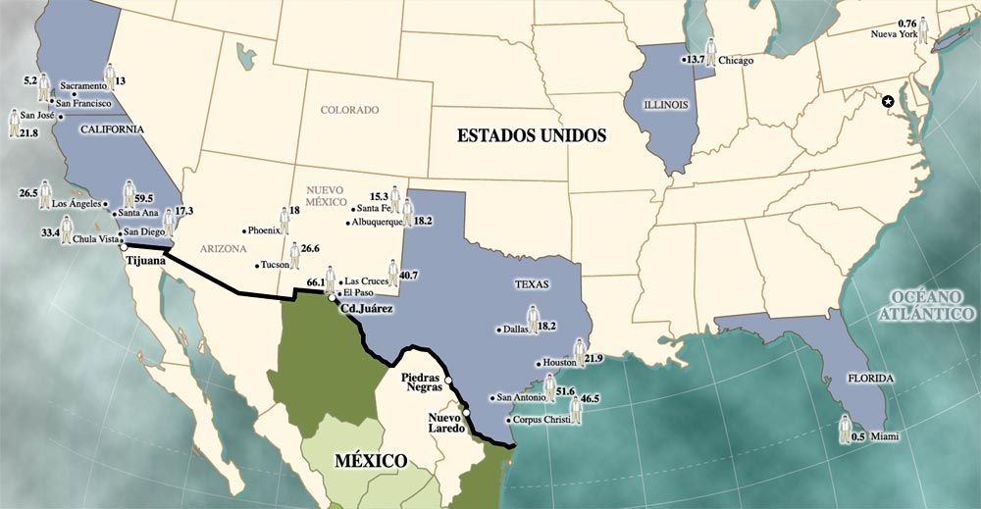
MEXICANS IN THE US.
It is estimated that over 11 million Mexicans are living in the US, mainly in California, Texas, New York, Illinois and Florida.
Average annual immigration over last five years, was over 525,000 Mexicans
Source: Banxico

Slide 6
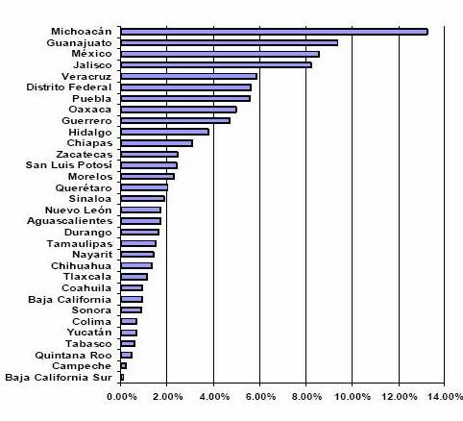
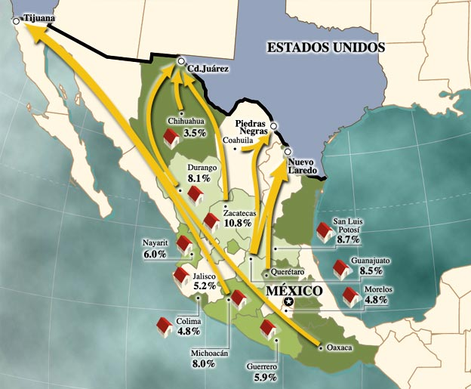
MEXICANS IN THE US.
Recent trends indicate an increasing migration to states like Colorado, Nevada, Washington, N. Carolina y Georgia.
7 –out of 32- states in Mexico receive about 60% of remittances
Source: Banxico

Slide 7

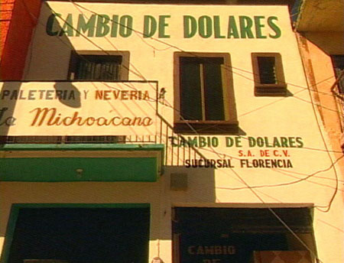
REMITTANCES
In 2006, money transfers from Latin-American immigrants exceeded $60 billion dollars
In Mexico, remittances from Mexican emigrants are the second major income (only after oil proceeds), reaching in 2007 $25.3 billion dollars.
Source: IADB y Banxico

Slide 8
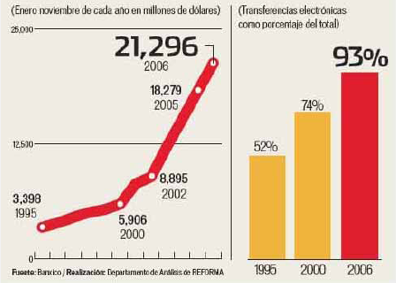
REMITTANCES
Mexican remittances have grown by an average annual rate of 20% during the past 6 years.
In 2007 remittances grew less than a 10% vs. 2006 because:
  Slowdown in US Economy
  Complicated immigrants policies
Above 80% of all the money sent is used for basic consumption needs.
Source: Banxico

Slide 9
“SU CASITA
EN MEXICO”

Slide 10

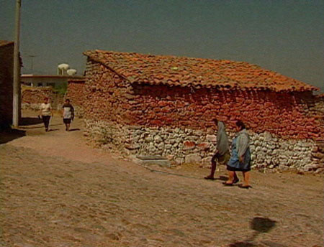
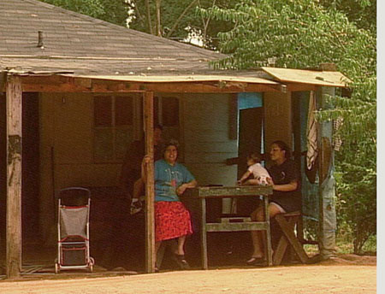
ORIGIN
The project emerged from the meeting between the Mexican and the US Presidents in 2001, where the “Partnership for Prosperity” was signed.
The intention was to create a program to increase the use of remittances for long-term investments.

Slide 11

“SU CASITA EN MEXICO”
“Su Casita en Mexico” is a program created to contribute to the social and economic development for emigrants and their families by:
  Giving them the opportunity to build family equity
  Provide credit history for future Credit Bureau Reference
  NO additional cost for the money transfers

Slide 12
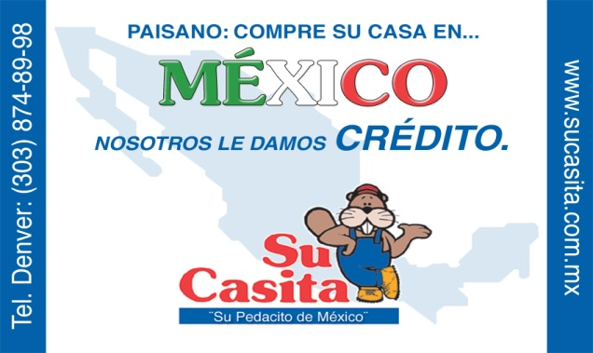
STARTING OPERATIONS
Based on the market research and the business plan evaluation, Su Casita started operations in Denver, Colorado.
  Mexican Population in Colorado = over 500,000.
  The state laws allow the offer Mexican mortgage loans as the asset is in Mexico, the transaction is closed in Mexico and they are regulated by Mexican laws.
Creation of “Su Casita USA, Inc.” - New intermediary company.
  Efficiently promote and operate the program.
  Offer personal attention.
  Build customer confidence.

Slide 13


ORIGINATION PROCESS
Branches in US promote and give service to borrowers nationwide
Gather documentation for loan file and Prequalification
  Credit Report (US and Mexico) Socioeconomic investigation.
The file is sent to Mexico to underwriting process and final approval.
Branches in Mexico assist borrower’s family to find the house they want to purchase (considering loan amount) according loan amount.
Appraisal of the house.
Power of attorney (Mexican Consulate).
Notary process in Mexico.
Closing
@
.
@
.

Slide 14
CURRENT OPERATION
By operating offices in Dallas, Chicago (2) and Denver, we are able to respond to applications.
Creation of strategic alliances:
  To increase coverage
  Because of legal restrictions in several states.
Advertising in local Radio, Television and Newspapers.
Nationwide toll-free number for information:
(877) - CASITA - 9

Slide 15
CURRENT SITUATION
The experience obtained these past few years have helped us adapt many requirements to the program needs.
For example:
  Loan Application adapted and “translated”.
  Use of “Matrícula Consular” as a valid ID.
  Use of Social Security Number.
  Acceptance of pay stubs from foreign companies.
  Evaluation of US bank statements as proof of savings.
  Acceptance of non-formal residents as borrowers.

Slide 16
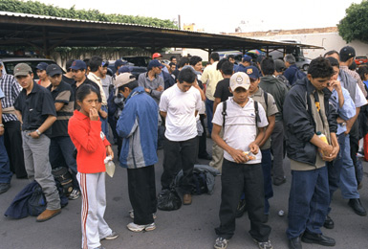
ACHIEVEMENTS
“Su Casita en Mexico” has financed over 1,750 mortgage loans for USD$75 millions.
A growth of 370% in the last year.
Created the first dollar based loan program for Mexican in US, along with IADB-Fomin

Slide 17
CHALLENGES
  We have detected that the main obstacles for the program are:
  Lack of confidence and low level of education among immigrants.
  Not enough information regarding the availability of homes for sale in Mexico.
  Few possibilities to finance housing acquisition with long-term funding through financial institutions for this market.
  Lack of facilities and infrastructure to provide personal assistance in the US
  Most customers do not have savings to cover upfront costs and minimum down-payment (20-30% of the value of the house).

Slide 18


CHALLENGES
Due to different and sometimes extremely complicated legal requirements by state, it has been hard to expand the operation.
The chance to actively promote and advertise “Su Casita en Mexico” within a clearly defined and integrated regulation for advertising in the U.S are limited.

Slide 19
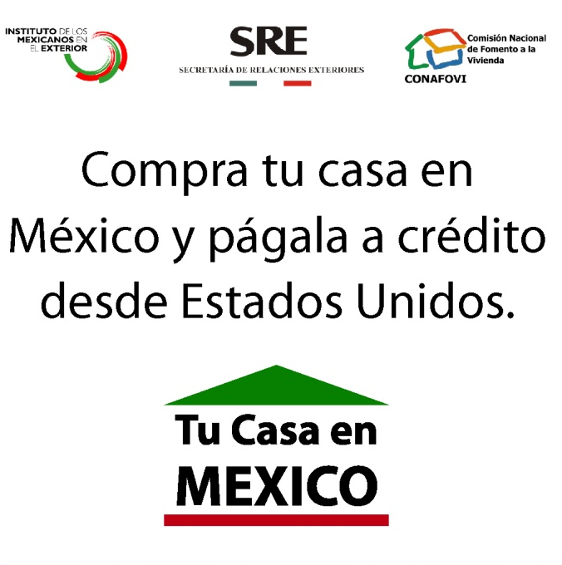
PROGRAM REQUIREMENTS
More participation from the U.S and Mexican Governments in promoting the program and providing relevant information to all participants.
Development of a unified and efficient regulation for the operation of operations like “Su Casita en Mexico” in the U.S.
Create a complete data base of home availability in Mexico
Integrate the housing offer by incorporating Mexican Homebuilders to the program.

Slide 20
NEXT STEPS
Develop Credit Score Models understanding the characteristics of the borrowers.
Alliances with remittances companies to use their network to receive payments. It will increase the options for the borrowers.
Outsource with servicing companies and attorneys to follow up collection procedures in different States, based in goals and success fees.
Develop new funding sources for pesos and dollar based loans.
Develop complementary programs :
  Micro financing
  Remodeling and House Improvement loans
  Construction Loans

