Slide 1

Improving Corporate Financial Reporting to Foster Economic Growth
ROSC Accounting & Auditing
June 2006

Slide 2
What is the ROSC Accounting & Auditing? (1/2)
Part of the joint IMF-World Bank “Reports on the Observance of Standards and Codes” (ROSC) initiative, in the wake of the Asian crisis in the late 1990s
Call for a strengthened international financial architecture to mitigate risks of crises and their contagion
Emphasis on risk prevention over crisis resolution
  Increased transparency
  Need for strengthened supervision / control mechanisms

Slide 3
What is the ROSC Accounting & Auditing? (2/2)
The ROSC covers 12 international “core” standards and codes directly relevant to economic stability and private and financial sector development
Accounting and Auditing are two of these standards

Slide 4


“Standards and Codes” Initiative
(12 ROSC modules)
Data Transparency
Fiscal Transparency
Monetary & Financial Policy Transparency
Transparency standards
Banking Supervision
Securities Market Regulation
Insurance Supervision
Payments Systems
Anti-Money Laundering - CFT
Financial sector standards
(as part of FSAPs)
Corporate Governance
Accounting
Auditing
Insolvency and Creditor Rights
Market integrity standards
« A&A »
« Bank ROSCs »

Slide 5
What are the objectives?
Benefits of improved accounting and auditing
Pro-growth agenda
  A better business climate, conducive to domestic and foreign investment
  Improved access to finance credit for local enterprises (especially SMEs)
  Access to long term financing through securities markets
  Deeper economic integration with major trading partners
Stability of the financial sector / reduced risks of crisis
Governance
  Higher accountability of state-owned enterprises
  Support to the World Bank’s fiduciary agenda and strengthened public sector and private sector governance
  Improved system of corporate tax collection

Slide 6
What are the objectives?
Benefits of improved accounting and auditing
Economic growth, Employment generation
Capital market development
Private Sector Development
Improved access to credit
Complete, reliable, timely and accessible financial information
Confidence of economic agents
Financial sector development
Auditors
Regulators
Stability of the financial

Slide 7
What do we do? What do we try to achieve?
Assessment of private sector accounting and auditing practices
  Benchmarking of local standards with international ones and
  Obtaining empirical evidence on the degree to which corporate entities and auditors comply with the standards
Issues of specific concern:
  The adequacy of the institutional / statutory framework
  The stage of development of the accounting profession
  The role of public sector standard-setters and enforcers
Diagnostic tool: www.worldbank.org/ifa/rosc_aa.html (update in process)
Assisting client countries in building capacity and improving the institutional framework for corporate financial reporting

Slide 8
Time line – Key milestones
Initiation / Scoping
Assessment
Dissemination / Implementation
Country Action Plan
Preparation of technical assistance projects
Technical advice
Discussion within the Bank and with other partners
Scoping
mission
Due diligence
Initiation letter to Govt.
Concept review mtg.
Decision meeting
Delivery (draft / final)
Dissemination
Follow-up
Publication

Slide 9
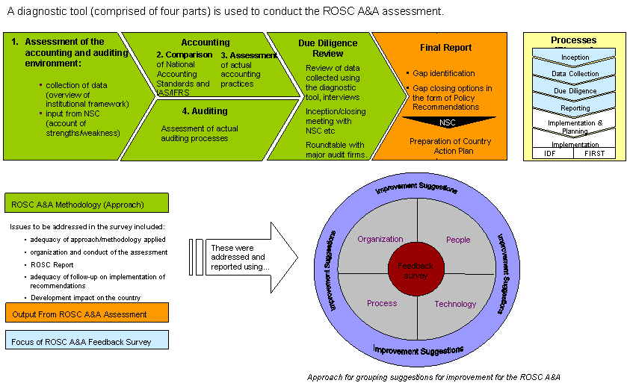
Process – Holistic view

Slide 10
Stakeholders
Government
Banking / insurance
Supervisor(s)
Tax authorities
Company registrar
Accounting
Oversight body
Corporate sector
(enterprises)
Capital
markets
Accounting
profession
Commercial
banks
World Bank
Academia
Other Donors
Informing
Educating
Monitoring

Slide 11
Countries covered to date
Overview by Region
40 reports* published on the Bank’s website** in June ‘06
Follow-up activities currently in progress in some 12 countries
* 39 countries
** www.worldbank.org/ifa/rosc_aa.html

Slide 12
Country covered to date
Middle Income Countries
2003
Colombia
Czech R.
Morocco
Romania
South Africa
2004
Chile
Hungary
Korea
Mexico
Peru
2005
Brazil*
Indonesia
Poland*
Serbia
Turkey
2006
Kazakhstan
Philippines*
Ukraine*
Increased emphasis on implementation of ROSC recommendations
Growing number of updates
* updates

Slide 13
Country covered to date
IDA / Blend Countries
2003
Kenya
2004
Bangladesh
Ghana
India*
Moldova
Nigeria
2005
Pakistan*
Senegal
Serbia -Montenegro*
Tanzania
Uganda
2006
Albania
Azerbaijan*
Botswana
Cameroon
Georgia
Indonesia*
* Blend countries

Slide 14
Country covered to date
Latin America and The Caribbean
Note: Jamaica published in FY04

Slide 15
Salient issues in LAC
Convergence in accounting standards (1/2)
Widely acknowledged as a necessity
Adoption v. adaptation
  Large middle income countries: reluctance to adopt IFRS
  Other countries recognize they have no other choice but to adopt
Applying IFRS is very challenging
  “Fair value” model (valuation of securities, property, etc.): new approach, difficult to apply
  Disclosures
  Etc.
  Requires a significant capacity building effort

Slide 16
Salient issues in LAC
Convergence in accounting standards (2/2)
Standard-setting
  No strong tradition in the Region
  Necessary even if IFRS have been adopted
  Translation issue
  Calls for enhanced cooperation at regional level
SMEs: need for a simplified system
Banking and insurance sectors
  Prudential approach: accounting frameworks not designed to inform investors and third parties
  Evolution toward IFRS needed to foster market discipline

Slide 17
Salient issues in LAC
Professional standards of auditing
International Standards on Auditing (ISA)
  Similar situation as for accounting (adoption v. adaptation; weak standard-setting; etc.)
  New ISAs focus on risks and auditors’ contribution to corporate governance
Code of ethics / professional conduct
  Most countries have their own code, often outdated
  “Threats & safeguards” approach to conflict of interest
  Prescriptive approach (i.e. rules-based)
  Quality control standards: new concept, seldom applied at present
Influence of Sarbanes-Oxley and debate in the EU (new 8th Directive)

Slide 18
Salient issues in LAC
The accounting and audit profession
Does the professional association play an effective role in advancing the quality of financial reporting?
Does it contribute to IASB and IAASB standard-setting?
Does it have adequate resources available?
Are licensing arrangements adequate?
  Mexico: US-style certification (2001) – other countries should follow that example
What is the image of the profession?

Slide 19
Salient issues in LAC
Role of financial sector regulators
Regulatory accounting principles v. GAAP
Standardized format for financial reporting by supervised entities
Regulation of the audit practice (special reports, ethical standards, accreditation process)
Enforcement of financial reporting by supervised entities
Importance of leveraging the work of external auditors - requires better mutual understanding and collaborative approach
Ensuring compliance with auditing, ethical and quality control standards
Public oversight bodies of the audit profession can make a significant contribution to the supervisors’ agenda

Slide 20
Salient issues in LAC
Statutory framework
Are all public interest entities subject to adequate accounting and auditing requirements?
  Requirement to have audited financial statements
  Publication of financial statements
  Consolidation
  Accounting standards to be applied: level of detail and sophistication of the financial information
Are SMEs subject to an excessive regulatory burden?
No common model in LAC – countries need to share their experience to learn from each other

Slide 21
Looking forward (1/3)
Expanding our geographical coverage – new assessments
  Honduras (FY07)
  Argentina (FY07)
  Haiti (FY07?)
  Costa Rica (FY07?)
  Bolivia (FY08?)
  Venezuela (FY08?)
Assessing progress – updating prior assessments, e.g.
  Colombia
  Jamaica
  Mexico
  Etc.

Slide 22
Looking forward (2/3)
Greater level of involvement at the implementation stage:
  Country Action Plans
  Components of Bank TA operations dedicated to accounting and auditing
  Cooperation with other donors (IDB, bi-laterals)
Fostering dialogue at regional level to develop common solutions
  Better comparability
  Learning from other countries’ experience
  Cost sharing
  Proposal for a Regional Dialogue Series using the GDLN (pilot session on May 25)

Slide 23
Looking forward (3/3)
Plans for a regional conference on corporate accountability in Latin America
Research agenda
  Overview of accounting and auditing regulation Latin America
  A study of the role of regional accountancy organizations
  Oversight of the accounting and auditing profession. What institutional arrangements should countries adopt?
Outreach effort toward other partners

Slide 24
Regional Dialogue Series (1/2)
Outreach: maintaining (reviving) the dialogue with country stakeholders
Knowledge sharing – presentations by experts who work with Bank on the ROSC
Fostering regional dialogue and cooperation
Tool for providing feedback to international standard-setters
2-hour sessions connecting up to 10 countries
May 25 pilot session
  7 countries (Bolivia, Dominican Rep., Ecuador, El Salvador, Guatemala, Paraguay and Peru)
  300 participants
  Positive feedback
Plans for FY07: 12 sessions

Slide 25
Regional Dialogue Series (2/2)
Tentative program for FY07
Module | Module Title | Tentative Date
1 | Towards a Global Standard. The agenda for convergence between IFRS and US GAAP | September 2006
2 | Accounting standards for small and medium-sized enterprises (SMEs) | October 2006
3 | Designing a national standard setting and oversight body | November 2006
4 | The respective roles of national and international accountancy bodies | December 2006
5 | From design to implementation: Establishing the national standard setting and oversight body | January 2007
6 | Why high quality financial reporting makes good business sense | February 2007
7 | Corporate Governance matters. Company Law, Board responsibilities regarding financial reporting | March 2007
8 | IFRS in the Banking Sector | April 2007
9 | IFRS in the Insurance Sector | April 2007
10 | Challenges and experience from the field. Making IFRS the standard for corporate financial reporting | May 2007
11 | Beyond regulation: ethics in the accounting and audit practice | May 2007
12 | Is there a model for financial reporting in the LAC? | June 2007

Slide 26
Thank you.
Questions?

