Slide 1
Disaster Risk Reduction in Latin America and the Caribbean Through Environmental Management and the Use of Economic Instruments
Several Contributions for
Interamerican Development Bank

Slide 2
Issues that will be addressed:
First presentation
Hazard location maps
Framework for the application of disaster risk reduction proposals
Disaster risk reduction by means of environmental and natural resource management
Economic instruments for environmental and disaster risk reduction
Conclusions and recommendations

Slide 3
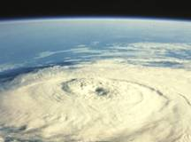
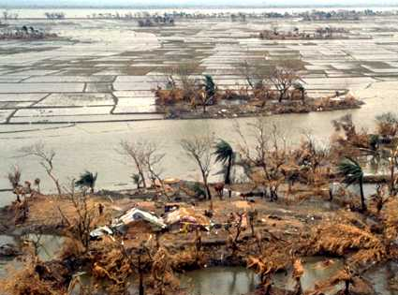
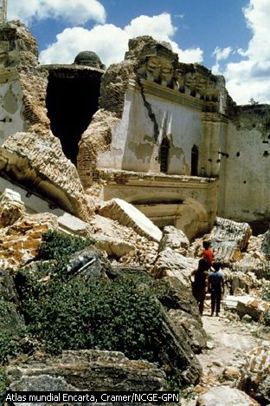
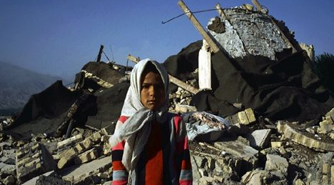
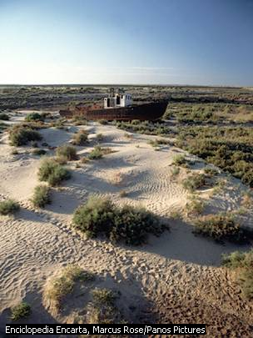
Hazards that have resulted in disasters in Latin America and the Caribbean (LAC) over the past 100 years

Slide 4
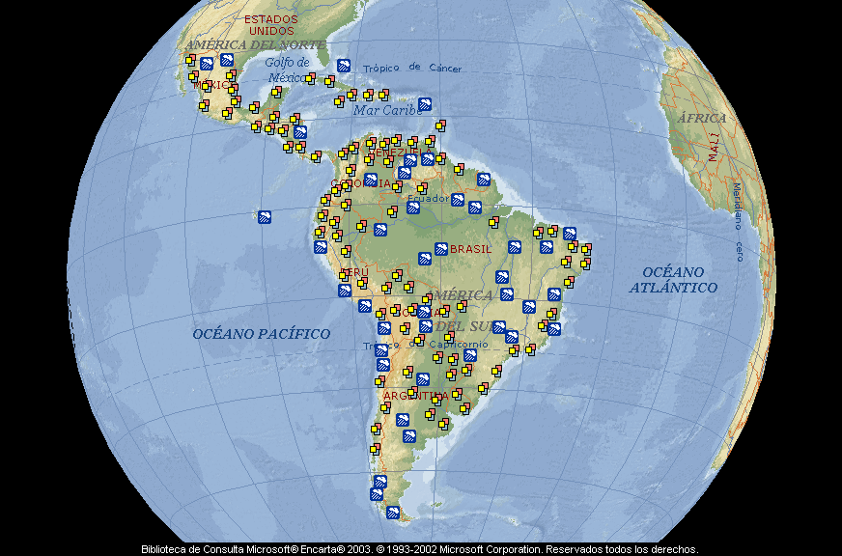
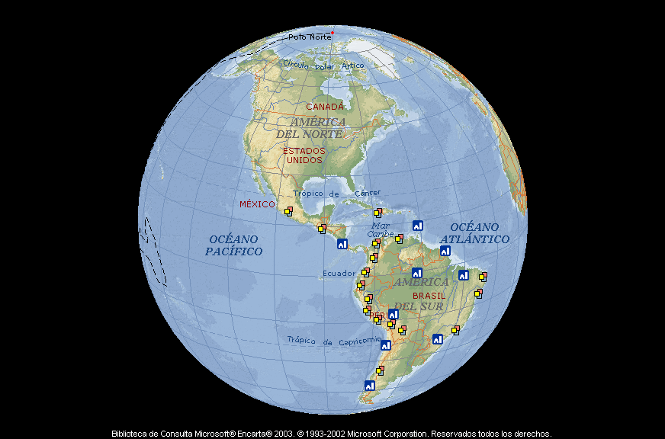
Floods
2 or more recurring events

Slide 5
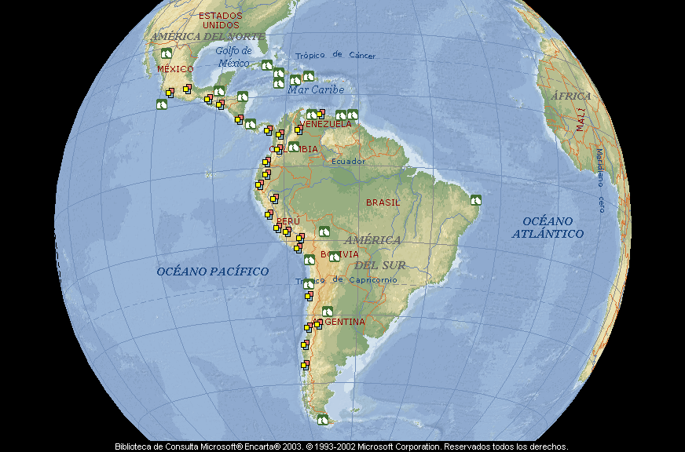
Earthquakes
2 or more recurring events

Slide 6
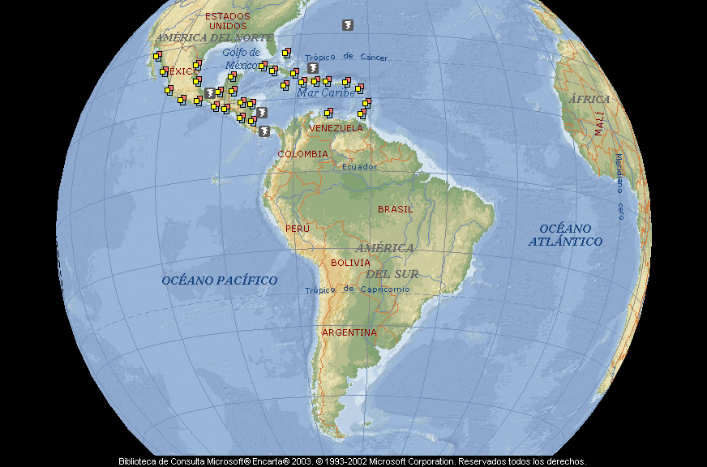
Hurricanes
2 or more recurring events

Slide 7
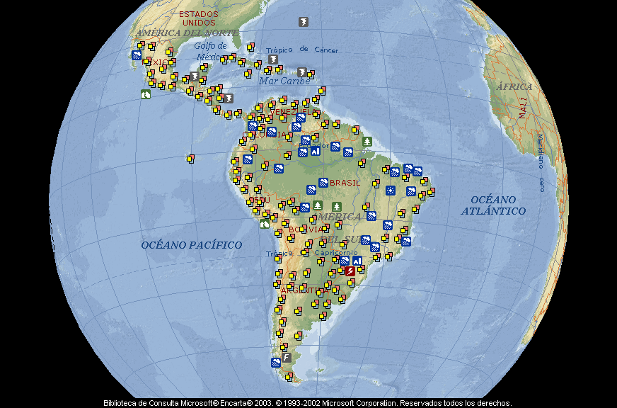
Areas under threat
2 or more recurring events

Slide 8
Conclusions from the maps
Floods are the more frequent hazards in the region.
Other significant hazards more prevalent in certain sub-regions:
  Earthquakes: on the western flank of all countries on the Pacific coast, the Andean-Coastal Arch in Venezuela and a section of the Caribbean.
  Hurricanes: in the Caribbean and Mexico
  Volcanic eruptions: in the Andean sub-region near the Pacific ocean in Peru, Ecuador and Colombia, and in Central America and Mexico
  Landslides: in the Andean countries and on the Atlantic coast of Brazil
There are up to 9 different hazards per country

Slide 9
Recommendations regarding floods
Comprehensive water resource management
Fight against deforestation
Reforestation
Sound environmental management of soils and slopes
Comprehensive waste management

Slide 10
Recommendations for countries with several hazards
Land use planning
Frequency, impact and vulnerability assessment
Prioritize actions depending on the levels of risk assessed

Slide 11
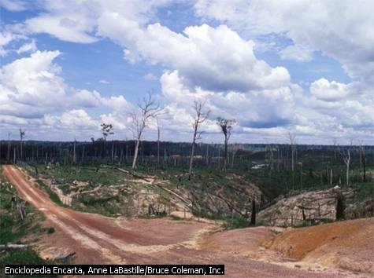
FRAMEWORK FOR THE APPLICATION OF DISASTER REDUCTION PROPOSALS

Slide 12
FRAMEWORK FOR THE APPLICATION OF DISASTER REDUCTION PROPOSALS
Exposure of the population
Assessment of socioeconomic vulnerability in LAC
Important aspects for environmental management
Important aspects for disaster risk management

Slide 13
LAC: the problem is urban in nature
Population average of LAC versus the population average of the rest of the world (%)
In 2001:
24 countries in which over 50% of the population were living in urban areas
12 countries in wich over 70% of the population were living in urban areas
By 2015:
80.5% of the population will be living in urban areas
Rest of the world

Slide 14
Socioeconomic vulnerability in LAC
Assessment factors:
Social condition
Economic performance and condition
Scientific and technological capabilities
Quality of environmental management
Situation of the environment

Slide 15
Method for socioeconomic vulnerability assessment
Management
Science and Technology
Economy
Group 4
Social Situation
Environmental Situation

Slide 16
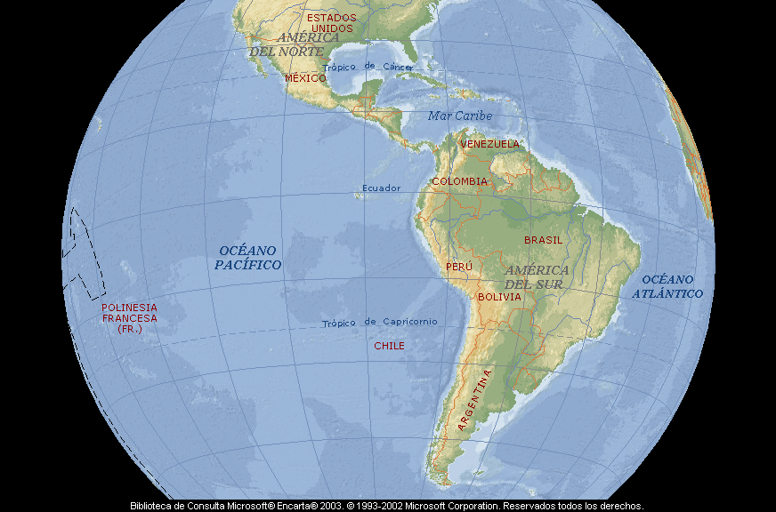
Vulnerability in LAC
Very slightly vulnerable
Slightly vulnerable
Vulnerable
Highly vulnerable
Extremely vulnerable

Slide 17
Important aspects for environmental management
Remarkable progress regarding the conceptual, legal and institutional basis
Worrying environmental situation in most LAC countries
The increase of poverty and poor distribution of income phenomena lower the priorities for environmental management
Reduction of programs and projects guided to strengthening environmental management

Slide 18
Classification according to environmental management capacities
Group 1
Group 2
Group 3
Group 4
Group 5

Slide 19
Group 1
Countries with good conceptual, legal and institutional basis and an environmental management performance better than the regional average

Slide 20
Group 2
Countries with good conceptual, legal and institutional basis and an environmental management performance within the regional average

Slide 21
Group 3
Countries with good conceptual, legal and institutional basis and an environmental management performance under the regional average

Slide 22
Group 4
Countries with an incomplete conceptual, legal and institutional basis and an environmental management performance within the regional average

Slide 23
Group 5
Countries with an incomplete conceptual, legal and institutional basis and an environmental management performance under the regional average

Slide 24
Important aspects for disaster risk management
Wide variety of hazards
The origin of hazards is natural or socio-natural
Increase of vulnerability as an unsolved aspect of development
High impact and great amount of disasters
Common features to manage risk in the region

Slide 25
Important aspects for disaster risk management
The efforts of the governments (at national and local levels) concentrate on the response
Gradual adoption of global and sectorial policies
Existing regulations are guided towards the management of disasters. They are weak in relation to prevention and mitigation.
Only a few countries have regulations enforcing that “who causes hazards is accountable for them.”

Slide 26
Important aspects for disaster risk management
Recent inclusion of hazard assessment in environmental impact evaluation
Hazards and disasters are managed in a centralized manner
In a great number of countries multi-institutional and multi-sector work is very weak regarding the stages of prevention and mitigation

Slide 27
Important aspects for disaster risk management
Gradual incorporation of hazard-related issues into development and government plans
There is a trend to incorporate non-governmental agents into the management of hazards
Only a few countries arrange their territories according to existing hazards

Slide 28
Disaster risk reduction by means of environmental and natural resource management
Risk

Slide 29
Disaster risk reduction by means of environmental management
Management policies and actions of national governments to face natural disasters related with environmental and natural resource deterioration
Chart of interrelationships between environmental management and risk management
Application of the chart of interrelationships in three recent cases of disasters in the region

Slide 30
Management policies and actions of central governments
Environmental and disaster risks
Land planning of territories
Management plans of areas under special administration systems
Impact analysis and environmental instructions
Environmental adaptation and supervision plans for industries
Regulations for sectors
Information and communication
Cooperation networks for assistance and environmental surveillance and control
Institutional issues

Slide 32
Application of the chart of interrelationships
Ecuador | El Niño phenomenon during 1997-1998
Nicaragua | Mitch Hurricane (1999)
Venezuela | Torrential avalanches in December 1999

Slide 33

Thank you

