Slide 1
Chile Solidario System Comprehensive Social Protection for the Country’s Poorest 225,000 Families
October 2002

Slide 2
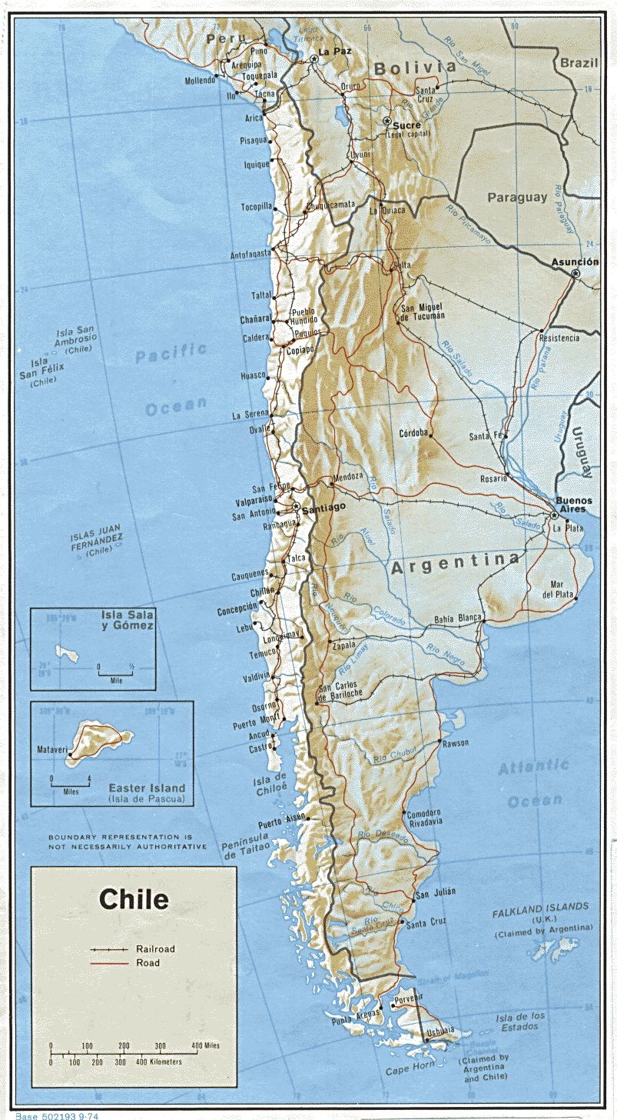
Chile
GOBIERNO DE CHILE
MINISTERIO DE
PLANIFICACIÓN Y COOPERACIÓN
Total: 756,626 Km2 on the continent, 1,250,000 Km2 in Antarctica.
Political – Administrative Organization:
13 regions,
51 provinces,
341 communes

Slide 3
Chilean Demographic Data in 2000
GOBIERNO DE CHILE
MINISTERIO DE
PLANIFICACIÓN Y COOPERACIÓN
Total population : 15,211,308
Percentage of women: 50.5
Natural increase: 1.5
Life Expectancy 2000-2005:
Women: 79.0
Men 73.0

Slide 4
Context of Chile Solidario
The country’s sustained growth from the mid ’80s up until 1998 made a steady reduction of poverty and indigence possible because of the impact that economic growth had on the labor market

Slide 5
Evolution of per capita income in US$ 1990-2000
The people’s average per capita income rose from
US$ 2,315 in 1990 to US$ 4,603 in 2000

Slide 6
Context of Chile Solidario
Unemployment rates since 1998 have been significantly higher than those observed before the ´90s, with the result that the decline in poverty rates has slowed somewhat and the incidence of indigence has risen slightly.
Between 1996 and 2000 poverty declined from 23.2% to 20.6%, while indigence rose slightly from 5.6% to 5.7%.

Slide 7
Evolution of poverty

Slide 8
Evolution of indigence

Slide 9
Evolution of the incidence of poverty and of indigence
1990-2000
(Percentage of the population*)
GOBIERNO DE CHILE
MINISTERIO DE
PLANIFICACIÓN Y COOPERACIÓN
GOBIERNO DE CHILE
MINISTERIO DE
PLANIFICACIÓN Y COOPERACIÓN
40
38,6
35
32,6
30
27,5
25
25,7
23,2
21,7
20,6
20
23,8
19,9
15
17,4
16,1
14,9
10
5
12,9
8,8
7,6
5,8
5,6
5,7
0
1990
1992
1994
1996
1998
2000
Non indigent poor
Indigent
* Household help living in the employer’s home and their family nuclei are excluded..
Source: MIDEPLAN, CASEN Survey 1990, 1992, 1994, 1996, 1998 and 2000.

Slide 10
Context of Chile Solidario
It has become increasingly difficult to undertake the reduction of indigence because of the complexity of the elements that comprise and sustain it.
The indigent are a group of 850,000 people whose monthly per capita income does not cover the basic food basket. They make up 5.7% of the country’s population.

Slide 11
Context of Chile Solidario
We have a broad and diversified offering of services and benefits for the poor that are organized by demand.
This model does not extend to the indigent because they have no connection with the existing social networks.

Slide 12
DESIGN AND PROGRESS OF AN EXTREME POVERTY REDUCTION STRATEGY

Slide 13
Ministry of Planning and Cooperation, MIDEPLAN
Mission
“To incorporate families living in extreme poverty into the State social protection network so that they can acquire economic and social capacities that will enable them to emerge from their depressed socioeconomic situation.”

Slide 14
Chile Solidario System
Ministry of Planning and Cooperation, MIDEPLAN
Combines assistence and advancement, promoting the social eligibility and integration of extremely poor families
Coordinates and targets for the families that belong to the System all public social advancement programs that are intended for families living in extreme poverty.

Slide 15
Expected Benefits
The four basic dimensions of extreme poverty are addressed simultaneously:
Income: through Monetary Subsidies and Jobs
Human Capital: through preferential access to education, health, training and housing
Social Capital : through integration into available local networks
Vulnerability to Disasters: by taking precautions

Slide 16
Ministry of Planning and Cooperation, MIDEPLAN
Strategic focal points of the System
Efforts targeting the Family:
This is a privileged area in which to generate processes to attain the advancement and development objectives for overcoming extreme poverty.

Slide 17
Ministry of Planning and Cooperation, MIDEPLAN
Strategic Focal Points of the System
Work coordinated on the basis of the institutional networks:
The networks confirm the synergic effect produced by the full and complementary combination of different local and national resources.

Slide 18
Ministry of Planning and Cooperation, MIDEPLAN
Strategic Focal Points of the System
Proactive State :
Public presentations are offered according to the specific needs of the families through direct and personalized efforts with each of them.

Slide 19
Components of the System
Ministry of Planning and Cooperation, MIDEPLAN
Component 1 : Personalized psychosocial assistance and Temporary Solidary Family Support (Voucher) component (FOSIS)
Component 2 : Monetary Subsidies
Component 3 : Preferential Access to Social Advancement Programs

Slide 20
First Component
Ministry of Planning and Cooperation, MIDEPLAN
Personalized Psychosocial assistance for a period of 24 months under the Bridge Program.
A professional or expert serves as Family Support Person and maintains a permanent link with the family through periodic visits to their home.
Families make commitments in the following areas: Identification; Health; Education; Family Dynamics; Work; Income; and Habitability and Quality of Life

Slide 21
First Component
Ministry of Planning and Cooperation, MIDEPLAN
Solidary Family Support (Voucher): Monetary support for 24 months linked to participation in the Bridge Program and compliance with a Commitment Declaration. The amounts of the Solidary Support (Voucher) correspond to the following:
First Year: $ 10,500 a month for 6 months
$ 8,000 a month for 6 months
Second Year: $ 5,500 a month for 6 months
The equivalent of one SUF (Sole Family Subsidy) a month for the final 6 months
Families that fulfill the program successfully will receive a Graduation Voucher equivalent to the value of one SUF for a period of three years.

Slide 22
Second Component
Ministry of Planning and Cooperation, MIDEPLAN
Traditional monetary benefits. These benefits will be assigned within the first 12 months after the family joins the System. The benefits include:
Sole Family Subsidy (SFS) to children under the age of 18 if they attend school. ($3,607)
Old age and/or disability Allowance Aid (PASIS), subject to periodic health check-ups. ($36.388)
Subsidy for Drinking Water Consumption (SAP), amounting to 100% of the cost of up to 15 cubic meters, for families with household connections to the public drinking water system.

Slide 23
Third Component
Ministry of Planning and Cooperation, MIDEPLAN
Preferential access to Social Advancement Programs
To mention only a few:
Training and Jobs in the Labor Market
Remedial Studies and/or Labor Skills
Technical aids for the disabled
Prevention and Rehabilitation of Drug Addiction
Care for Children at Risk
Prevention of and Support in cases of Domestic Violence
Preferential subsidy for Job Recruitment

Slide 24
The Importance to the System of Ethnicity
It is worth drawing special attention to the public offering for the indigenous rural population. This is the group that clings most strongly to its cultural roots and whose organizational system is based on the community, through a complex network of social relations.
Chile Solidario seeks to reinforce and develop the social capital of the target families by adjusting its implementation to the unique culture and lifestyles of the indigenous families. (Mainly the Aymara and Mapuche groups)

Slide 25
The Importance to the System of Ethnicity
Design of a strategy for implementing the System that takes account of the unique cultural elements of the indigenous families that will benefit from it
Establishment of Committees of National and Regional Ethnic groups that belong to the System
Cultural Relevance of the methodology. Training and Adaptation.
Appropriate strategy for reaching indigenous families at the local level, in light of their community-centered organizational structure.

Slide 26
Minimum conditions for emerging from indigence
53 conditions broken down into the following areas:
Identification
Health
Education
Family Dynamics
Habitability
Work
Income

Slide 27
Expected results from working with the Families
That at least 70% of the participating families will attain minimum standards of living, including income that situates them above the indigence line.
That at least 90% of the participating families will be familiar with the local service networks and benefits at their disposal.
That fully 100% will be invited to participate in a Government Program designed specifically with them in mind.

Slide 28
Institutional Structure
Ministry of Planning and Cooperation, MIDEPLAN
MIDEPLAN is responsible for the System and its functions will include:
Collecting and updating information about the families that belong to the System
Overseeing and evaluating the System’s progress.
Establishing, coordinating and supervizing national, regional and local support networks for the poorest families.
Coordinating and targeting for the families and their members that belong to the System all of the social advancement programs aimed at addressing extreme poverty.

Slide 29
INSTITUTIONAL STRUCTURE
MIDEPLAN
Social
Protection
Network
Coordinates the System’s Execution
Centralizes Family Information
Certifies Eligibility
Signs Agreements with Local Agents
Supervizes Advancement System
Coordination
Agreement
Local Social
Advancement
Networks
Administers System Access
Social Advancement Management
Keeps information about Member Families.
Signs and fulfills Agreement
Family Support
Professional
Guaranteed
Services
Maintains a Direct Link with the Family.
Family Follow-up
Recommends Social Advancement Activities
Support
Family
Contract
FAMILIES
Sign and fulfill Family Contract

Slide 30
Identification and selection of beneficiary families
The scores achieved in the CAS survey were used to identify the beneficiary families
For the selection, the indigence line was standardized using the survey scores
CAS Survey: sole and standardized instrument to select beneficiaries for social programs, especially monetary subsidies for extreme poverty: contains variables for housing, education, occupation and income and assets

Slide 31
CHILE SOLIDARIO SYSTEM System Coverage

Slide 32
Component 1: Psychosocial assistance provided by professionals and experts, starting in August 2002

Slide 33
Progress in bringing families into the System (Component Nº 1: Bridge Program)

Slide 34
Families approached, by Region
(Bridge Program at October 15, 2002)

Slide 35
Component 3: Preferential access to social advancement programs
Formation of National and Regional Committees for Coordinating Institutions
Agreements with Ministries and Public Services targeting the offerings:
Ministries of: Interior; Education; Government; Health; Labor and Social Insurance; Justice; National Goods; National Council for Narcotic Drug Control; National Board for School Assistance and Fellowships; National Board of Nursery Schools; Chile Barrio Program; Civil Registry and Identification Service; National Service for Minors; National Institute of Agricultural Development; National Women’s Service; Young People’s Institute; National Indigenous Development Corporation; and National Disability Fund

Slide 36
Some lessons learned from working with the families
The family highly values the relationship with the family support professional (promoter): Conversation and information
Work of family support professionals is a family communication tool
Relationship with local networks facilitates access and personalizes family service

Slide 37
Some lessons learned from working with the families
Resistance to free benefits. Bilateral nature of commitments valued.
Families reveal greatest needs in the areas of: inhabitability and family dynamics

