Slide 1
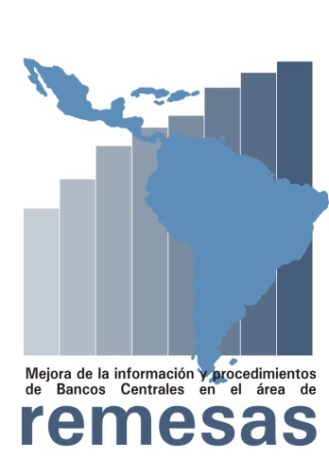
Measuring Remittances in the Western Hemisphere
Centro de Estudios Monetarios Latinoamericanos
Y Fondo Multilateral de Inversiones (FOMIN-BID)
Improvement of Central Bank Information and
Procedures in the Area of Remittances
Washington
June 28th, 2005
Kenneth G. Coates
Director General
CEMLA

Slide 2
Central Bank Interest in Remittances
AT THE MACROECONOMIC LEVEL:
Increased aggregate consumption and investment
Balance of payments strengthened by non-debt-creating flows
Additional supply on the foreign exchange market
Acyclical nature reduces country risk and lowers cost of external debt
Potential impact on monetary policy
AT THE MICROECONOMIC LEVEL:
Increased living standards of beneficiaries
Inclusion of low-income sectors to the formal banking sector (financial democratization)
Small and micro enterprise finance

Slide 3
Measurement Problems
Discrepancy of information from different sources
Little “bilateral” information
Lack of knowledge of market structures
Lack of precision in measurement techniques
Lack of registration of market operators (informality)
Little use of household surveys
Lack of agreement on a precise definition of remittances
There have been various recent initiatives (G-7 and others) aimed at improving the measurement of remittances by seeking to agree on harmonized methodology at the conceptual level.
In coordination with the progress of such initiatives, the CEMLA/MIF project is the first to make a practical attempt to adopt common practices at the regional level.

Slide 4
Program Goals
DIRECT:
To improve the statistical measurement of remittance flows
To gain better knowledge of remittance market structures
To contribute to the formulation of an appropriate regulatory policy
To disseminate results and sensitize participants
INDIRECT:
Lower the cost of sending and receiving remittances
Promote the financial inclusion of participants, both in originating and receiving markets.

Slide 5
Program Components
Establishing the Implementation Unit at CEMLA
(Program Coordinator and team)
Preparation, design and implementation of procedures for measuring remittances
(Background paper, launching seminar, institutional arrangements, Manual on Best Practices in Measurement)
Strengthening knowledge of remittance markets
(Implementation workshops, survey missions and technical assistance)
Transfer of knowledge
(Preparing reports and publishing documents)
Training and sensitization
(training courses, sensitization events and website)

Slide 6
Institutional Arrangements
IMPLEMENTING UNIT – CEMLA:
Technical, Administrative and Logistical Coordination.
Preparing Papers, Events, Missions, Publications and Reports
Hiring consultants and delivering training
Technical Secretariat for the Working Group and Steering Committee
WORKING GROUP IN REMITTANCES (WGR-LAC):
Representatives of 22 participating central banks in the region
Periodic meetings to familiarize themselves with project content, coordinate the work program, analyze recommendations for procedures and methodologies, agree on terms of reference for the missions and further their knowledge of remittances.
Responsible for promoting change in their institutions
REMITTANCES INTERNATIONAL STEERING COMMITTEE (RISC):
Experts from stakeholder institutions and international organizations with recognized expertise in the measurement and regulation of remittances.
They shall integrate international experience to the program, provide support in specific methodological aspects, and identify and provide additional technical assistance resources.

Slide 7
Program Timetable
CONSIDERATION BY MIF AND CEMLA:
Approved April 27-28, 2005
SIGNING OF AGREEMENT:
June 28 2005 at “International Forun on Remittances” Washington.
LAUNCHING:
September 1-2, 2005, CEMLA headquarters, México City.
DURATION:
42 months
SUSTAINABILITY
FINANCIAL: Upon project termination there shall be a Sustainability Workshop to identify financing for continuation in the event that unsatisfied demand for technical assistance missions and training courses persists. The program foresees 9 missions and 9 courses, whereas 22 central banks have already signalled their intention to participate.
INSTITUTIONAL: The possibility that the institutional arrangements created for the program (WGR and RISC) be maintained as a central bank forum on remittances to be held every two years shall be analyzed.

