Slide 1
IKR
Controlled Vocabulary
Kyle Strand Karen Mokate Joseph Busch Aline Martinez
kyles@iadb.org karenm@iadb.org jbusch@ppc.com alinepilar@yahoo.com
Taxonomy Boot Camp - Washington, D.C. - November 15th 2010
The opinions expressed in this publication are those of the authors and do not necessarily reflect the views of the Inter-American Development Bank, its Board of Directors, or the countries they represent.
The unauthorized commercial use of Bank documents is prohibited and may be punishable under the Bank’s policies and/or applicable laws.
Copyright © 2010 Inter-American Development Bank. All rights reserved; may be freely reproduced for any non-commercial purpose.

Slide 2
Presentation Roadmap
Introduction to IDB
Organizational Context
Project Approach
What we did
Next Steps
Reflections
Notes:
From Aline:
Taxonomy development for subject facet – issues we faced
Terminology development:
Obtain facet or term assessment from an organization point of view:
What terms work, don’t work
Feedback across different organizational units or user types
Conduct facet assessment for the taxonomist’s point of view:
Number of terms
Source of facet
Inclusions and exclusions
Terms/concepts out of place
Obvious gaps or inconsistencies
Questions—samples
For business units—how to handle legacy units that are represented and not currently represented by new unit names
Names-- use language of origin or English translation; use acronyms, full name, map both
Single or multiple assignment to asset
Determine which type of hierarchy structure best servers business/user needs.
2 levels-easier to support indexing /search interface
3 levels-more logical, fewer top terms, options for intermediate terms
Determine whether to use polyhierarchies
Define level of tagging (major/ minor concepts) - which helps determine level of term specificity
Inventory the number of terms and the degree of specificity they represent
Diminish the number of terms to simplify the facets
Keep the amount of terms presents more specificity
(concrete examples)
Determine whether to combine Sectors with Topics or keep them separate
In indexing- separating terms creates more work for indexer
In search – separating terms allows for higher specificity in recall, but system needs to be tailored to identify the difference
If Topics and Sectors are kept separate, need to consider realigning sectors with IDB organizational sectors.
Organizational units presented challenges in:
Number of hierarchy levels (simplicity versus detail)
Legacy unit names--some unit changes have replacements (map terms); some don’t have new names creating need to determine how to present defunct terms in a current hierarchy
Geographic units –fitting in country offices with country departments to avoid duplicating the country hierarchy
Validation process (the SME index or search using new terms):
How many terms are used to index assets
Keep track of user suggestions
Terms
Feedback
(concrete examples)
Look at policies in geographic tagging
When asset covers multiple countries-determine whether there’s a benefit to limiting geographic tagging; does “all” provide value
Use relevant fields; irrelevant fields are left blank
Determine how people think about the facets
“Document types” were interchanged with “activities”
What I heard from the lunch meeting Thursday
Timing has provided opportunity to:
Evaluate vocabulary with other groups
Compare vocabulary to additional related resources (WB…)
Raise the organization’s view of how high taxonomy is as a corporate-wide priority
Working group’s reputation as the project experts and owners is strong and effective

Slide 3
Introduction
Inter-American Development Bank (IDB)

Slide 4



Inter-American
Development Bank
Development Financing
Loans / Grants
Technical Assistance
Research
48 member countries
26 in LAC (majority shareholders)
29 Offices | 3,000+ employees
Notes:
Established in 1959, we are the largest source of development financing for Latin America and the Caribbean, with a strong commitment to achieve measurable results, increased integrity, transparency and accountability. We have an evolving reform agenda that seeks to increase our development impact in the region.
While we are a regular bank in many ways, we are also unique in some key respects. Besides loans, we also provide grants, technical assistance and do research. Our shareholders are 48 member countries, including 26 Latin American and Caribbean borrowing members, who have a majority ownership of the IDB.

Slide 5
Project Components
Search Engine
Controlled Vocabulary
Governance & Management
Repository
Platform
Institutional
Knowledge
Repository
(IKR)
Notes:
(a) the development of a common controlled vocabulary to assist in the consistent classification and identification of knowledge products, and a corresponding governance structure to ensure continued relevance;
(b) the implementation / adoption of a metadata schema compliant with international standards to facilitate classification, retrieval, and exchange;
(c) the implementation of a repository platform able to interact with current Bank tools and external knowledge sources which will consolidate access, and provide additional context and meaning to Bank knowledge products;
(d) enhancing the institution’s search capabilities, both internally and for external parties, through the implementation of a new engine with clustering capabilities; and
(e) the development and application of standard practices for the classification and dissemination of Bank knowledge products, supported by the incorporation of a governance structure to ensure coherence and consistency.

Slide 6
IKR Project: Vocabulary Objectives
development of a common controlled vocabulary
adoption of a metadata schema compliant with international standards
application of standard practices for the classification of Bank knowledge products
Controlled Vocabulary
Notes:
(a) the development of a common controlled vocabulary to assist in the consistent classification and identification of knowledge products, and a corresponding governance structure to ensure continued relevance;
(b) the implementation / adoption of a metadata schema compliant with international standards to facilitate classification, retrieval, and exchange;
(c) the development and application of standard practices for the classification and dissemination of Bank knowledge products, supported by the incorporation of a governance structure to ensure coherence and consistency.

Slide 7
Organizational Context
Notes:
Organizational Context
Failed attempts in the past
# of vocabularies in existence
Context of silos and fragmentation
Context in which taxonomy is not appreciated / understood
Context of a new tool
The “double sided” ?

Slide 8
Time
Number of unique vocabularies
Level of vocabulary
consolidation
1990
2008
Notes:
Failed attempts in the past
27(CHECK) vocabularies in existence
Context of silos and fragmentation
Context in which taxonomy is not appreciated / understood
Context of a new tool
The “double sided”

Slide 9
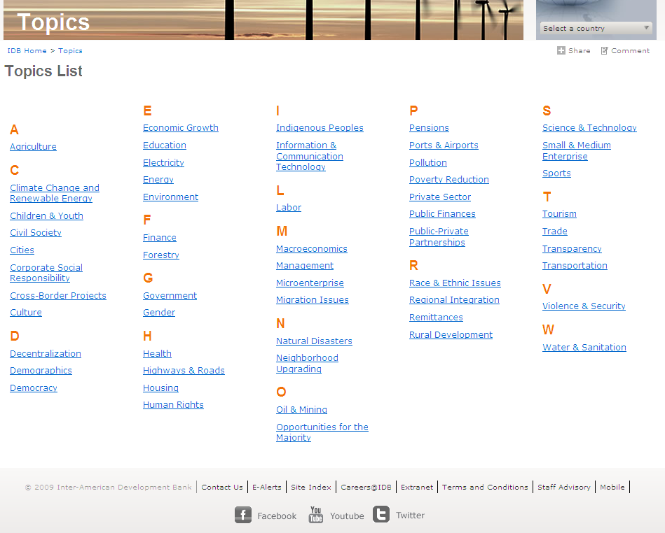
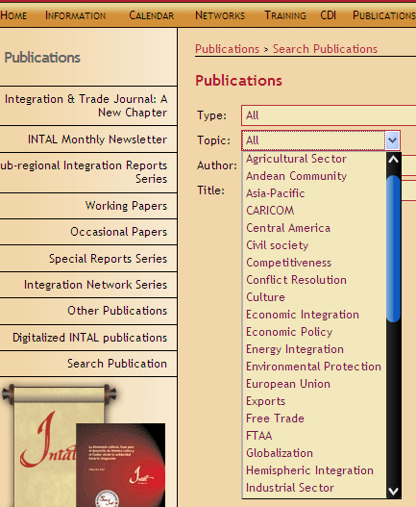
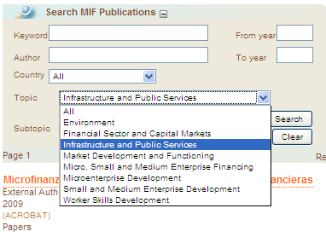

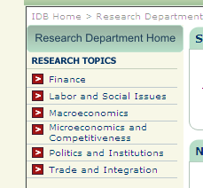
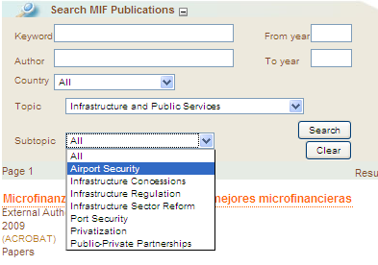
Controlled Vocabulary
Notes:
Web Topics
MIF Topics
INTAL Topics
Confusing for a knowledge seeker

Slide 10
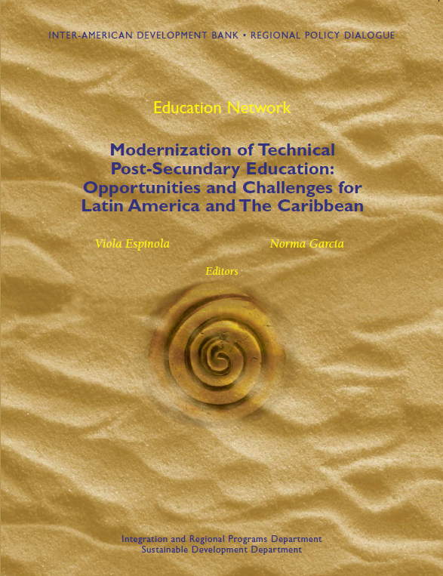


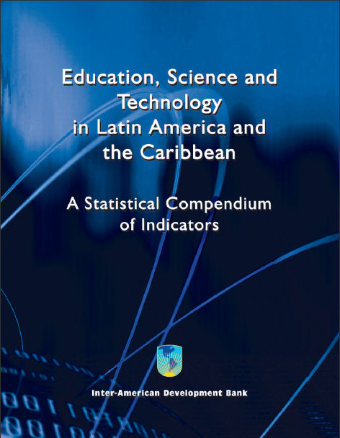


Higher Education
Post-secondary Education
Tertiary
Education
Notes:
Extreme fragmentation
Too many different vocabularies
Consistent classification and organization
Vocabulary working group

Slide 11

“Sea” of Documents
Notes:
Difficult to differentiate and find exactly what you need.
Can’t find the document you are looking for?
Time (and money) wasted looking for things
Opportunities lost (and opportunity cost)

Slide 12
The Approach
Notes:
Scope
Business case
Engagement

Slide 13
$15,500 worker/year
$46.5 million per year
(per 3,000 workers)
Sources: Tackling Information Overload at the Source, IDC, 2009
* The Expanding Digital Universe, IDC, 2007

Slide 14
How much time do you spend looking for Bank Knowledge Products?
  How many Bank systems do you use?
  How often do you turn to external search engines?
  Do you resort to sending e-mails?
  Telephone Calls?
  Do you eventually knock on doors?
Do you find what you are looking for?

Slide 15
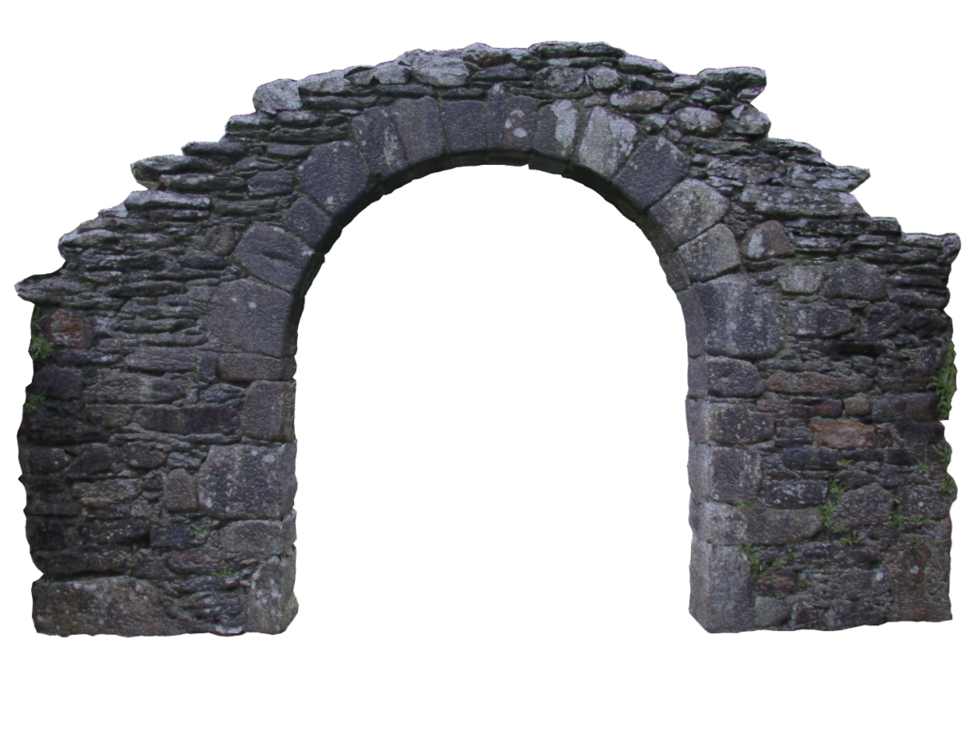



Metadata
Accessibility
&
Visibility
Repository Platform
Notes:
Picture source: http://hbkerr.deviantart.com/art/Stone-Arch-Stock-135665245 (arch)
http://www.google.com/imgres?imgurl=http://farm1.static.flickr.com/130/322616123_cf68a0fc06.jpg&imgrefurl=http://www.finds.org.uk/flickr/photos/tagged/as/southampton/page/2&usg=__dhDZC7juGND787UP_HSGAeiE6BA=&h=374&w=500&sz=113&hl=en&start=22&zoom=1&itbs=1&tbnid=JVy-jq65UIBk6M:&tbnh=97&tbnw=130&prev=/images%3Fq%3Dstone%2Bpath%2Bperspective%2Bcreative%2Bcommons%26start%3D20%26hl%3Den%26sa%3DN%26gbv%3D2%26ndsp%3D20%26tbs%3Disch:1

Slide 16

Metadata?

Slide 17

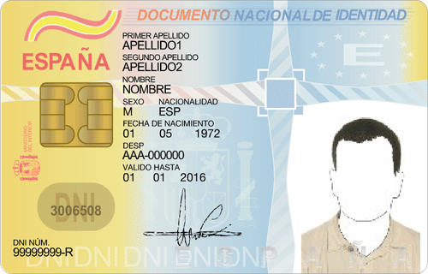

Slide 18


Slide 19
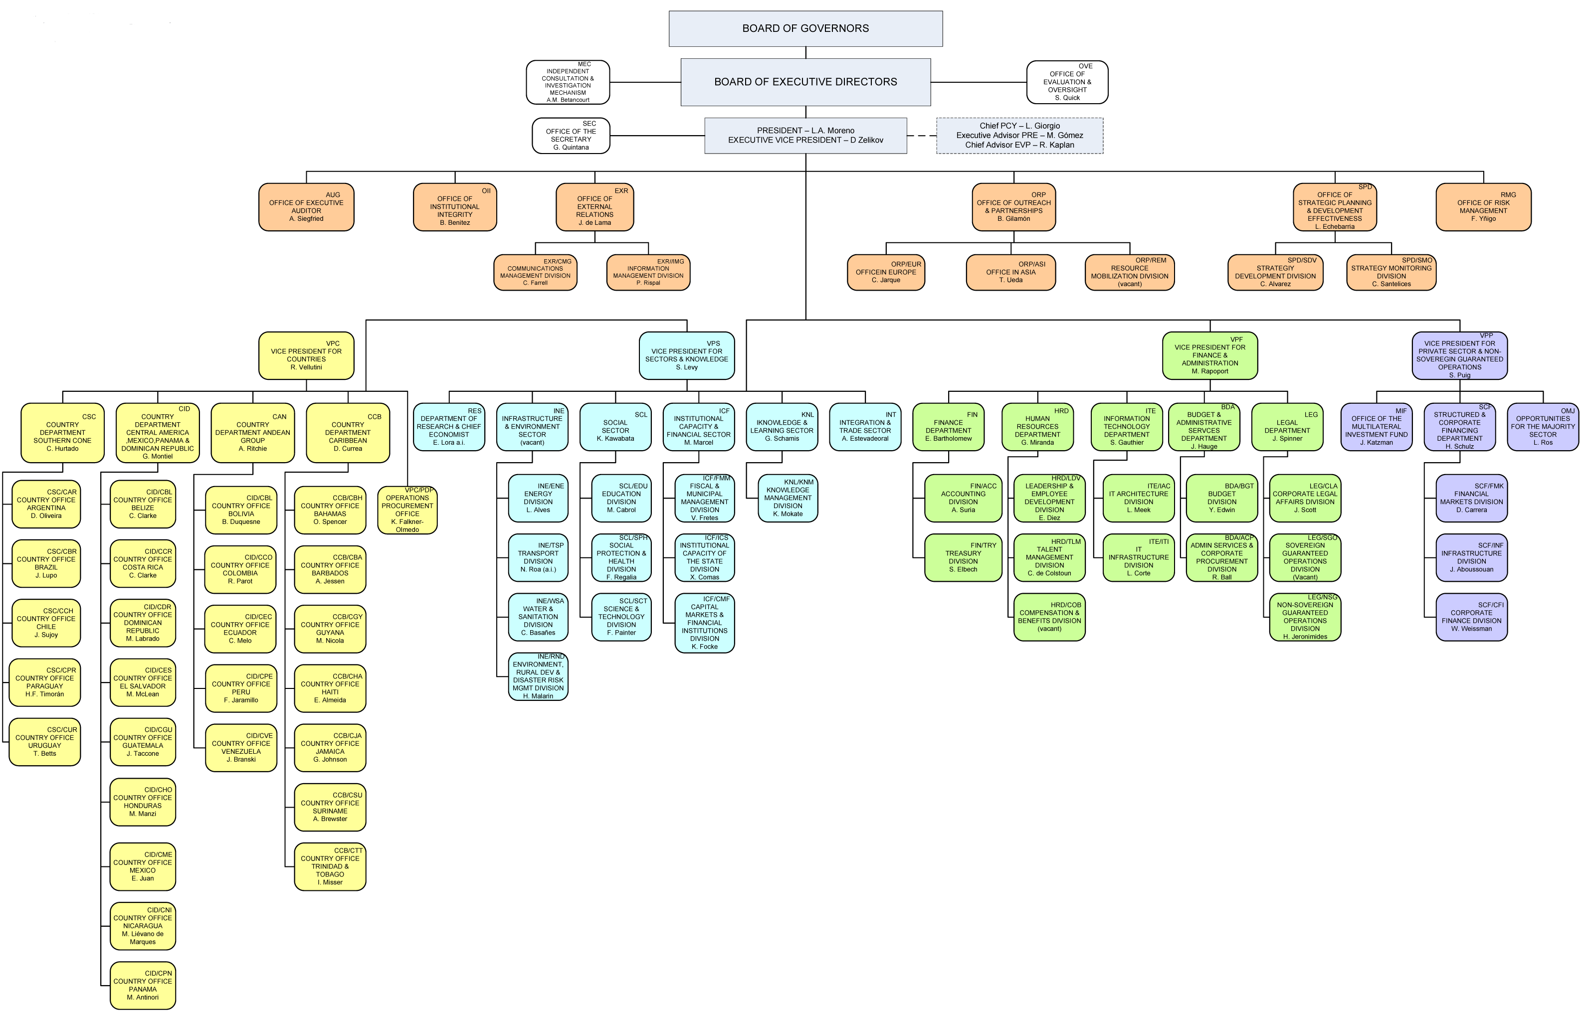
Working Group
Advisory Group

Slide 20
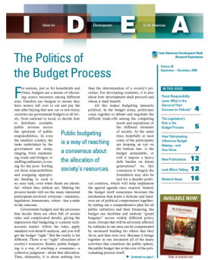
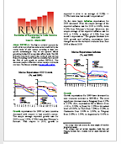
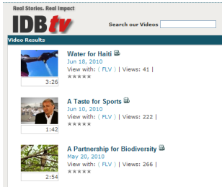
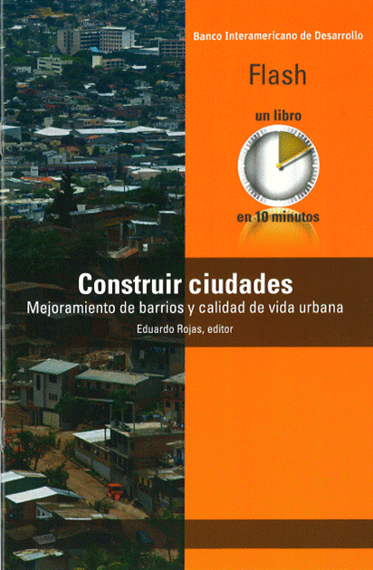




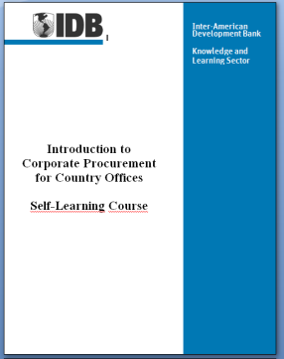
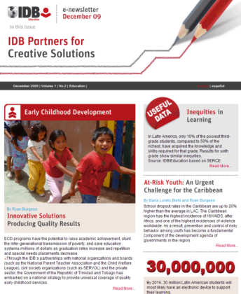

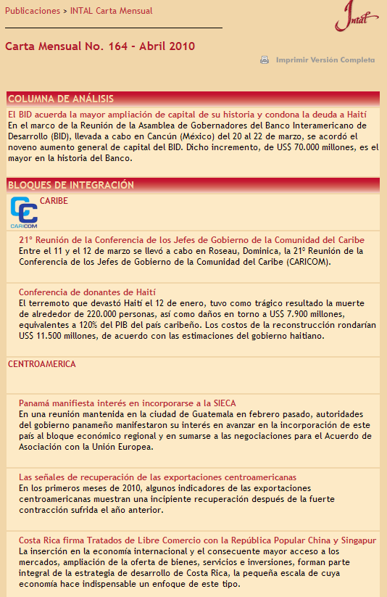

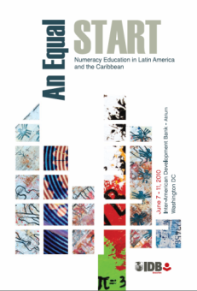
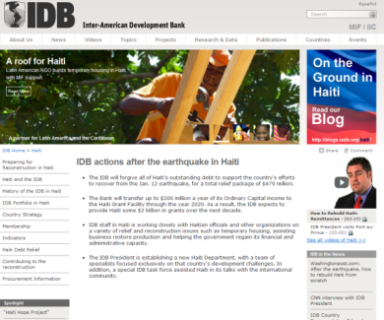
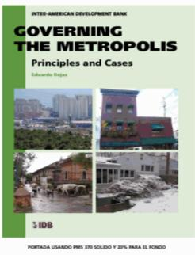

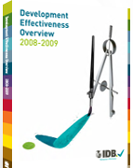
Monographs
Working Papers
Evaluations
Presentations
Technical Notes
Books
Studies
Newsletters & Journals
Discussion Papers
Policy Briefs
Notes:
Segment to only Knowledge products
Non-threatening
Push-out Bank wide (opportunity)

Slide 21
What we did
Notes:
What we did
Inventory / Assessment
Faceted vocabulary
Validation
Charter
Governance
Software (forthcoming)

Slide 22
Process
Assessment
Sustainability
Validation
Development
Notes:
What we did
Inventory / Assessment
Faceted vocabulary
Validation
Charter
Governance
Software (forthcoming)

Slide 23
Assessment
Analysis: current state of vocabulary
Action Plan
Among the issues identified:
Inconsistent terminology across vocabularies
Inconsistent style
Simple lists not A – Z
Simple lists mix granularity
…
The overall environment is one of extreme fragmentation
- KAPS Group

Slide 24
Process
Assessment
Sustainability
Validation
Development
Notes:
What we did
Inventory / Assessment
Faceted vocabulary
Validation
Charter
Governance
Software (forthcoming)

Slide 25
Sustainability
  Vocabulary Strategy
  Governance
  Vocabulary Group
    Group Charter
    Process Guide
    Communications Plan
Advisory
Group
Vocabulary
Users
Vocabulary
Group
Vocabulary Editor
Tech.
Implementer

Slide 26
Process
Assessment
Sustainability
Validation
Development
Notes:
What we did
Inventory / Assessment
Faceted vocabulary
Validation
Charter
Governance
Software (forthcoming)

Slide 27
Vocabulary Development
Inventory review
  Institutional point of view
  Taxonomist point of view
Questions
What works?
Legacy Units?
  Multilingual
  Acronym / Full name
  Facets
Activity Codes
Best practices papers
Consultant/Firm Final Report
Economic Consultation Mission
Eligibility Review Meeting
Events
Lessons Learned
Mission for Operational Program Update

Slide 28
Vocabulary Development
Determine structure
  Levels?
  Poly-hierarchy?
  Combinations?
Topics?
  Macroeconomics, Management,
  Finance, Education
Sectors? (org association)
  Water, Infrastructure,
  Energy, Education
Topics & Sectors?
  Education?
Facets
Document Type
Organizational Unit
Countries & Regions
Topics & Sectors

Slide 29
Vocabulary Development
Inventory terms and degrees
  Reduce number of terms
  Maintain specificity
Urban Development & Housing
. Housing
. Housing & Public Financing
. Housing Markets
. Housing Policy
. Infrastructure & Historical Sites
. Integrated Urban Development
. Neighborhood Upgrading
. Sites & Services
. Urban Development
. Urban Development Credit
. Urban Development Policy
. Urban Environment
. Urban Infrastructure
. Urban Land Management
Urban Development & Housing
. Housing
. Cultural Heritage & Historic Preservation
. Neighborhood Upgrading & Urban Poverty
. Urban Development
. Sustainable Cities
Notes:
Determine whether to combine Sectors with Topics or keep them separate
In indexing- separating terms creates more work for indexer
In search – separating terms allows for higher specificity in recall, but system needs to be tailored to identify the difference
If Topics and Sectors are kept separate, need to consider realigning sectors with IDB organizational sectors.
Organizational units presented challenges in:
Number of hierarchy levels (simplicity versus detail)
Legacy unit names--some unit changes have replacements (map terms); some don’t have new names creating need to determine how to present defunct terms in a current hierarchy
Geographic units –fitting in country offices with country departments to avoid duplicating the country hierarchy
Validation process (the SME index or search using new terms):
How many terms are used to index assets
Keep track of user suggestions
Terms
Feedback
Look at policies in geographic tagging
When asset covers multiple countries-determine whether there’s a benefit to limiting geographic tagging; does “all” provide value
Use relevant fields; irrelevant fields are left blank
Determine how people think about the facets
“Document types” were interchanged with “activities”

Slide 30
Process
Assessment
Sustainability
Validation
Development
Notes:
What we did
Inventory / Assessment
Faceted vocabulary
Validation
Charter
Governance
Software (forthcoming)

Slide 31
Validation
Taxonomists
Subject Matter Experts
Other Organizations
Internal Content
External Content
External Users
End goal = use
Achieve desired Benefits
  Metadata quality
  Search
  Systems

Slide 32
Next Steps and Reflections

Slide 33
Next Steps
  Software
  Multilingual
  Synonyms
  Consolidation beyond IKR

Slide 34
Reflections
Be creative in balancing the number of terms with specificity
(its ok to let go)
Buy-in:
Work with those units that want to work with you,
and keep the group open
Never perfect, never finished
Notes:
See the vocabulary as a living entity, the goal is not an immutable finished product.

Slide 35
http://www.iadb.org
The Inter-American Development Bank Discussion Papers and Presentations are documents prepared by both Bank and non-Bank personnel as supporting materials for events and are often produced on an expedited publication schedule without formal editing or review. The information and opinions presented in these publications are entirely those of the author(s), and no endorsement by the Inter-American Development Bank, its Board of Executive Directors, or the countries they represent is expressed or implied.
This presentation may be freely reproduced.
Thank you
Questions?

Slide 36


