Slide 1
Climate-resilient coastal development: leveraging DRR and CCA to promote integrated coastal zone management
Allan Lavell
Regional Policy Dialogue on
Disaster Risk Reduction Best Practices for Climate Resilient Coastal Area Development
Bridgetown, Barbados
October 20-21, 2011
Notes:
25 minutes

Slide 2
Preliminary Considerations
Disaster risk reduction and climate change adaptation are increasingly recognized to need a strong development base
Development organizations, territorial, sector or global, are not yet fully cognizant of the needs, opportunities and mechanisms that derive from the physical hazard problem under stationary, much less so under changing, climate conditions.
Integrated disaster risk management and climate change adaptation concerns and practices are even less developed in terms of their integration into work portfolios, planning principles, and/or units such as those dealing with CZM.

Slide 3
Context
In the Caribbean, as in all small island developing states:
coastal areas and resources are critical for human and economic growth.
such resources are subject to growing development pressures.
-- environmental hazards increasingly challenge the achievement of sustainable development goals.

Slide 4
Existing ICZM Models in the Region
Three models for ICZM in the Caribbean: (Anderson, 2003)
specific agency is established with assigned functions and prerogatives and a legal structure exists to specifically support it.
ICZM integrated into broader environmental management concerns and with agencies established to deal with it subordinated to higher environmental agency dictates.
existing legislation and agency domains deal with coastal “problems” as part of the overall land management process.

Slide 5
Necessary Transitions
Coastal zone management originally seen as protector of coastal resources subject to increased anthropogenic pressures and competing demands
The impact of environment on society was not originally a concern, but now a critical concern
Perceived location of DRR concerns in other agencies and practices has led to lack of development agency concern.
Historic disaster losses and climate change and the new challenges it represents signifies that all planning agencies must be cognizant of and promote DRR .

Slide 6
Rationale for DRR-CCA-ICZM Integration in the Caribbean
Difficulty of reducing risk so far, and the now accepted skewed development origins of risk mean a far greater imperative to incorporate disaster risk management concerns in all planning formats, sector or territorial, including ICZM.
ICZM is called to play an important role in reducing risk given coastal zones are the basic development areas in Caribbean countries .

Slide 7
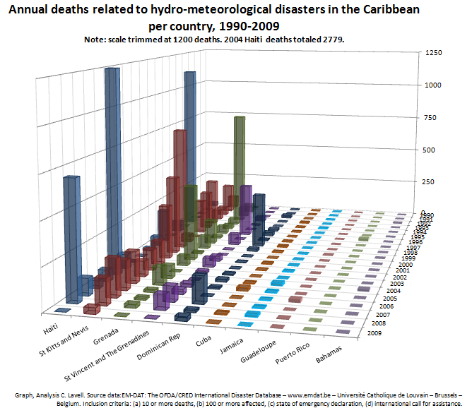
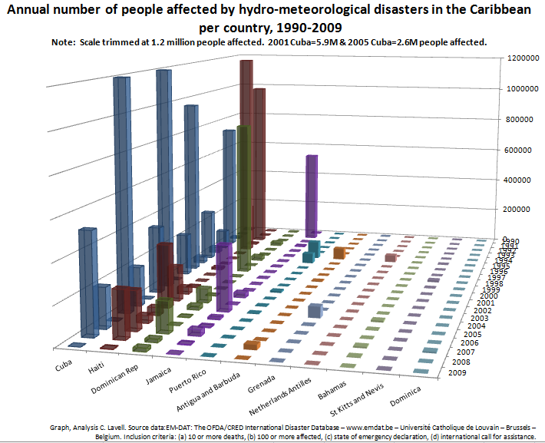
Differences between countries
Country-specific risk manifestations point toward the unique configuration of hazard, exposure and vulnerability for each of the region’s countries that require custom tailored ICZM solutions based on the cultural, physical and bureaucratic idiosyncrasies of each individual state.

Slide 8
Challenges for integrating DRM-CCA in ICZM Policy and Practice
ICZM is as yet a scarce practice in the Caribbean region
Limitations in ICZM capacities and capabilities
Limitations in ICZM legal standing or prerogatives,
Dispersed nature of CZM responsibilities and interests
Limited interaction between DRM-CCA and CZM actors
Difficulty of converting existing DRM schemes into ICZM formats

Slide 9
Needs or Opportunities
ICZM could
Provide for and support the ongoing integrated monitoring, study, analysis and evaluation of evolving or emerging disaster and climate related risk contexts.
Provide an integral policy and strategic framework for both DRM and CCA that makes explicit the relationships with sector and spatial planning principles and mechanisms.

Slide 10
Needs and Opportunities
An important policy and action role of coastal zone management could be the role of guarantor of integral views and approaches to development in the context of the coastal zone.
authority and prerogative for rationalizing and coordinating proposals and actions emanating from more strictly sector based or territorial organizations that have a major impact on the development processes that affect coastal areas.
Promotion of integral approaches for guaranteeing sustainability where the natural (and anthropogenic) environmental stresses affect human development.

Slide 11
Needs and Opportunities
DRR-CCA could be seen as a central pillar for ICZM, and not simply as an action that is promoted by it.
development of processes that guarantee that CZM agencies can play the role of intermediaries for the diverse stakeholder interests that affect the coastal area in terms of hazard impacts

