Slide 1
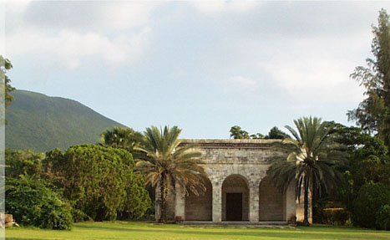
Violence Interventions with Children
Julie Meeks Gardner, PhD
Caribbean Child Development Centre
University of the West Indies
JAMAICA

Slide 2
Effects of violence on children
Successful programmes: international evidence
Importance of documenting programs
Experiences from Jamaica

Slide 3
General Effects
Physical harm
Long term psychological consequences
fear anger
withdrawal depression
confusion digestive problems
nightmares/ sleep problems
avoiding activities
Post Traumatic Stress Disorder
(World Fed. Mental Health, 2002)
Notes:
So what are the effects of all this violence and trauma?
There are the effects if there is physical harm to the youngster, and because these are often visible or produce clear physical symptoms, they are quite likely to be acknowledged and hopefully treated.
On the other hand, there are a range of psychological consequences, and one problem is that when dealing with treating the physical hurts, say, or when the caretakers are dealing with their own grief when someone dies, or the logistics of displacement to give another example, often some of these more subtle signs are likely to be overlooked or dismissed.
Another problem is that many signs may not become apparent immediately, and in fact may not become apparent for may years. Sometimes by the time they appear the predisposing problem is forgotten by the caretaker, assuming they knew about the problem in the first place.
Some youngsters are severely affected, and suffer from Post Traumatic Stress Syndrome which can not only cripple their lives, but can affect their ability to look after their own children. I am looking forward to the talk later in this symposium about Post traumatic stress syndrome.

Slide 4
Effects in young children
Irritability
Immature behaviour
Sleep disturbances
Reduced exploration
Emotional distress
Fear
Regression in toileting and language
Notes:
One more thing. Even very young children : infants and toddlers and can display symptoms following exposure to violence and trauma: one list of symptoms is here. These symptoms may be transient, but some may also play a role in longer term child development such as the reduced exploration which can delay development significantly.

Slide 5
Effects in the Long term
Poor school achievement
Antisocial behaviour and aggression
Notes:
And there are further long term outcomes. Poor school achievement which is a predictor for poor lifetime success. Poor school achievers tend to hold lower paying jobs, earn less money and these can negatively affect their own children’s schooling and possibilities.
A well known cycle is that youngsters exposed to violence often display antisocial behaviour and aggression themselves, and this is clearly one cycle we need to break.

Slide 6
Violence
Children
Notes:
We are concerned about violence both because it directly affects our children, and because some children contribute to the problem both while they remain young, and as they mature into adolescents and adults

Slide 7
How to approach solutions to this problem?

Slide 8
Public health approach
Determine details of the problem
Identify risk factors
Design, pilot, evaluate interventions
Implement most promising interventions on a wide scale
Notes:
We have carried out a number of studies within the two areas 1. (Determine details) and 2. (Identify risk factors) and are now conducting our first intervention pilot, that is, from this area (3.) We have quite a bit of work to complete before we can determine the most promising interventions.
I am going to briefly describe the earlier studies and then I will talk about the current intervention and some of the difficulties we are facing, which may be relevant to others of you who are working on this problem.

Slide 9
Public health approach
3. Design, pilot, evaluate interventions
What already exists?
What is successful?
Can these progammes be implemented and taken to scale?
Notes:
We have carried out a number of studies within the two areas 1. (Determine details) and 2. (Identify risk factors) and are now conducting our first intervention pilot, that is, from this area (3.) We have quite a bit of work to complete before we can determine the most promising interventions.
I am going to briefly describe the earlier studies and then I will talk about the current intervention and some of the difficulties we are facing, which may be relevant to others of you who are working on this problem.

Slide 10
Programs to reduce child/youth violence: International
Several international reviews
Most reports from US, Canada, W. Europe
Few programs reported from developing countries
Few with adequate assessments
Very few ‘proven’ interventions

Slide 11
Documenting Interpersonal Violence Programs
WHO Handbook, 2004

Slide 12
Types of Inventory Data (1.)
Geographic location
District, region, nation, international
Urban, peri-urban, rural
Income/ age/ gender groups targetted
Type of violence aimed at preventing
e.g. school-related, child abuse, bullying

Slide 13
Types of Inventory Data (2.)
Details of programme. e.g.
Interventions using treatment & rehabilitation
Educational interventions
Skills development
Hotlines
Social development
Conflict resolution & anger management
Parental skills development
Peer education
Screening for at-risk youth…..

Slide 14
Jamaica
Notes:
Just to remind you, or for those of you who don’t know, Jamaica is a small island in the middle of the Caribbean Sea, south of Cuba and west of Haiti. Jamaica is well known for many things…

Slide 15
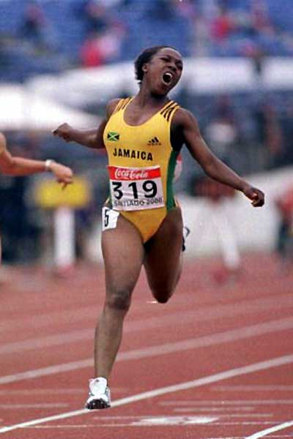
Notes:
…including our music, our athletes, and our beaches…

Slide 16
Notes:
…but unfortunately, also for our gun crimes and other violence.

Slide 17
Programs to reduce child/youth violence: Jamaica
37 programs islandwide
Many in capital city, Kingston (27/37)
Age group most targetted 13-18 years (28/37)
Most based in schools (27/37)
Most operated by churches or other faith-based organizations (18/37)
Study funded by UNICEF Jamaica; In cooperation with Ministry of Health

Slide 18
Programs to reduce child/youth violence: Jamaica
Number with any assessment = 2/37
Number with control trial = 1/37
Study funded by UNICEF Jamaica; In cooperation with Ministry of Health

Slide 19
For this study, requirements for intervention:
Young children
Training
Repeatable on a large scale i.e. not too costly/ too dependent on large resources
Study funded by the CHASE Fund, Caribbean Health Research Council,
& the British Council

Slide 20
The Incredible Years
Promote social, emotional, and academic competence in children:
social skills
understanding of feelings
conflict management skills
school readiness & cooperation with teachers
Notes:
We originally planned to design our own program, but on examining the literature, we discovered a comprehensive program which covered the same areas we were aiming at, and which had been shown to be effective in a range of environments, though it had not been previously used in developing countries. This was called the Incredible Years program, designed by Carol Webster-Stratton, and the program aimed to promote social, emotional and academic competence in children through increasing social skills, children’s understanding of feelings, their conflict management and their academic readiness.

Slide 21
Study design
School
1. Parent intervention
2. Teacher intervention
3. Both interventions
4. Control
Notes:
To take you quickly through the study design, we randomly assigned each of the 4 schools participating to receive both interventions, the teacher intervention only, the parent intervention only, or neither intervention.

Slide 22
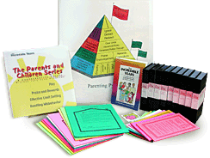
Intervention
Parents
12 weekly 2 – 2 ½ hour workshops
Play
Praise and Rewards
Limit Setting
How to Support Your Child's Education
Promoting Positive Behaviors
Reducing Inappropriate Behaviors
Notes:
The parent intervention comprised 12 weekly group meetings, or workshops, each about 2 to 2 ½ hours long, with a leader and an assistant who were part of the trained research team, and about 8-12 parents. The primary topic areas were the importance of play, praise and rewards, setting limits, supporting the child’s education, promoting positive and reducing negative behaviours

Slide 23
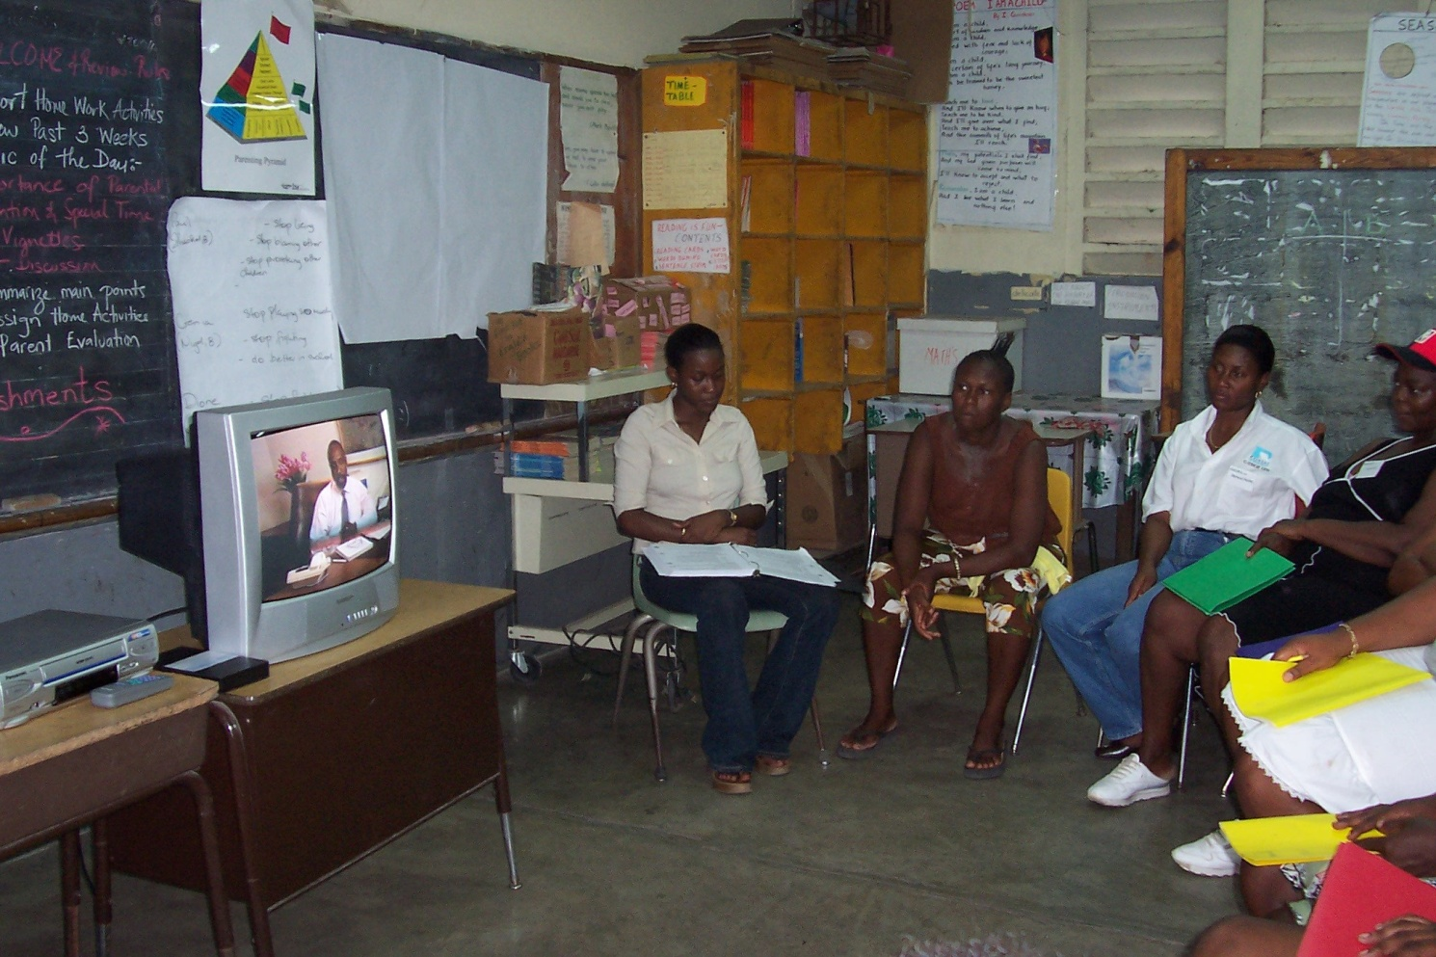
Participants in a Parent Workshop viewing video

Slide 24
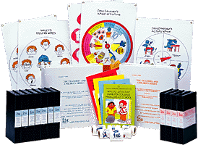
Intervention
Teachers
15 hours of workshops (3 or 5 sessions)
Attention, Encouragement, and Praise
Motivating Children Through Incentives
Preventing Behavior Problems
Decreasing Inappropriate Behaviors
Building Positive Relationships with Students
Notes:
The teacher workshops comprised 15 hours in either 3 or 5 sessions, and these are the areas focused on: attention, encouragement and praise, motivating children, behaviour problems and building positive relationships with students.

Slide 25
Preliminary Results
Teacher intervention improved children’s school achievement
Parent intervention improved children’s difficult behaviours at home and at school

Slide 26
Issues and Observations
Participation
Unplanned interruptions
e.g. hurricanes
Unmet assumptions
Parent literacy
Class size
Classroom structure
Notes:
Unfortunately, because the study is still ongoing, I will not be able to give you any results. Instead, I am going to describe some of the issues and observations we have come across which may be of use to others who are attempting an intervention.
We have had less enthusiastic participation than we had hoped for, both from the teachers and the parents. In early discussions, both groups were in agreement that they needed help, and they said that they would be willing to come to workshops. However this was not always the case.
We had a number of unforseen problems such as visits by hurricanes which not only prevented participation during the storm, but afterwards there is dislocation because of lack of electricity and water, and in one case a school which hosted the parent workshops had its roof blown off. Parents and teachers who are busy trying to restart their own lives after a disaster are not usually inclined to take time to attend workshops.

Slide 27
Conclusions
More interventions designed
Local contexts important
Consider adapting successful programs
Careful assessments conducted & reported
Inventories (national or regional) to note:
Areas, groups served
Gaps in service delivery

Slide 28
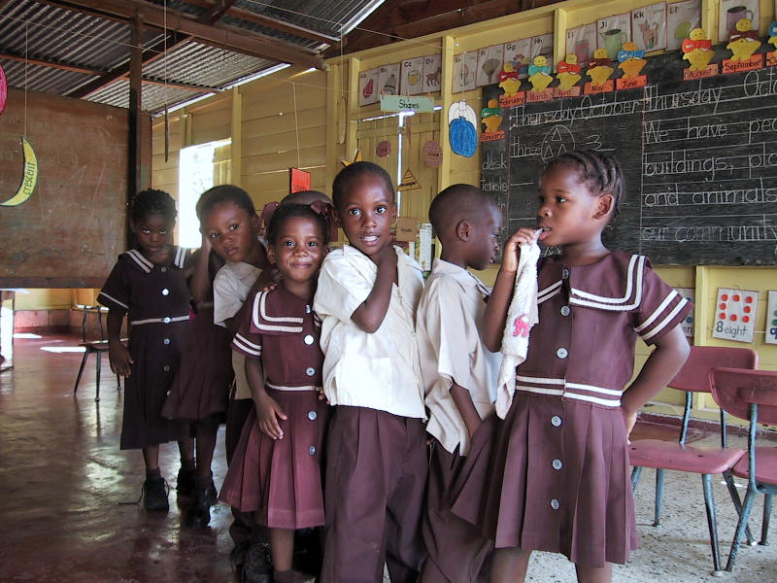
Notes:
For example, many of our classrooms are only separated by a blackboard rather than a wall, so a single room would contain several classes. This leads to crowding so that teachers are not able to walk around to interact with children as the programme suggests. The noise level can also be very high, for example when rain falls on these zinc sheets which make up the roof, you cannot hear someone else talking right beside you.

