Slide 1
Using data to understand homicides in Trinidad & Tobago
Joel Miller
September 2005

Slide 2
Background
IDB diagnostic on crime and violence in Trinidad and Tobago (2004)
Focused on describing problems to help develop solutions
Limited data and resources

Slide 3
Data on homicide
Police recorded crime
through time
by police jurisdiction
Newspaper coverage of murders
Interviews with stakeholders (e.g. NGOs, police, government, prisons, probation)

Slide 4
Police statistics: trends

Slide 5
Police statistics: trends

Slide 6
Police statistics: trends

Slide 7
Police statistics: trends

Slide 8
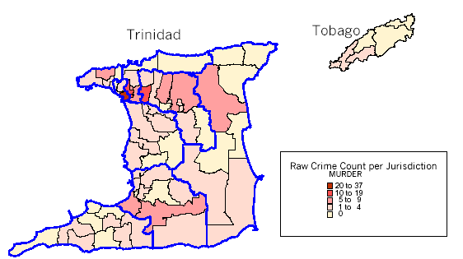
Police statistics: maps

Slide 9
Newspapers: Methodology
First 100 homicides in 2004
Coverage in Guardian, Trinidad & Tobago Express, and Newsday
Created database of characteristics: places, victims, offenders, circumstances etc.

Slide 10
Newspapers: Key murder characteristics
Happen more at night
Predominantly victims (and probably suspects) young males
Guns frequently used
Gang involved

Slide 11
Newspapers: Time of day
50%
45%
45%
40%
35%
30%
25%
20%
20%
15%
15%
10%
7%
8%
5%
5%
0%
12:00am-
4:00am-
8:00am-
12:00pm-
4:00pm-
8:00pm-
3:59am
7:59am
11:59am
3:59pm
7:59pm
11:59pm

Slide 12
Newspapers: Key murder characteristics
Happen more at night
Predominantly victims (and probably suspects) young males
Guns frequently used
Gang involved

Slide 13
Newspapers: Age of victims
35%
32%
32%
30%
25%
24%
20%
15%
10%
7%
5%
3%
1%
1%
0%
14 and
15-24
25-34
35-44
45-54
55-64
65 +
under

Slide 14
Newspapers: Sex of victims

Slide 15
Newspapers: Key murder characteristics
Happen more at night
Predominantly victims (and probably suspects) young males
Guns frequently used
Gang involved

Slide 16
Newspapers: Types of murder
Organized killings
Altercations
Property motivated killings
Domestic/family violence

Slide 17
Crafting solutions: matching problem and response
Develop detailed understanding of crime problem:
Victim
Offender
Physical context/triggers of crime
Intervene to reduce possibilities for crime to happen:
Reduce offender motivation to commit crime
Enable victims to avoid crime
Block opportunities for crime
Notes:
Scanning Identifying problems using knowledge, basic data, and electronic maps.
Analysis Using hunches, information, and data to dig deeper into problems’ characteristics and causes.
Response Working with the community (where appropriate/possible) to devise a solution.
Assessment Looking back to see if the solution worked and what lessons can be drawn.
The Boston Gun Project
Problem-oriented policing initiative aimed at homicide victimization among young people in Boston.
Boston experienced epidemic of youth homicide between the late 1980s and early 1990s.
Youth homicide (ages 24 and under) increased 230 % -- from 22 victims in 1987 to 73 victims in 1990. Remained high well after the peak of the epidemic. Boston averaged about 44 youth homicides per year between 1991 and 1995.
1) assembling an interagency working group of largely line-level criminal justice and other practitioners; 2) applying quantitative and qualitative research techniques to create an assessment of the nature of, and dynamics driving, youth violence in Boston; 3) developing an intervention designed to have a substantial, near-term impact on youth homicide: 4) implementing and adapting the intervention; and 5) evaluating the intervention's impact.
Partnership included (Boston Gun Project Working Group) Boston PD; Mass. Dept’s of probation & parole; office of Suffolk County DA; office US Attny; Bureau of ATF; Mass. Dept of Youth Services (juvenile corrections); Boston School Police; and gang outreach and prevention "streetworkers" attached to the Boston Community Centers program. Other important participants, either as regular partners later in the process or episodically, Ten Point Coalition of activist black clergy, Drug Enforcement Administration, Mass. State Police, and office Mass. AG.
Began in 1995, implemented "Operation Ceasefire" in late spring of 1996.
Operation Ceasefire innovative partnership between researchers and practitioners brought together to assess the city's youth homicide problem and implement intervention (near-term impact).
Based on "pulling levers" deterrence strategy focused criminal justice attention on small # of chronically offending gang-involved youth responsible for much of Boston's youth homicide problem.
Impact evaluation suggests that intervention was associated with significant reductions in youth homicide victimization, shots fired calls for service, and gun assault incidents in Boston.
Comparative analysis of youth homicide trends in Boston relative to youth homicide trends in other major U.S. and New England cities also supports a unique program effect associated with the Ceasefire intervention.

Slide 18
Some suggested solutions: “organized killings”
Police patrol of hotspots (especially at night)
Physical measures in hotspots (street closures, street lighting)
Gang mediation
Enhanced protection for families “under attack”

Slide 19
Using data to understand homicides in Trinidad & Tobago
Joel Miller
September 2005

