Slide 1
Covanta
Energy from Waste
PPP Americas
May 2010

Slide 2
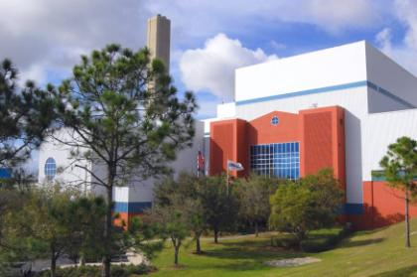
“Covanta has clearly separated themselves from the competitive field… This is the type of facility operator we want to partner with…one that is innovative, caring for their workforce, and environmentally conscious.”
James D. Warner, Executive Director
Lancaster Solid Waste Management Authority
Introduction to Covanta Energy
Energy-from-Waste Leader
Covanta Holding Corporation (NYSE: CVA)
Largest EfW operator in the world
Global presence; local relationships
North America, Asia & Europe
4,200 employees
44 EfW facilities owned and/or operated
20 million tons of waste per year
9,000,000 MW-hr of renewable energy/yr
Strong balance sheet & stable business
2009 revenue $1.6 billion
2009 operating cash flow = $397 million
Lee County EfW, Florida
2

Slide 3
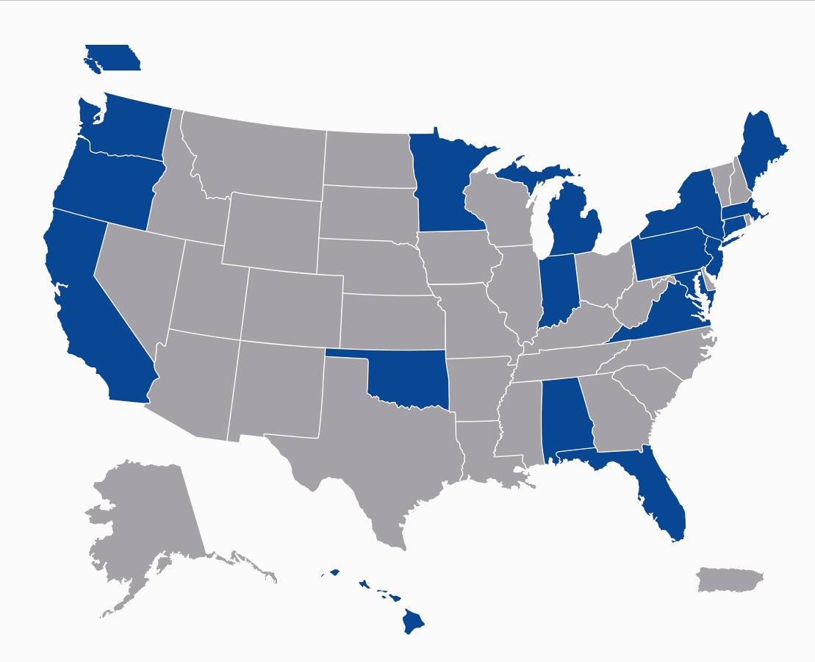
“Covanta Energy, through the dedication and hard work of its management and employees, has demonstrated leadership in the area of occupational health and safety.”
Mark R. Warner
Former Governor of Virginia
Introduction to Covanta Energy
North American Operating Portfolio
Corporate Headquarters Fairfield, NJ
41 EfW facilities (240 TPD to 3,000 TPD)
13 Transfer Stations
3 Ashfills and one landfill
8 Biomass to electricity facilities
5 Landfill gas to energy facilities
2 Hydro electric facilities
Covanta Operates in 18 States and Canada
3

Slide 4
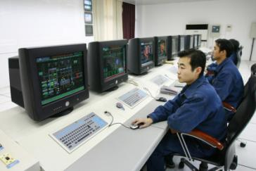
“Meeting our renewable targets will also require a number of other changes: more onshore wind farms sited in the right places, greater use of energy derived from waste, a major expansion of energy from biomass…more solar power”
Gordon Brown
U.K. Prime Minister
Introduction to Covanta Energy
International Portfolio
Europe
Office outside Birmingham, England
Ireland – Dublin EfW Project (about to start construction)
Italy – Trezzo EfW Facility
UK – pursuing over 10 new EfW facilities
Asia
Office in Shanghai, China
China – Sangfeng/Covanta JV
2 EfW facilities operating
2 EfW facilities about to be built
More EfW being pursued
India, Bangladesh, Philippines – 4 IPP facilities
4

Slide 5
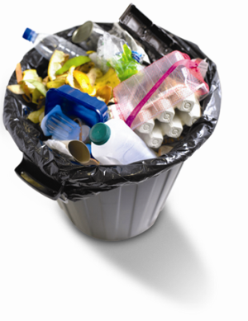
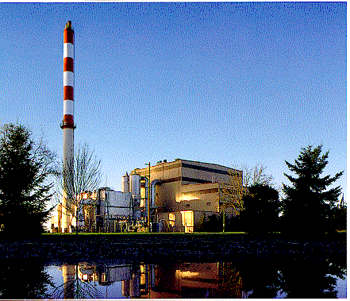
“Covanta Energy’s EfW technology not only safely processes the post-recycled waste stream; it creates clean, renewable energy.”
Jill Buck, Founder and Executive Director, Go Green Initiative
Benefits of Energy-from-Waste
EfW: Meeting Three Critical Global Challenges
Climate Change One ton of trash reduces one ton of CO₂ eq.
Energy Security Renewable energy available locally
Creates Jobs Typical facility creates 1,000 construction jobs (3+ years)
500 - 750 kWhrs of Power
50 lbs of Recycled Metal
Ash: 10% of Original Volume
One Ton of MSW
5

Slide 7
“The Power Sector can be gradually de-carbonized by shifting increasing proportions of electricity production to non-carbon fuels, this includes options such as…waste-to-energy, and/or biomass.”
Global Roundtable on Climate Change
Benefits of Energy-from-Waste
Environmental Benefits of EfW
Reducing greenhouse gas emissions
Avoids a nominal one ton of CO₂ equivalent for each ton of waste processed
Provides sustainable waste disposal practices as part of an integrated waste management system
Global community recognizes EfW as a preferred disposal alternative to landfills
EfW compliments recycling and recovers metals and energy from residual waste
Reduces volume of waste by 90%
Reduces long haul trucking of waste to distant landfills
Doesn’t shift trash burden to distant communities or future generations
7

Slide 8
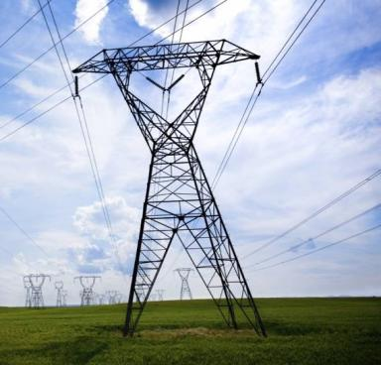
“Generation of energy from MSW disposal in a waste-to-energy facility not only offers significant environmental and renewable benefits, but also provides great energy diversity and increased energy security for our nation.”
U.S. Council of Mayors
Benefits of Energy-from-Waste
Energy Benefits
Generating clean energy from local renewable fuel source
US EPA states EfW “produces electricity with less environmental impact than almost any other source”
Baseload power – 24/7
Home grown power generated in populated areas where electricity is in demand
Promoting Energy Security
One ton of waste will produce 500-750 kWhrs
Avoids burning coal and other fossil fuel
Potential to produce 3-5% of U.S. electricity
8

Slide 9
“We can now be fairly certain that a future low carbon energy system will include a meaningful contribution from the following eight renewable energy sources…. Municipal Solid Waste-to-Energy…”
World Economic Forum January report:
Green Investing towards a Clean Energy Infrastructure Jan. 2009
Benefits of Energy-from-Waste
Economic Benefits
Stabilize and energize the local economy
EfW offers predictable waste disposal cost
Exporting to distant landfills exposes communities to price uncertainty
Local solutions for local waste management challenges
Green jobs to construct, operate and maintain
High paid permanent jobs for local workforce
Goods and Services purchased locally
Competitively priced renewable energy source
9

Slide 10
Why PPP’s?
Design, construction and operational expertise are key factors.
We have built 20+ plants on time and on budget.
With a staff of operational support engineers with ensure safety, environmental compliance and performance.
Long term price stability to Public Entities.
Contract structures provide for stable prices over the term of the contract subject only to normal escalation provisions
Public Entity involvement allows for public policy to be implemented and managed.

Slide 11
PPP Contract Structures
From “Guidelines for Successful Public-Private Partnerships” EU Commission March 2003

Slide 12
Covanta Project Structures
• Tip fee – 13 Facilities
– Vast majority of the facilities owned by Covanta
– Covanta receives per ton fee
– Typically collect 100% of energy revenue and responsible for
project debt service and all other costs
• Service Fee – 11 Covanta Owned/Operated Facilities
– Annual service fee to operate and maintain facility
– Production incentives plus percentage of energy revenue
– Project debt service and other cost pass-throughs to client
– Facility capacity dedicated to one client
• Service Fee - 17 Covanta Operated Facilities
– Annual service fee to operate and maintain facility
– Production incentives plus percentage of energy revenue

Slide 13
Typical Service Fee Contract
Municipal clients are generally responsible for waste delivery and ash disposal as well as payment of:
Fixed operations and maintenance fee adjusted annually for inflation
Debt service principal and interest
Pass through costs for certain commodity items
Effects of force majeure or change in law
Incentive fees for exceeding performance criteria
Covanta responsible for operating and maintaining facility in accordance with contract standards, including:
Environmental compliance
Minimum level of waste processing
Minimum level of energy sold
Facility energy revenue is typically shared, usually 90% to the client community and 10% to Covanta

Slide 14
Typical Tip Fee Contract
Covanta is paid a price per ton of waste delivered to the facility
Usually includes escalation adjustment
Often includes provision for cost increase due to change in law
Covanta receives 100% of energy revenue
Covanta is typically responsible for
Facility operation and maintenance
All or a portion of waste delivery and ash disposal
Payment of project debt service
Number of tip fee contracts varies at each facility
Clients may be municipalities or commercial waste collection companies
Most facilities have at least one large client

Slide 15
Economic Incentives
Europe
EU Landfill Directive
Recognition of landfill methane as a reduction target
65% reduction in landfilling of biodegradable Municipal Solid Waste
Significant Landfill taxes & other incentives to recycle and recover energy
Kyoto
Recognizes Energy-from-Waste as an eligible offset it CDM protocol
China
Supports the projects with a feed in tariff for the energy produced.

Slide 16
Economic Incentives - US
Federal and numerous state laws considers EfW a renewable energy source
Still no comprehensive U.S. renewable energy or climate change policy
Stimulus bill extended PTC’s for new EfW
Potential incentive if EfW included in Federal renewable energy portfolio standards
Exemption from carbon caps would provide incentive over fossil fuels
Recognition of GhG offsets would offer substantial benefit to promote EfW

Slide 17
Conclusions
Are environmental technologies a luxury that governments simply cannot afford?
No. The long term benefits, both economic and environmental, can be implemented without being luxuries with a properly structured project.
Do PPP’s to the extent that they constitute long term design and operations contracts, provide an advantage over traditional methods as regards environmental benefits?
Yes. Private Partners can bring significant improvements by allowing the companies to achieve a critical mass of expertise over the long term that brings environmental benefits

Slide 18
Conclusions
Bearing in mind the high initial costs, what incentives should governments offer in order to promote the most cutting-edge environmental and energy-efficient technologies?
EfW does require REC’s to be economically competitive in Latin American markets. Landfills will be less expensive up front, but will bring future costs that are often not accounted for in setting waste disposal fees.

Slide 19
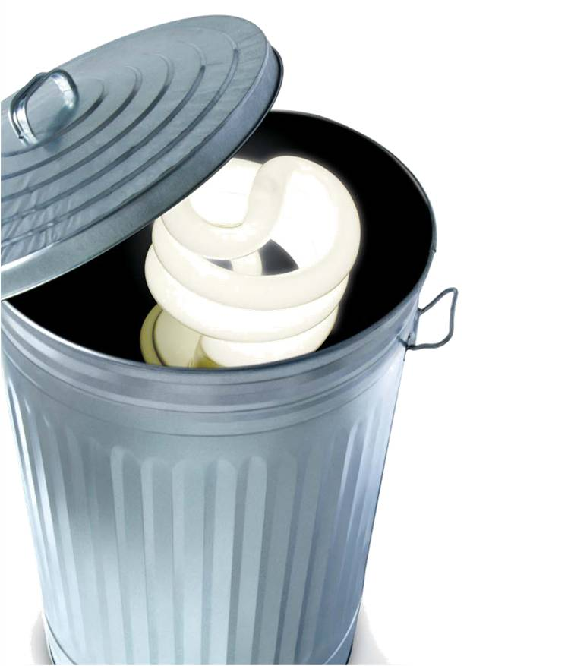
Reduce, Reuse, Recycle,
then Recover…
Watts from Waste!

