Slide 1
REGIONAL POLICY DIALOGUE CARIBBEAN SUB-REGIONAL MEETING AID for TRADE
Koosiram Conhye
Principal Assistant Secretary
11 December 2008
Ministry of Finance and Economic Empowerment

Slide 2
OBJECTIVES
Aid for Trade- Mauritius’ stand
Mauritius’ experience and reflecting on how best to utilize AfT
Mauritius’ initiatives- enhancing regional trade ,investment activities and fostering regional integration.
Operationalising AfT-some proposals
The way forward
Ministry of Finance and Economic Empowerment

Slide 3
MAURITIUS STAND
Beneficiaries -Small and vulnerable economies like Mauritius must be included among the beneficiaries of AfT
Complement -AfT cannot and should not be a substitute for development benefits. It must complement Multilateral Trade Reforms
Adjustment Costs –AfT should assist to meet the adjustment costs of countries affected by erosion of Preferences
Coherence and consistency – AfT processes should enable development partners to work together towards a common mandate
Operationalisation – The operationalisation of AfT should be accelerated
Budget support –an indispensable element for AfT.
Ministry of Finance and Economic Empowerment

Slide 4
THE MAURITIAN ECONOMY
CHARACTERISTICS
Size-1865km²(area)
Location-far from major trade partners
Vulnerable to external shocks
Lack of natural resources
Limited by the extent of the market
Ministry of Finance and Economic Empowerment

Slide 5
THE MAURITIAN ECONOMY (Cont'd)
Shift from a traditional mono-crop sugar based economy to a 5 pillar economy with emerging sectors
From a preference based model of development to a globally competitive one
5 planks of reforms:
Fiscal consolidation
Economic empowerment
Labour market reforms
Restructuring of the Economy
Ease of Doing Business/Improving the Investment Climate
Ministry of Finance and Economic Empowerment

Slide 6
REFORM PROGRAMME
Setting the stage for Robust Growth in 2005
Reforming Budgets in 2006& 2007
2008-2009 Budget- AMIGO Plan-To propel Mauritius further in the path of reform
Converting the economy into an Attractive, Modern,Inclusive,Green and Open economy
Ministry of Finance and Economic Empowerment

Slide 7
IMPLICATIONS OF REFORM
Requires funding and support
AfT-an effective financing instrument
No reform without support of international partners
Reforms possible mainly because of access to market financing and support from development partners
Support is available as Mauritius has plans and programmes
Ministry of Finance and Economic Empowerment

Slide 8
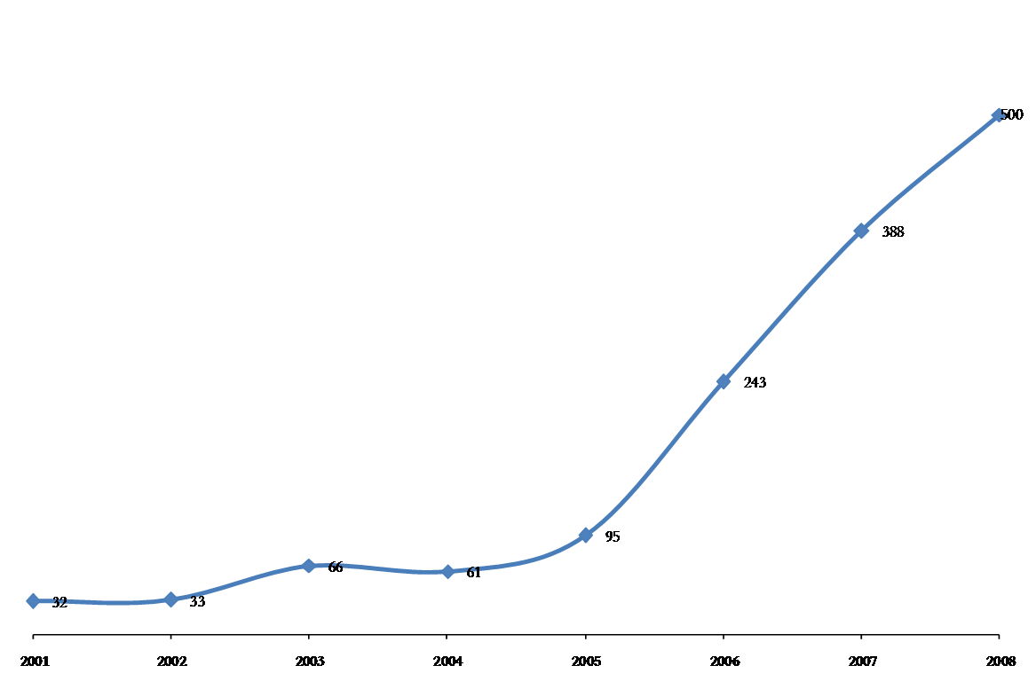
Impact of Reforms
Post October 2006:
Economic Growth from 2.3% to 5.6%
Unemployment Rate from 9.6% to 7.4%
Employment creation from 3000 a year to 11,000 a year
FDI from US$ 95M to US$ 500M
Private Investment from 15% of GDP to 22% of GDP
Ministry of Finance and Economic Empowerment

Slide 9
Ranking of Mauritius in World Bank Doing Business Survey out of 181 countries
Ministry of Finance and Economic Empowerment

Slide 10
Mauritius International Rankings
1st in Sub-Saharan Africa
WB Doing Business 2009
Index of Economic Freedom 2007
Ministry of Finance and Economic Empowerment

Slide 11
AID FOR TRADE - SOME PROPOSALS
Commitment –The donor community who must commit appropriate financing on a multi-year basis that is firmly predictable, for each of the main sub-regions and for each country.
Identification and prioritization- Beneficiaries have the responsibilities to identify and prioritize their trade-related programs/projects.
Private Sector Initiative -Liberalization and private sector development are complementary . The participation of the private sector in developing national programs/projects should be encouraged.
Cross Border Initiative -support for regional and sub-regional and cross-border trade-related programmes and projects.
Infrastructure v/s capacity building-Emphasis should equally be laid on policy/regulation or capacity building rather than only on infrastructure and adjustment.
Ministry of Finance and Economic Empowerment

Slide 12
MAURITIUS EXPERIENCE-LESSONS
Vision—Reforms require clear vision and strong leadership
Go global- Liberalization and integration into the global economy is the key towards achieving high and sustainable rates of growth.
One market- Liberalization should embrace both domestic and export markets. Globalization knows no barriers
Macroeconomic stability -Restoring and sustaining macroeconomic stability is essential for a successful implementation of the overall reform program
Local landscape-The quality of domestic institutions is equally important for an efficient implementation of the programmes. Good governance, democracy, equity ,rule of law.
Role of state- The State should do what it does best i.e. facilitator, regulator, provider of services
Partnering- The State may also need to play a more active role in inviting public-private partnership in identifying priorities and formulating sectoral reform policies/programmes.
Regional blocks and regional integration –The integrating into the global economy is through forging sub-regional and regional integration within the continent.
Funding social cost-Liberalization process, whether at the regional level or global level, has large social adjustment costs that need to be financed by concessional external assistance. The use of AfT funds for this purpose would be very appropriate.
Ministry of Finance and Economic Empowerment

Slide 13
Please address any queries on mof@mail.gov.mu and kconhye@mail.gov.mu
THANK YOU

