Slide 1
Inter American Development Bank Regional Policy Dialogue
The 1 to 1 Model:
Exploring its Potential in a Rural One-Teacher
Costa Rican School
Clotilde Fonseca
Executive Director, Omar Dengo Foundation
IX Hemispheric Meeting of the Education Network
Washington, D. C. November 8, 2006

Slide 2
“Coleridge´s Flower” text by Jorge Luis Borges by way of introduction…
If a man were to visit Paradise in a dream,
and, upon waiking up, would find
the flower of Paradise on the table,
beside his bed, as testimony of having been there…
¿What then?

Slide 3
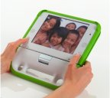
¿Are we being confronted by what we could call the OLPC “flower”?
We have all participated in the dream
What do we do now, when the dream has turned into reality?
How do we approach the developments and transformations?
Are we prepared to cope with the implications?
What do we do now?

Slide 4
1 The Project
El Silencio School
Costa Rica

Slide 5
An experience, an approach in a poor rural community (112 inhabitants)

Slide 6
El Silencio Project
One-Techer School in a rural and isolated area
Poor “campesino” children
School infrastructure improved through international support (Putney Student Services)

Slide 7
Student Population and Educational Environment
Children of different ages and grades work together
Laptops used at home and in school, including during vacation periods
Project based learning and collaborative learning approaches
MicroWorlds PRO + MS Office, Encarta, web design tools

Slide 8
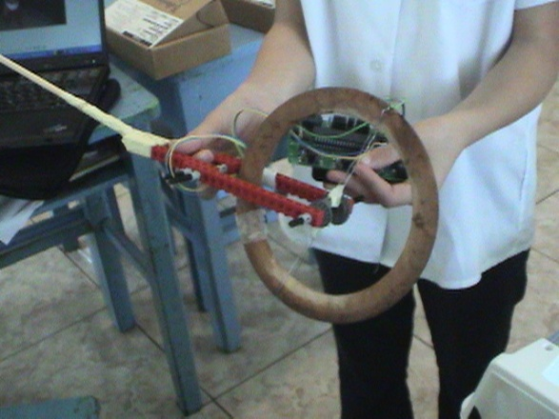
Pedagogical Approach
Powerful ideas + Curriculum- related projects | Children´s interests + Associated to real-life, relevant content

Slide 9
School and Community Integration
Approach promotes link between school, home and community
Rich environment extends beyond the walls of the school and the mind

Slide 10
Essential Characteristics
1. Immersion | A technology immersion experience (laptop, robotics, Internet)
Personal Meaning and Relevance | Learning experiences and situations designed to be personally meaningful and pertinent (map creation + map of the town)
Powerful Ideas | Projects revolve around powerful ideas Links to personal, social and cultural knowledge
4. Support Network | Intellectual and pedagogical support network for growth and exchange among teachers

Slide 11
2 Context of the Project:
National Program of Educational Informatics MEP-FOD
(1988-2006)

Slide 12
National Program of Educational Informatics (1988-2006)
Joint effort of the Ministry of Education and ODF
18 years of experience, research and development
Over 1.5 million children, youth and teachers served over almost two decades
500.000 students in the program at present
Priority given to rural and marginal urban schools
Capacity building core
Computer programming to stimulate creativity and thinking skills

Slide 13
Type of Computer Use in Schools breaking the linear view of development
Computer Lab | Computer in the Classroom | 1 a 1 Child + Laptop
Limited use at specific times Project- based learning 2 students share the computer | Computer for the teacher & student Students share computer and use it for specific activities only Few computers for many students | Laptop for every student Laptop used in the class, school and at home Permanently assigned to student/free use

Slide 14
3
Some Considerations and Initial Outcomes

Slide 15
Reflections and Findings [The high risk of “express” solutions]
The great tragedy of our times: Leading technologies used as an add on or “novelty” without innovation in learning approaches
Technology does not contribute much without vision and good learning practices

Slide 16
1. Preliminary Outcomes (Students)
Improvements in Learning | Rapid and joyful appropriation of technology Increased interest in subjects and research Concern over quality of productions Children tend to learn faster than teacher
Child-Compurer interactions | Children prefer digital materials over paper Children are interested in keyboarding skills Have less need for printed texts
Transition to middle and high school | Clearly prefer 1 to 1 than computer lab New challenges in transition to high school Students tend to keep linked to school

Slide 17
2. Preliminary Outcomes (Teachers)
Teachers´s capacity and potential | Teacher took on the responsability Increased motivation and training Has taken on a leadership role in relation to other colleagues from rural areas
Teacher Preparation | Intense preparatory work needs to be undertaken to begin the project Advice and support to teacher are key Gradual teacher development works better
Capacity to Adapt | Teachers require flexibility and capacity to adapt. Has to be willing to learn with the children and from the children

Slide 18
3. Preliminary Outcomes (Parents)
Parents Links to school | Children´s projects with computers have linked parents more intensely with school Grandparents and members of the community also participate actively
Parents fears & concenrs | They are afraid that someone may rob the children and that they may need to pay for it They are afraid to break it
Capacity building for parents and family | Parents develop new technlological competencies Improve quality of teacher student interactions. Children share their projects with them

Slide 19
Some Limitations & Obstacles
Connectivity | They have an ISDN line. At times it is slightly unstable From the point of view of knowledge and capacity, kids do not have problems using the Internet
Problems associated to used laptops | Initial comptuers in the project were used and presented constant problems When they strated to fail, students became frustrated

Slide 20
4 Video
“The Voices of El Silencio”

Slide 21
5. Example of a Project
“The maps of the community”

Slide 22
Project on the Community: Creation of a Community Map
Objectives:
To learn more about the community through addressing powerful ideas in science, math, social studies
To become familiar with new digital technologies (including robotics)
Learning outcomes:
Kids explore the community. They observe and learn about its characteristics
They learn basic concepts about geomery and measuring
They acquire useful skills and compentencies (measuring)
They use 3D map tools and create community representation at scale

Slide 23
Project on the Community
Creation
of a community map
Learning to use map and compass
Creation of maps using paper and pencil
Discussion of strategies to approach the construction of maps

Slide 24
Proyect on the Community
Creation
of a digital map
Use of MicroWorlds to create digital maps based on group discussions and on the initial
design
Programming the maps makes it possible to address other learning elements

Slide 25
Project on the Community
Institutions in the Community
Institutions, mass media, transportation and community activities
Some students build quite sophisticated representations of the information gathered

Slide 26
Proyecto vinculado a la Comunidad
Construction of a 3D model
Students measure the size of the community by using a movement sensor installed on a bicycle (robotics project)
They were able to establish the factor to build the 3D representation at scale
They measured their hones and reproduced them at scale (200 times smaller than their real size)
They use that factor to build roads and church also

Slide 27
Project on the Community
Integrating Robotics
Students build an alarm system and an electronically activated lighting system
They also build a seismographer (they live near a volcano)

