Slide 1
Achieving the Millennium Development Goals in Guatemala
Gustavo Yamada, Arlette Beltrán,
Juan F. Castro and Enrique Vásquez
Centro de Investigación de
la Universidad del Pacífico
April 2006

Slide 2
Achieving the MDGs in Guatemala
Introduction
This research commissioned by SEGEPLAN, Guatemala’s Planning Secretariat, and sponsored by the IADB is an integrated quantitative approach that proves that the sole avenue to gain clear awareness of the challenges and possibilities Guatemala has to attain the Millennium Development Goals (MDGs) within the time frames committed with the international community is taking advantage of the existing interrelations among economic growth, income redistribution and additional social policies.

Slide 3
Achieving the MDGs in Guatemala
Introduction
Guatemala might meet most of the social millennium goals by 2015, provided that the country spurred its current economic growth pace, implemented supplementary income redistribution policies and undertook a set of additional, conclusively effective and closely coordinated social policies.
In order to meet these extreme poverty, education, gender, health and nutrition goals, the additional annual resources would be range from 1.10% the GDP –provided that the country grows at a 3% rate per year for the next 10 years- to 0.59% of the GDP, if the growth rate attains 5% per year.

Slide 4
Today’s agenda
Purpose of the study
Models: what do indicators rely on?
The integration process: how do indicators interrelate?
Summary of findings: how can MDGs be met at the lowest possible cost?
Conclusions and constraints
Sectoral models
Simulation and integral costing: policy interventions.

Slide 5
Purpose of the study
Identifying the most significant variables that support an explanation on how the indicators related to the first five Millennium Development Goals (MDGs) behave.
Assessing the relationship among these variables and proposing an integral set of policy measures to support goal meeting for each indicator.
Estimating the cost related to implementing these policy measures → Which is the most cost-effective policy combination to meet these goals?

Slide 6
Models:
what do indicators depend on?
Two types of models
Macrosimulation accounting model. Aimed at determining the economic growth and income redistribution combination required to reduce the monetary dimension of the poverty gap by 50% (first MDG indicator goal).
Macroeconometric models linked to all the other MDG indicators. Intended to pinpoint the set of determinants best explaining the phenomenon under discussion (that individuals complete primary school, attain literacy, do not die before age 5, etc.). Within the set of determinants → policy variables over which the “planner” may spur the desired changes regarding the indicator .

Slide 7
Models:
what do indicators depend on?
Three “major variables” to be combined:
Economic growth.
Redistributive policies (income redistribution to enhance equality).
Policy variables → specific policy measures.
Models need to be integrated so that variables may be combined → maximum advantage is to be taken of the interrelations existing among all the set of variables involved.

Slide 8
The integration process:
how do indicators interrelate?
Three blocks:
Macrosimulation accounting model.
End product: evolution of indicators 1, 2 & 3.
Intermediate product: evolution and square of the average household expenditure that “feed” the other models.
Models for education and gender equality indicators.
End product: evolution of indicators 6, 7, 8, 9, 10 & 11.
Intermediate product: evolution of the percentage of men and women that “feed” the other models in every level of education.
Models for the nutrition, child mortality and maternal health.
End product: evolution of indicators 4, 13, 14, 15, 16 & 17.
The child mortality and maternal health models are interrelated through indicators 15 & 17.

Slide 9
The integration process:
how do indicators interrelate?
Two scenarios:
No additional social policies scenario (NASP).
Only growth effects , and, if applicable, the redistribution necessary to meet the poverty goal in its monetary dimension, are taken into consideration.
Baseline scenario → supports determination of how far goals are if: (i) sectoral policy measures to support achievement of goals fail to be taken and the economy grows at the expected rate; (ii) based on the expected growth rate, only the redistribution policies necessary to narrow the poverty gap in its monetary dimension are implemented.
Scenario including additional social policies (IASP).
In addition to growth and redistribution, the effects of the sectoral policy interventions performed to meet all the goals proposed are also considered.
The policy variables identified during the modeling process are increased under this scenario.

Slide 10
The integration process:
how do indicators interrelate?

Slide 11
The integration process:
how do indicators interrelate?
The core query in this research was answered once models had been integrated:
Establishing the most cost-effective policy combination to meet goals or, in any case, minimize the gap between the value of indicators and the relevant goals.
We can hardly refer to policies and costs linked to meeting a goal. Consequently, understanding goal achievement from an integrated point of view is critical.

Slide 12
Summary of findings:
how can MDGs be met at the lowest possible cost?
Total cost linked to the most cost-effective integrated intervention ensuring: (i) that all possible goals will be met; and (ii) that all those indicators, the related goal of which fails to be achieved, do show significant improvement.
Cost of redistribution policies
Cost of sectoral policies
Total cost

Slide 13
Summary of findings:
how can MDGs be met at the lowest possible cost?
Achievement of goals: although greater growth translates into reduced size and cost related to sectoral policies, the latter continue playing a major role.
Sectoral policies and achievement of goals.

Slide 14
Conclusions and constraints
Which is the core message of this multisectoral implementation quantitative model in the case of Guatemala?
That integration of pro-poor growth policies, redistribution programs and additional social policies is critical to cause significant improvement of the situation of the poor and socially excluded population in Guatemala over the next 10 years.
Isolated, one-way measures would be either insufficient or extremely costly to meet the MDGs.

Slide 15
Conclusions and constraints
Most of the estimations and calculations featured in this presentation are based on the Encuesta de Condiciones de Vida – ENCOVI (Living Standards Measurement Study) and Encuesta Nacional de Salud Materno Infantil – ENSMI (National Mother-Child Health Survey), conducted in 2000 and 2002, respectively. Policy identification and prospecting depend on the level of data collected through both surveys and represent the structural and institutional characteristics prevailing in Guatemala in those years. Institutional efficiency could either improve or downgrade in the next 10 years, and the costs estimated will rise or fall accordingly.
Identification of possible interventions to support the achievement of MDGs through the macro and microeconometric models does not supersede the need to assess the impact and cost-effectiveness of the various policy measures proposed.

Slide 16
Sectoral models

Slide 17
Simulation and integral costing:
policy interventions
The simulation and costing exercise aimed at identifying a set of policy variables, which the “planner” may influence to support goal achievement.

Slide 18
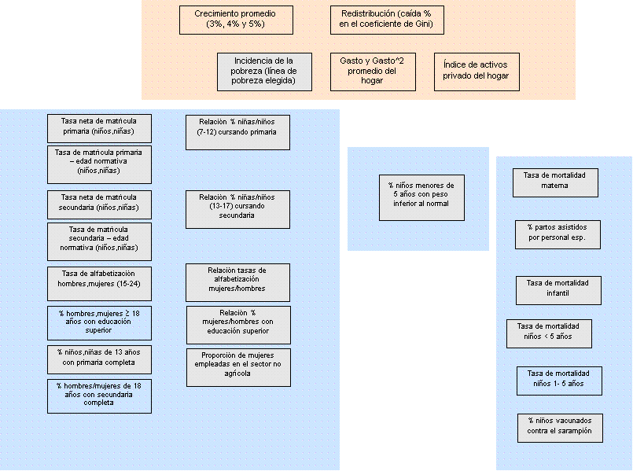
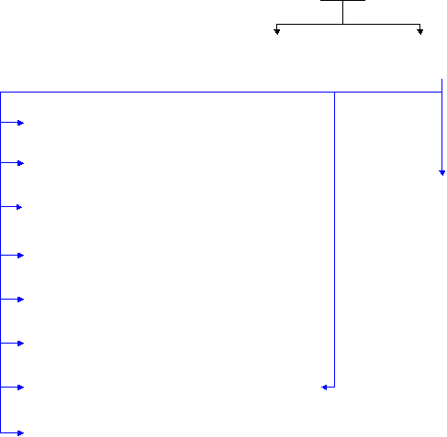
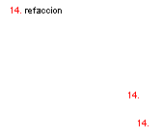
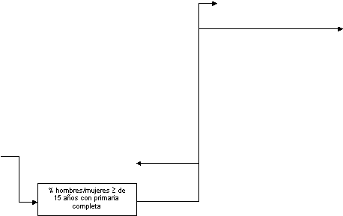
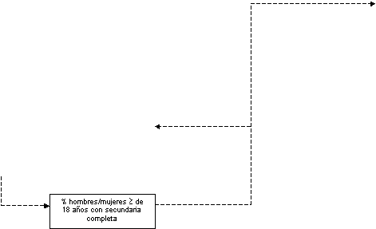

Slide 19
Simulation and integral costing:
policy interventions
Accordingly, each policy variable modifies certain indicators (based on the relationships and elasticities identified by the microeconometric models) and involves an intervention unit cost.
This integrated system allows two types of questions to be answered:
Which policy variables need to be used and how deeply do they need to be applied in order to meet the 10 goals proposed at the lowest possible total cost?
How should the available resources be allocated among the policy variables identified so that the gap between indicators and their relevant goals is as narrow as possible?
The findings in this presentation offer an answer for the first type of question.
Specific policy interventions are yet to be ascertained.

Slide 20
Simulation and integral costing:
policy interventions
Which policy interventions?
Reduce the proportion of people having no access to drinking water and electric power.
Reduce the proportion of people having no access to healthcare services: healthy child checkups, prenatal checkups, public health insurance and breast-feeding programs.
Improve healthcare infrastructure: hospital and primary healthcare centers.
Reduce the proportion of people having no access to school programs: schooling packages and scholarship.
The overall cost for the all the aforementioned items would range between 0.6% and 0.7% of the GDP per year, depending on the country’s growth rate.

Slide 21
End of presentation

