Slide 1
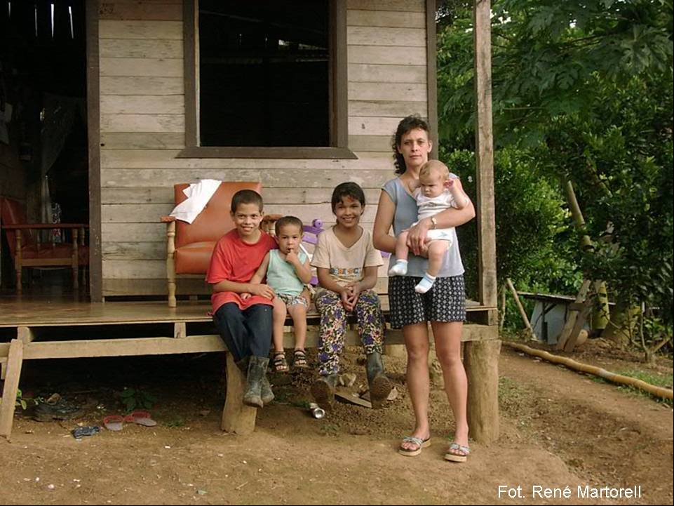
Mixed Institute of Social Aid
VII Regional Meeting of the Poverty and Social Protection Network
November 11-12th, 2004
Washington, D.C

Slide 2
The Challenges of the Institutionalization of the Reduction Poverty Policies and Programs
Social Authority, Decentralization and Participation
Planning and Development of Productive and Work Generative Activities

Slide 3
The Mixed Institute of Social Aid’s Experience. Costa Rica
Marta Lora

Slide 4
The Mixed Institute of Social Aid (IMAS) is a Public Institution, with autonomous institutional status and own legal capacity, founded by means of Law 4760, April 30th, 1971.
Its task is to assist and fight the poverty. That is why, according to its attributes included in its creation Law, it is the Director Institution in this field.

Slide 5
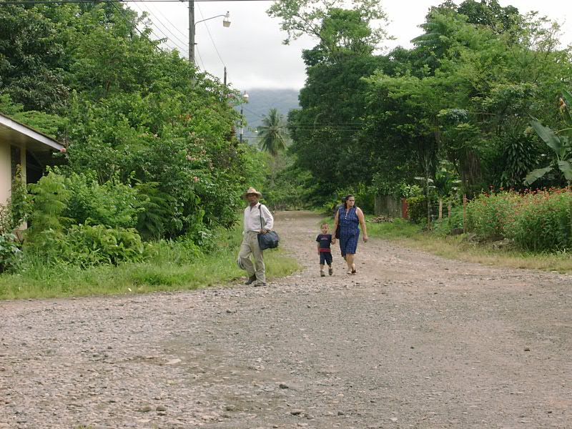
Some data about the poverty situation in Costa Rica …

Slide 6
A fifth part of the population (homes) is poor because of insufficient incomes: 18,5%
13,4%, because of Basic Unsatisfied Necessities (NBI)
5,1% in Extreme Poverty
A 10 % of the population lives on risk of impoverishment
The poverty stagnant stays, although the social expense recovery.

Slide 7
The social investment is socially regressive: the resources do not arrive to the most needy people in sufficient proportions.
A less and disadvantage insertion to the work market goes with poverty.
The educative level is determinant for the poverty situation.
The number of people by home is higher every time that the poverty situation is emphasized.

Slide 8
In the poor homes, the number of people that constitutes the Work Force is lower than those among the Not Poor.
In the poor homes, the number of Employed People is lower than the Not Poor ones.
The Open Unemployment Rate in the extreme poverty homes reaches the 27,1%; against 5% in the Not Poor ones.
The poverty continues to be predominantly rural, but it advances over the cities.

Slide 9
The percentage of homes with Feminine Householder Heads is higher among the poor than among the Not Poor, showing the link between poverty and genre.
The number of worked hours per week dedicated to the main occupation is sensibly lower at poor homes.
The young and numerous homes stand out from the numbers of the poverty incidence
In the indigenous communities, poverty is intense.

Slide 10
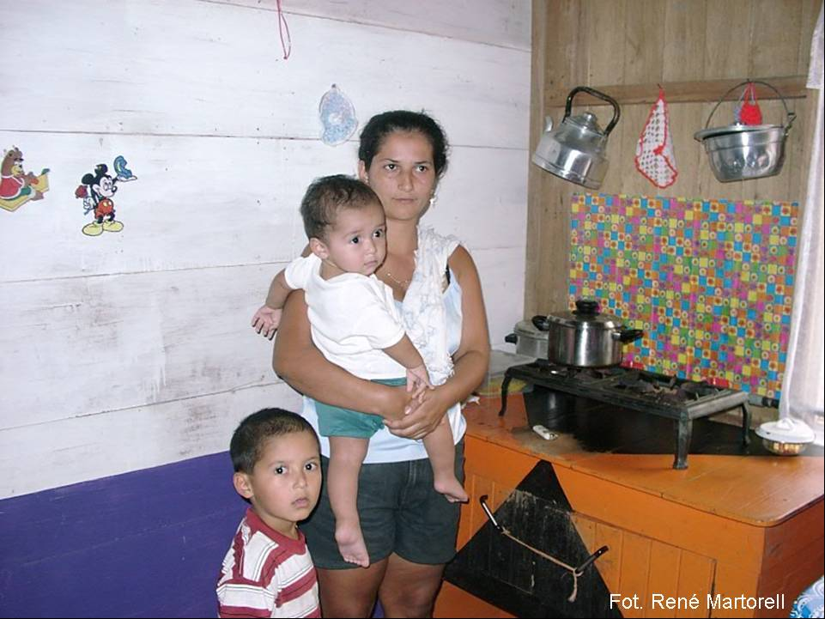
Historical action of the IMAS in the promotion and development of labor- economical programs and projects.
Fot. René Martorell

Slide 11
During its history, the IMAS has developed many actions and projects in order to bring integral solutions to the poverty situation of the families, by means of broad impact programs, like those which foment the production and work in the familiar sphere.
Fot. René Martorell

Slide 12
1971: Generation of economic production alternatives to families in poverty conditions.
1975: Program of basic seeds, vegetables and fruits
1976: Program of Social Interest Housing (PROVIS) and Program of support credits to the informal sector, seeking to bring an integral assistance to the needs of these families.
1979 - 1983: Program of Urban Development; soft credits to micro-entrepreneurs of the informal sector.
Fot. René Martorell

Slide 13
1980 - 1985: Program of Mutual Aid and Communitarian Companies (Soft Credits)
1980 - 1986: Program of Craftsmanship and Little Industry
1985 - 1988: Program of Socio-productive Projects; financing to individual or collective projects.
1984 - 1987: Promotion to Agriculture Export Project
Fot. René Martorell

Slide 14
1988: Employment Generation Program
1992: Production Support Program.
1989 - 1998: Assistance to the Organized Communal Movement Program.
In recently periods,2000-2004, the IMAS has developed even more this working line, as we will see then:
Fot. René Martorell

Slide 15
During the period 2000-2004, the IMAS goes on developing actions and offering economic incentives to support incipient productive activities, proposed by a community, organized groups and people in poverty condition.
Qualifying processes to improve or give knowledge to entrepreneurs in the management of the productive unit and allows them to improve the quality and the produced quantity of a productive enterprises.
Fot. René Martorell

Slide 16
How does the IMAS work?
Fot. René Martorell

Slide 17
National development Plan
National Policies
Orientator Frame
Poverty Surpassing National Plan
PAO
Institutional Policies
Institutional Strategies
INEC
Panorama of Poverty
Different Axis of Institutional Action
SIPO
SABEN
Other Sources

Slide 18
Labor and Economic opportunities
Childhood and Adolescence
Integral Assistance to Women Development
Family Strngthening
Different axis of institutional action
Environment Improvement

Slide 19
Laboral and Economic opportunities
Productive Ideas. It offers economic incentives to start, support and fortify productive activities proposed by a community, organized groups or people in poverty condition
Qualifying Opportunities. It promotes group and individual training and qualifying actions, such as: seminars, courses and others.

Slide 20
Labor and economic opportunities
Working Modalities:

Slide 21
Labor and Economic opportunities
Modality: Solidarity Local Funds.
. It executes in communities, most of them rural, dispersed, lacked of basic services, with difficult credit access and few qualification opportunities and technological orientation for the production
. It promotes the creation and strengthening of the communal funds that impel the credit to finance productive activities.

Slide 22
Labor and Economic opportunities
Modality: Solidarity Local Funds.
Modality: Integration and Development Funds.
. It destines resources for qualification and the credit destined to the development of agriculture productive, livestock, craftsmanship, commerce, productive infrastructure reparation, among others.
. A base organization assumes the execution responsibility procedures of disbursing, pursuit, collecting and qualification.

Slide 23
Labor and Economic opportunities
Modality: Solidarity Local Funds.
Modality:Integration and Development Funds.
Non reimbursable financial incentive for development of Individual production.
It finances individual projects that requires capital for acquisition of machinery and small equipment, raw material, working capital, commercialization support and others.

Slide 24
Labor and Economic opportunities
Modality: Solidarity Local Funds.
Modality: Integration and Development Funds.
Non reimbursable financial incentive for development of Group production.
Non reimbursable financial incentive for development of Group production.
It finances group projects that requires capital for acquisition of machinery and small equipment, raw material, working capital, commercialization support and others.

Slide 25
Main Results of the Institutional Action in Productive Project matters
Fot. René Martorell

Slide 26
In the last four years, the IMAS has developed 1492 productive projects in the whole country.
Most of the projects belong to the production area and a fewer quantity to the services and commerce areas.
Fot. René Martorell

Slide 27
With the Productive Ideas subsidy, it is produced and generated a broad range of products and services, among them:
Vegetables and basic seeds
Craftsmanship
Dress and bed clothes
Farm animals commercialization
Groceries and cloth
Goods and services production, like bakery and pastry
Energy (biodigestors)
Ornamental plants
Fishery
Beauty services
Avian farms
Mechanic, body repair and painting
Cabinetwork articles
Selling of bazaar articles, etc.
Fot. René Martorell

Slide 28
The projects concentrate their activity in the scope of the Production (74%) followed by the Commercial activities (15%) and finally Services (11%).
They develop as small subsistence companies; although the given resources are limited, the 90% of the projects are active and producing.
Fot. René Martorell

Slide 29
More than half of the projects (agriculture, stock farming and hens) incorporated family work/although in small scale, they generate employ.
The 82% of the projects were considered successful; the reasons for their success are the following: the IMAS’ subsidy, the beneficiaries’ experience and the commercialization (ease to put the product in market).
Fot. René Martorell

Slide 30
The 68% of the projects generate gross resources produced by their operation; besides satisfying subsistence necessities. That means improvements in their socioeconomic situation.
There constitute an opportunity for the population to be able to insert itself into productive processes.
Fot. René Martorell

Slide 31
It an important strategic action, because it incorporates the low resources population to the productive market and constitutes a dynamic and proper way to surpass poverty.
Fot. René Martorell

Slide 32
Some final reflections

Slide 33
The present characteristics of poverty demand new treatment and orientations approaching, where it would assumed the poverty overcoming, not only as a problem that competes to the social field, but also as an explicit aim of the social and economic policy, excluding old practices which consider the fight against poverty as marginal o secondary actions in government plans.

Slide 34
To establish programs orientated to the generation of stable and well-paid employs, that offer more and better opportunities to overcome their situation to poor families, besides directing the attention specially towards the most deteriorated and needy areas.

Slide 35
To establish articulated processes, where come together labor, agricultural and industrial policies, that transcend the national market.
The same way, to generate the necessary infrastructure to mount storing and product and road infrastructure selling places, that empower the development in areas considered a priority.

Slide 36
To develop actions aimed to strengthen the human capital in different human development areas: health, education, housing, cultural sphere, sports, etc. that make possible to create a qualified social base over which it could be sustained a development model, according to the present demands of society.

Slide 37
It is necessary the protagonist presence of diverse actors of the Civil Society and Public Institutions, in order to organize and develop working plans jointly with the population and in a co-responsible way, to overcome present conditions of the families in poverty and extreme poverty conditions.

Slide 38
The National Plan to Overcome the Poverty and the Development of Human Capacities “New Life” 2002- 2006 establishes a group of STRATEGIC ACTIONS, which are directed to the institutions’ participation, according to the following:

Slide 39
Strategic actions of the New Life Plan:
To reorganize the social programs, in order to reach a higher efficiency and impact in the human development and the poverty
To generate and distribute the national wealth, by means of the employment creation and the production support, specially in low development areas.
To incorporate the genre focusing in whole actions as a transversal axis.
Coordinated and articulated intervention of the public institutions and other social actors, to reach common goals.

Slide 40
At the same time, the IMAS establishes in its Operative Annual Plan (PAO), about Productive Activities and Employment Generation, the following STRATEGIC actions:

Slide 41
IMAS’ Strategic actions:
Effective Incorporation of the community: by means of communal base organizations, or by means of organizations of the direct beneficiaries of the projects.
The improvement and increasing of the productivity of the low resources social groups: through the qualification and specific technical training; that means, to develop qualification processes parallel to the development of program’s actions.

Slide 42
The real access to productive resources: providing resources or generating spaces in order to the program beneficiaries dispose the access to resources or soft loans; with them, they can face the necessities that demand the productive project that they want to develop.
Employment generation: as a result of the programmatic actions established and developed, it is expected that the projects become into permanent and sustainable activities and provide employment to the beneficiaries and their families, as well as to other persons linked to them.

Slide 43
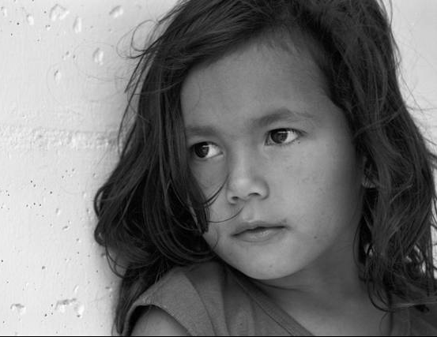
We can defeat the poverty ...
... only if all of us contribute the necessary and, specially, if we contribute what is fair...

Slide 44
Thank you …
Fot. René Martorell

