Slide 1
Free Software and SMEs,
A Perspective of the Future
Sérgio Vale Aguiar Campos, Ph.D.
Dept. Ciência da Computação
Universidade Federal de Minas Gerais

Slide 2
What is Free Software ?
Software that comes with the source code
  You get the running system and the instructions used to build it!
Free as in Freedom, not as in Gratis!
Can be sold, even though not often.
Can be “attached to”, i.e., Free code can be used together with proprietary code.
Can be protected: being free doesn't mean anyone can look into your data

Slide 3
Why Free Software ?
Flexible
  Can be adapted to run in less powerful computers, such as, old computers, thin clients, etc
  Lowers acquisition cost
Technology ownership
  SMEs don't have to follow requirements of home users.
Open Standards
  Supplier independent: everyone uses the same Open Office
  Data always available

Slide 4
Disadvantages of Free Software
Too many options!
  I just want to process my data, not learn about Linux, Red Hat, SuSE, KDE, Gnome, LDAP, Samba, NFS, MySQL, .............
Requires technical personnel to keep running
  More expenses ???!!!
What if something goes wrong ?
  Who do I call ?
Does everything I do need to be free as well ?
Not enough applications!

Slide 5
What's Missing in Free Software Today ?
A solution that is:
  Easy to install and use
  multifunctional
  Scalable
  Operates between environments free and proprietary
  Easy to manage
  Of good “reputation”
  Constantly updated
Competent support team
Training

Slide 6
Free Software Tomorrow
A lot of what is missing in free software today can be found in proprietary software:
  Because of IT companies
We will see more and more of systems with:
  Open and gratis component: Linux
  Comercial component: suport, training, especific software, ... - Someone to call when things go wrong
The hybrid vision has:
  Low cost: part of the system is free (as in gratis)
  Support and warranty

Slide 7
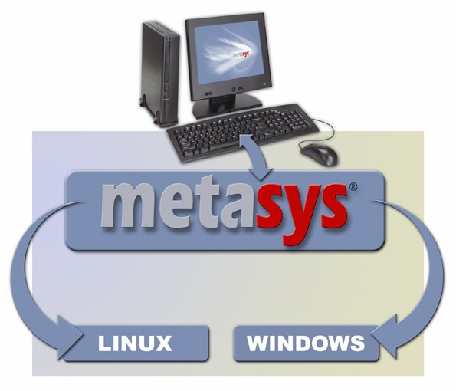
What We Are Doing About It
A meta-operating system:
integrates computational environments

Slide 8
The Metasys Solution
Allows:
  A seamless integration between Windows and Linux
  The execution of both Linux and Windows apps in any workstation
  Windows look and feel in a Linux environment
  Uses low cost workstations
  Administration and management are simplified and web based.
  Total cost reduction: hardware, software, services

Slide 9
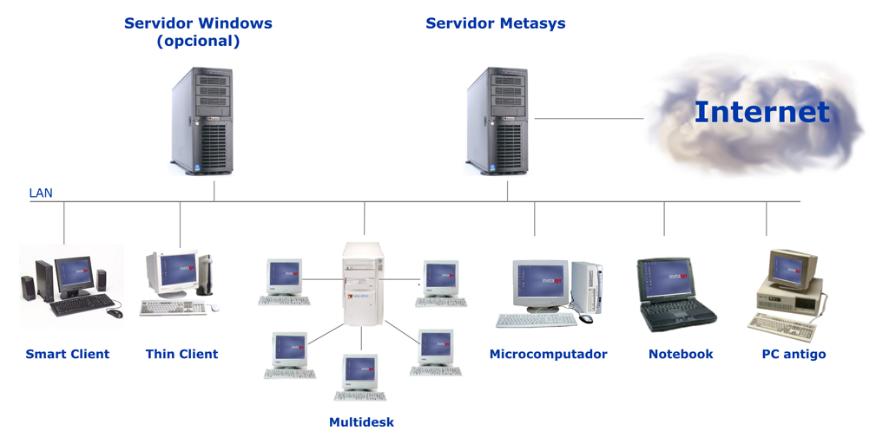
The Metasys Architecture
Programs are read from the servers HD and executed locally.

Slide 10
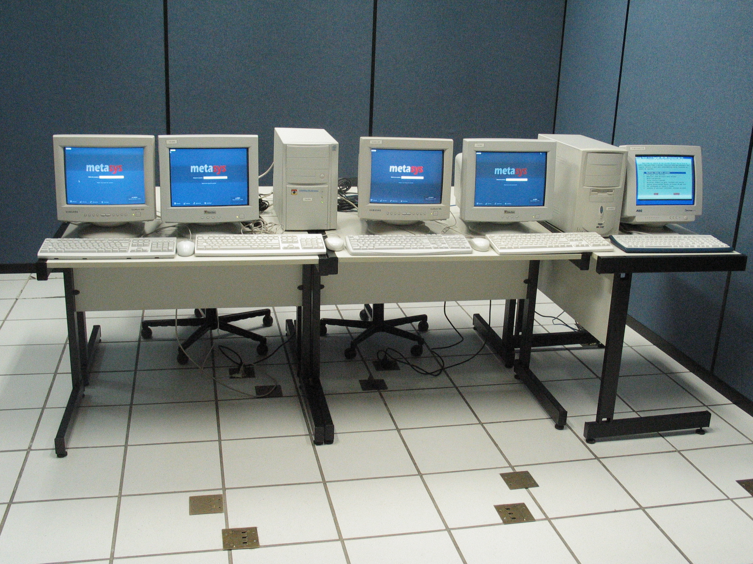

Slide 11
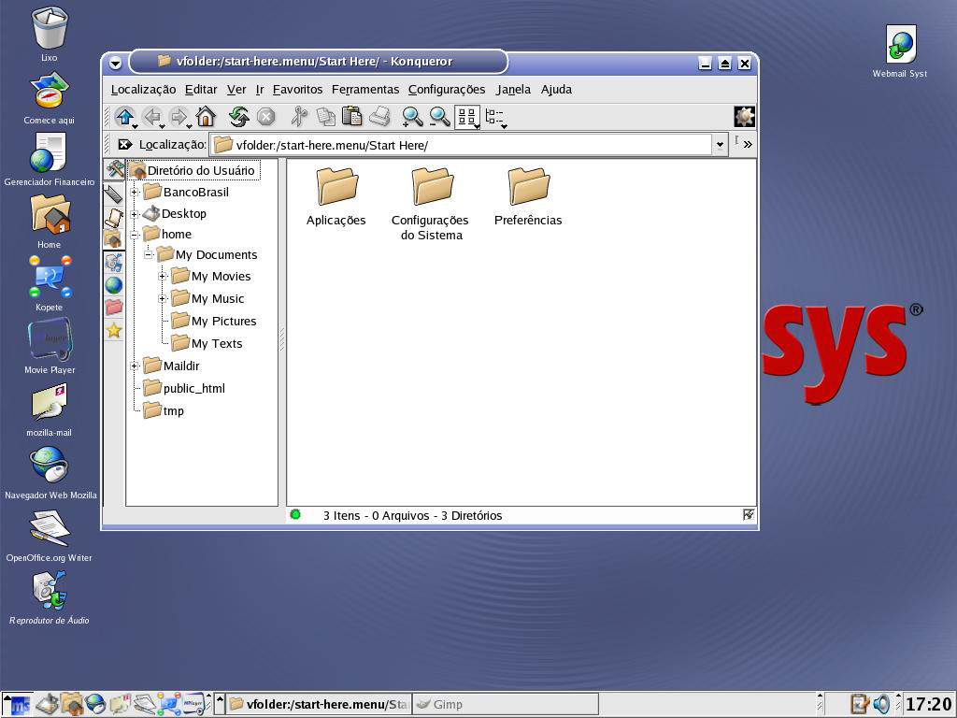

Slide 12
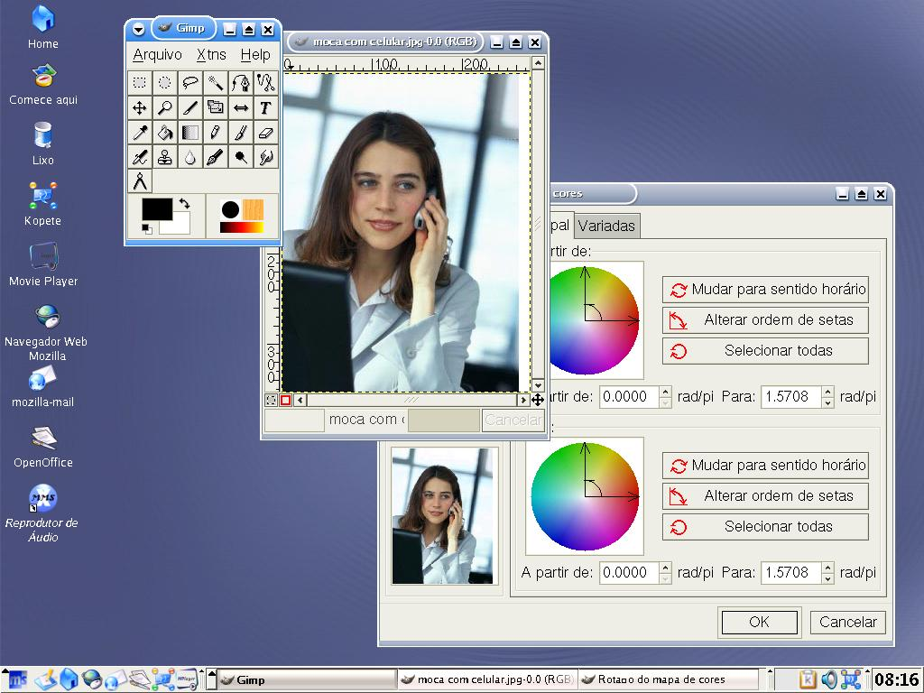

Slide 13
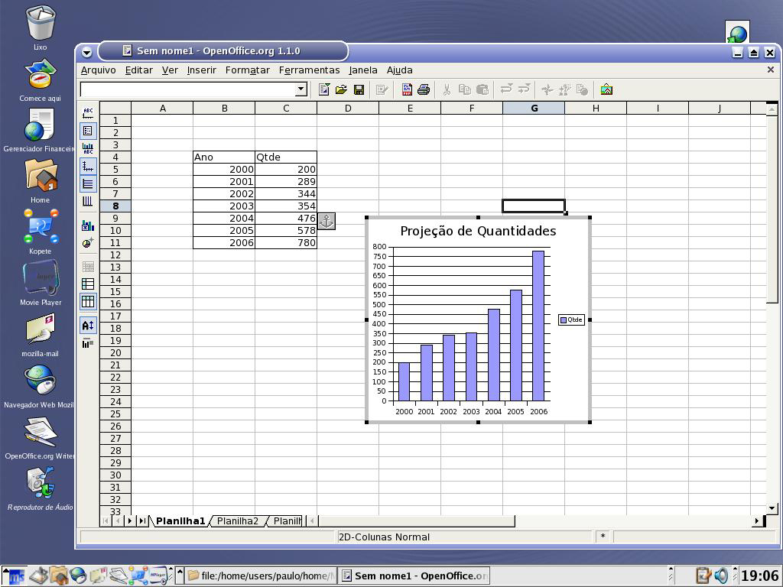

Slide 14
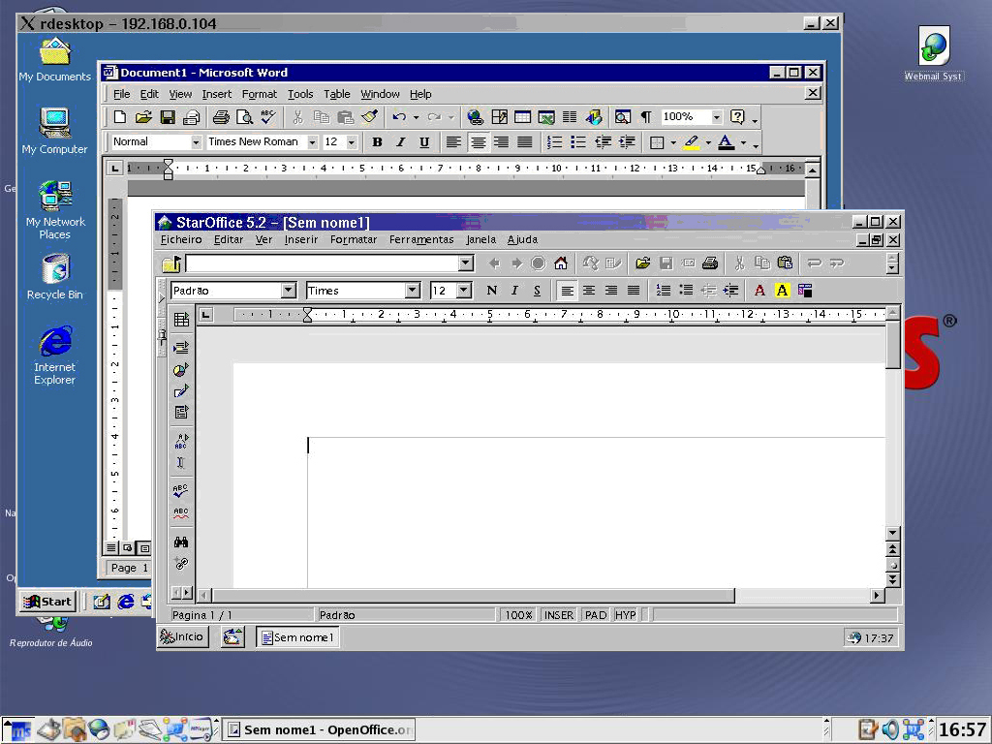

Slide 15
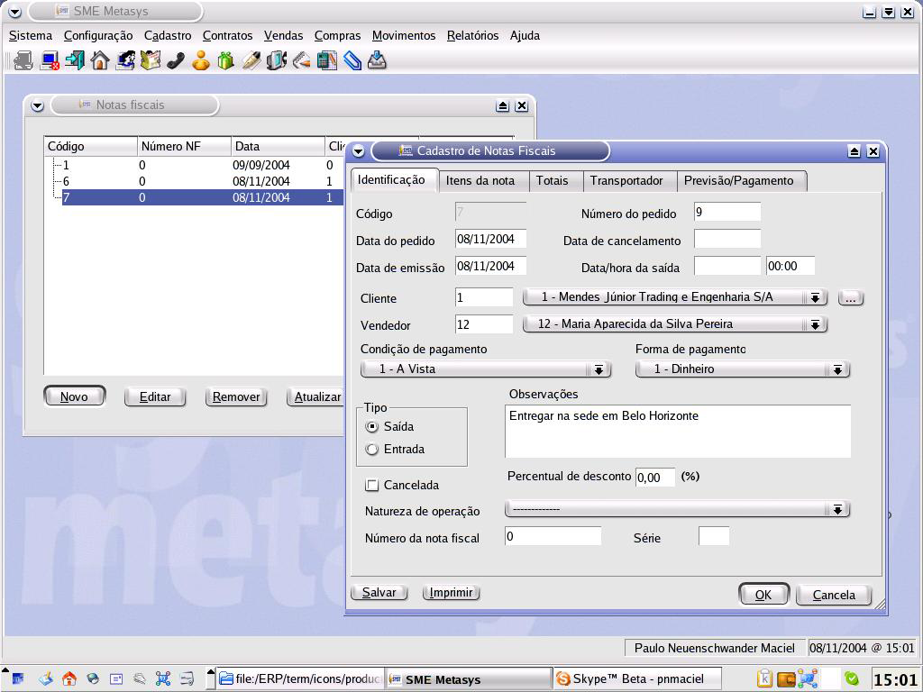

Slide 16
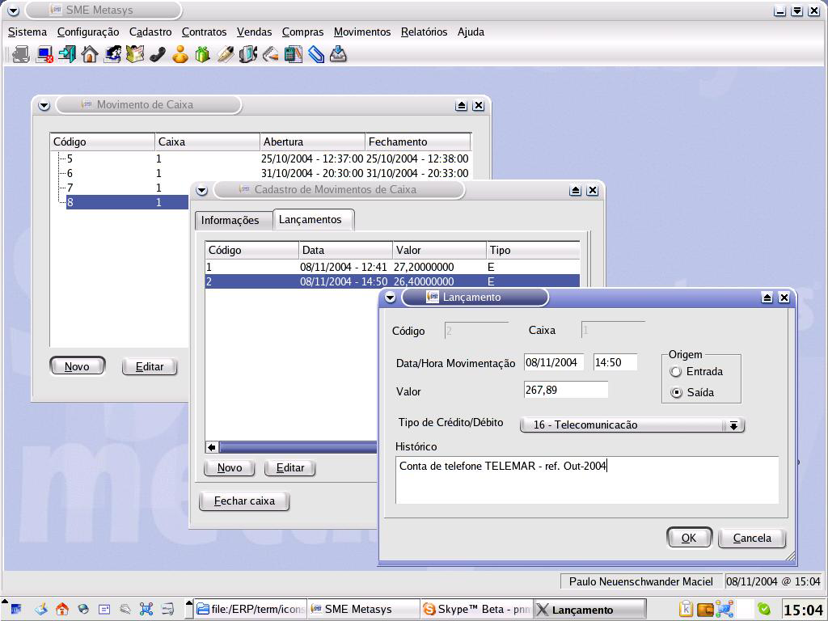

Slide 17
Example: Lab with 50 Computers
Cost comparison
62% savings of R$ 215,374.00 or US$82,836.00

Slide 18
Conclusion: Free Software and the SME
Free software can provide significant savings for SMEs
But must be careful
  Free software can be confusing
Free software does not mean everything is open
A carefully constructed solution, such as Metasys, can offer
  $$$ Savings
  Ease of use
  Reliability (simplified and robust administration)
  Powerful end application software.

