Slide 1
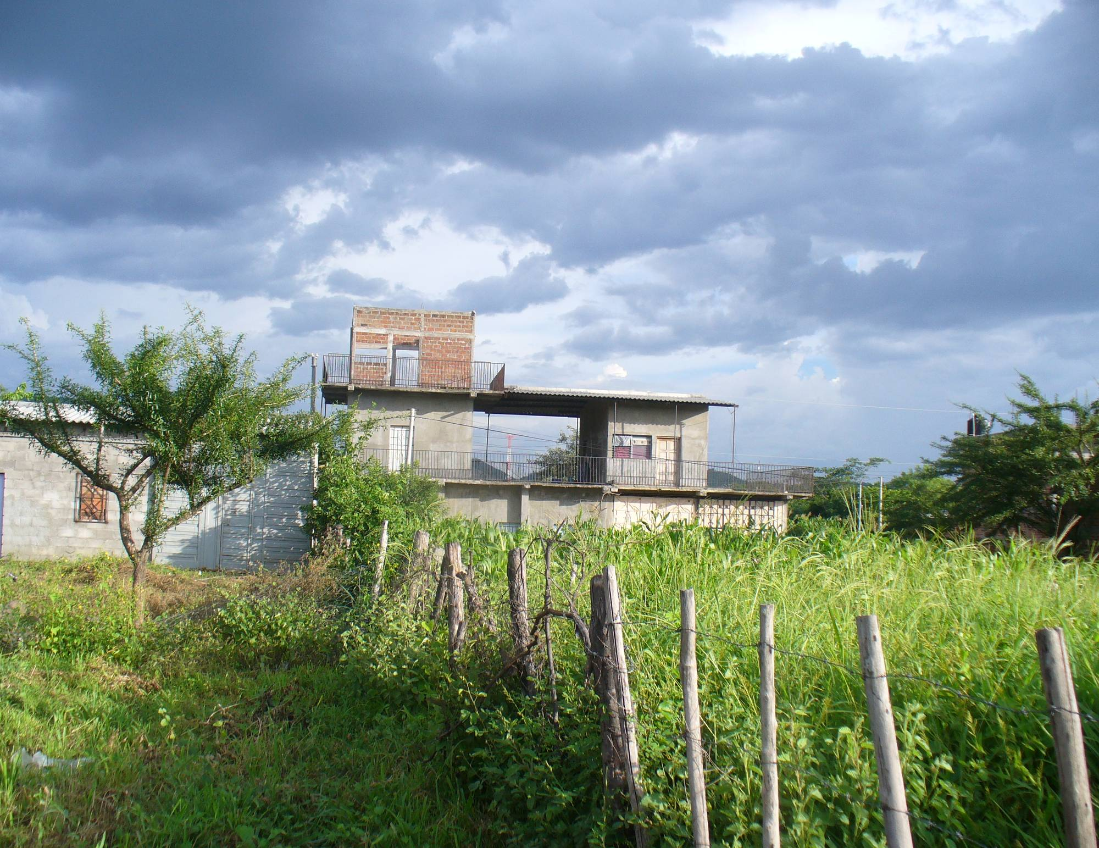
Building capital: the role of migrant remittances in housing improvement and construction in El Salvador
Brendan McBride
IDB-MIF Presentation,
May 15, 2009
Notes:
My Latin America experience - primarily been in research about the impact of immigration, in ES and Brazil, and some recent writing on new affordable housing mechanisms in Latin America.
Work experience in affordable housing
Always interested in linkage between two

Slide 2
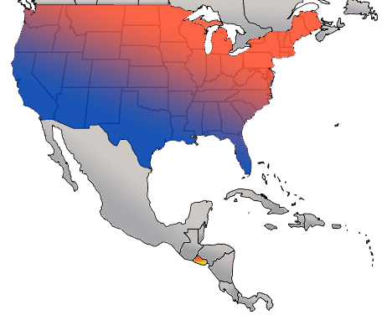
REMITTANCES FLOW
The scope and impact of migrant remittances in El Salvador
USA
National level:
18% of GDP
Six times ODA
Equal to exports
Household level:
22% of households
51% of household income
3.7 BILLION
EL SALVADOR
Notes:
El Salvador one of the countries most deeply affected by international migration and remittances.
One in seven Salvadorans live abroad, mostly in US. Nearly every family in ES and every aspect of Salvadoran society seem impacted by migration.
Migrant remittances clearest indicator of migration’s impact in El Salvador. As Manuel Orozco has written, millions/billions.
Macroeconomic role
Capital flows, but micro-targeted family capital, increments of an average of $200
All in all, a critical global flow of capital to El Salvador, both macroenomically and in the way that they increase standards of living family by family.

Slide 3
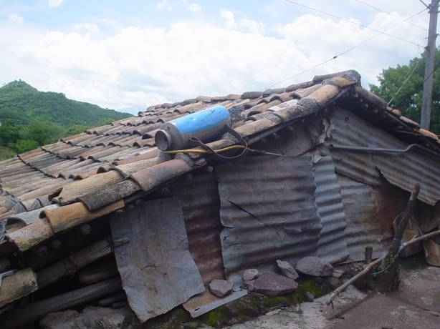
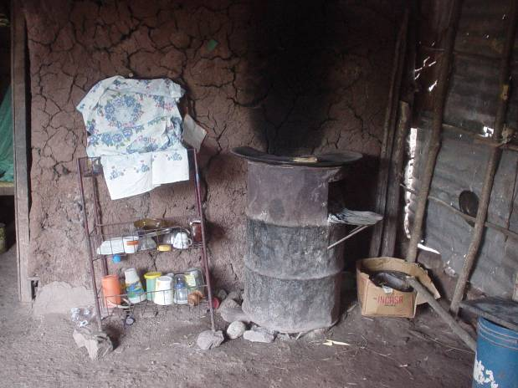
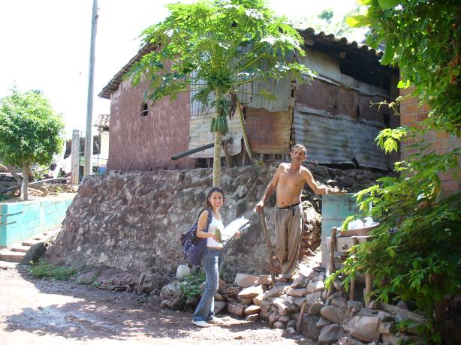
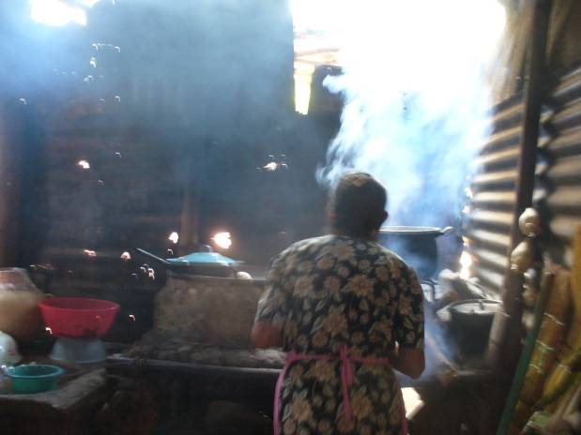
34% of the Salvadoran population live in substandard housing conditions
The magnitude of remittances side by side with the housing deficit leads us to ask: what role do these capital flows play in housing improvements?
Notes:
Despite these flows, El Salvador is not a place without housing problems.
These are either qualitative or quantitative deficits.
I saw these housing deficits while doing previous research in El Salvador in 1997, even in towns that received large flows of remittances from migrants abroad.

Slide 4
National statistics tell us that a small percentage of remittances is used for housing, and the literature does not speak specifically to remittances’ use for housing.
$ REMITTANCES $
?
HOUSING
Current sources do not tell how remittances and housing are related. The goal of this study was to explore the connection between the two and provide empirical evidence of the role of remittances in housing production.
Notes:
Existing sources do not answer this question, or at least not in a satisfactory way. National survey says 1.5 percent spent on housing uses, and .27% on improvements.
Remittances’ use for housing purposes was not well understood.
Likewise, remittances were an unknown variable in the study of housing.
The connection between these two important phenomena was entirely unclear.
A desire to understand the connections between remittances and housing was the motivation for this thesis.
The goal was to begin providing empirical evidence for how remittances play a role in the housing process and housing outcomes.

Slide 5
Research questions
How and how much are remittances used for housing purposes by remittance households, and what impact have they had on housing outcomes?
How does the use of remittances influence the housing process, particularly the major inputs to housing – land, labor, capital, and materials?

Slide 6
Analytic framework
Literature of remittances defines important indicators relating to remittances
Literature of housing defines important indicators for informal housing process and outcomes
In-depth survey on remittances and housing
The survey was administered to 100 randomly selected households in the San Jerónimo area
Notes:
Reviewed literature of both to select indicators that can tell us about how remittances and housing are related.
the survey collected information about the characteristics of households
Migrant characteristics – connections - remittances
Housing spending over last decade, land spending, and indicators that tell us about the unique workings of the housing process and its outcomes
Also asked people other questions about animals they owned, households assets et al. Amazing I was not kicked out of anyone’s house!

Slide 7
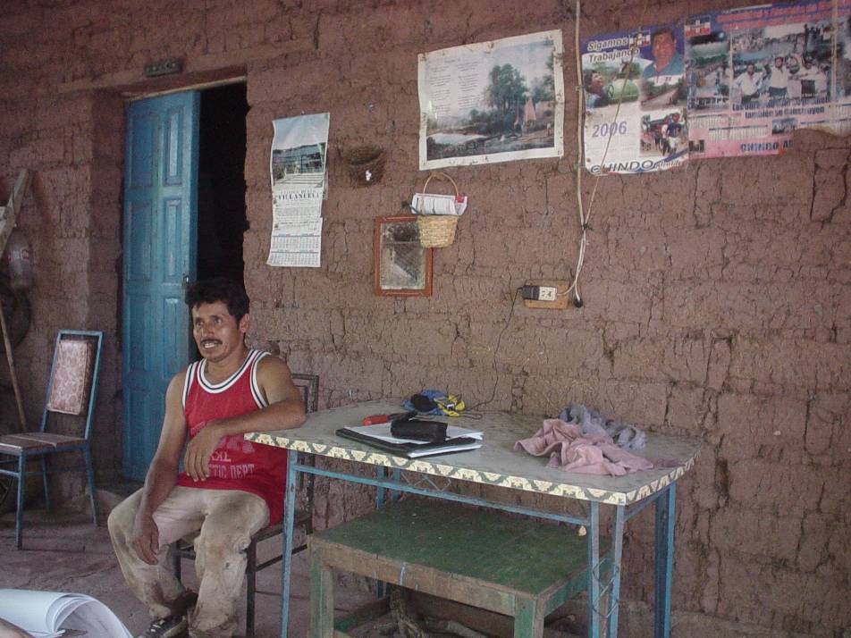
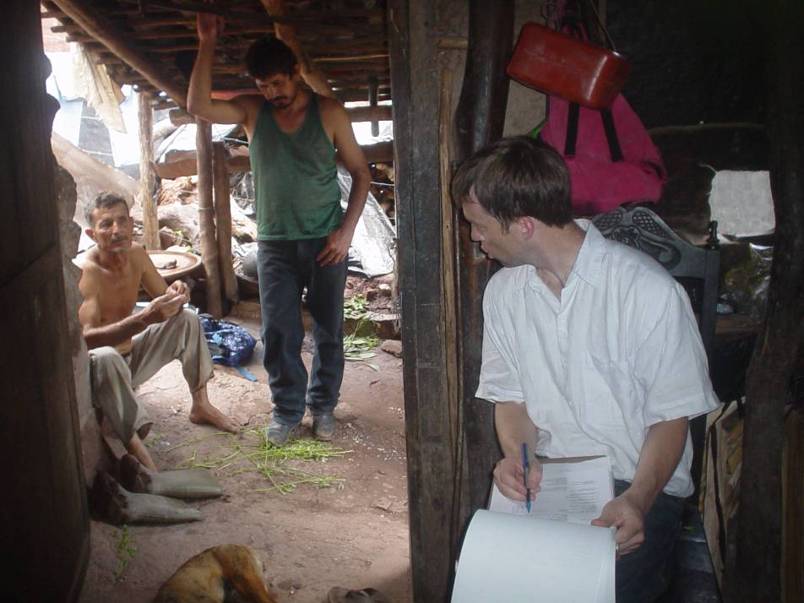
The findings from the household survey
Notes:
To prove that I really did this, I have included some action slides

Slide 8
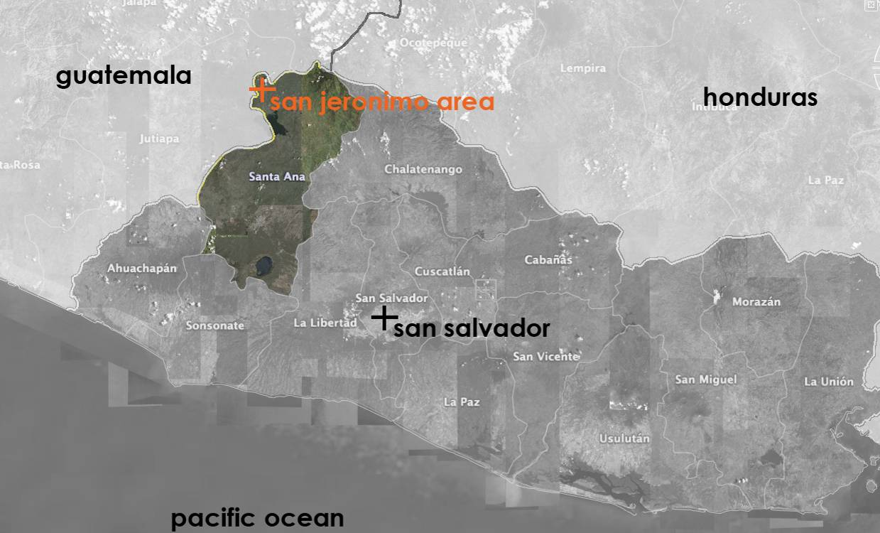
Findings from the survey
Notes:
Since 1970’s villagers have been migrating north. The migration first showed strong growth in the 1980’s during the civil war, but did not abate after the peace accords. It continued to build momentum throughout the 90’s and into this millennium.
Majority of migrants go to NY, with smaller concentrations in LA and DC.

Slide 9
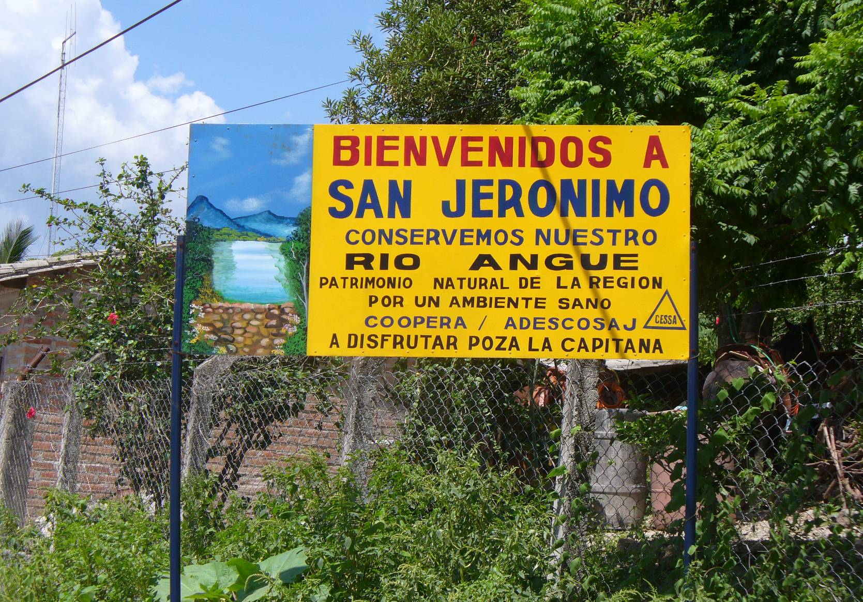
The study locale: San Jerónimo
Semi-subsistent agricultural community.
Since 1970’s villagers have been migrating.
The migration grew sharply in the 80’s during the civil war and continued to grow into the ’90’s.
Majority of migrants go to the NY metropolitan area, with smaller concentrations in LA and DC
Nearly half worked in the construction and service industries.
Two-thirds are men.

Slide 10
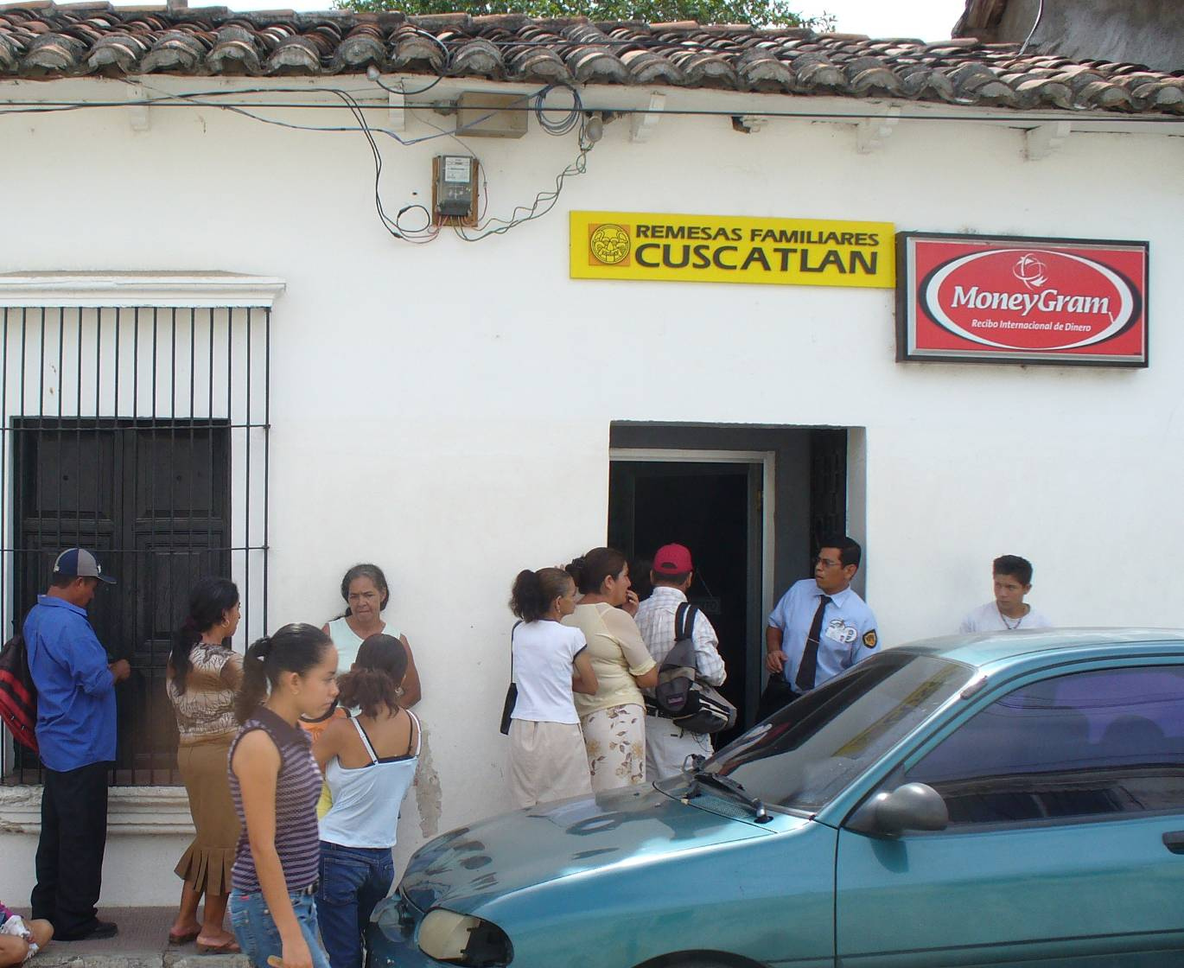
Profile of remittances’ role
61% of households receiving remittances.
Annual remittances averaged $2,334.
Represented 48% of household income.
Remitters averaged $1,104 annually
Mother of migrant is receiver 45% of time
Remittance households have more income – $1,275 annually – than non-remittance households.

Slide 11
The local housing process
State largely uninvolved in housing regulation
Families coordinate the process, using their own resources and means
Formal housing loans never used
Households spend what they have
Capital was and is limited for many households.
Notes:
The household survey and interviews with a range of local actors gave an idea of how housing has gotten built locally.
Dynamics were similar to other communities where I had worked in Latin America.
Households had to dedicate the bulk of their income to consumption.
Capital was the missing ingredient for poor households, and a limitation for relatively middle income households.

Slide 12
The use of remittances for housing

Slide 13
“Through the grapevine” talk about remittances and housing
“You see the difference between the houses, [those with remittances] have their houses nicely arranged, made of brick and block, nice doors and walls, furnished.”
“[Those with remittances] can have their pretty little houses with furniture, made of brick….they have duralita [roofing] and iron in them.”
“People who get remittances have good houses, houses of cement with ceramic [floors], some have new homes.”
“You see the difference in the house…you see that [migrants] have sent for the houses to be built.”
“People are knocking down old houses and building new ones. That’s how the town is growing.”

Slide 14
Percentages of households making improvements over last 10 years
NON-REMITTANCE HOUSEHOLDS
REMITTANCE HOUSEHOLDS
Notes:
Households with remittances are significantly more likely to have made improvements to their housing or build new over the past decade.

Slide 15
Amount spent on average per household
NON-REMITTANCE HOUSEHOLDS
REMITTANCE HOUSEHOLDS
Notes:
The most basic and powerful finding of this study.
Non-remittance households have spent limited funds on housing improvements - this is in line with the limitations on capital
Remittance households have spent on average more than seven times as much on housing improvements over the past decade as non-remittance households.
This finding provides the strongest evidence that remittances are being used heavily for housing purposes.
This difference in spending indicates that remittances allow households who receive them to spend significantly more to improve their housing circumstances.

Slide 16
Spending across income categories
Notes:
This chart = how much households with the same income characteristics have been able to spend on housing. (separated into quintiles)
In all categories, remittance households are outspending non-remittance households.
In 3 groups the difference in housing spending is statistically significant.
This makes sense for non-remittance households: low-incomes have limited their ability to improve their housing circumstances.
For remittance households the limitation of capital does not seem to apply.
Remittances playing a major role in addressing the housing needs of the poorest groups.
Remittance households have spent amounts on housing that have been completely unattainable for non-remittance households.
The difference in the high group: remittance households may be spending a lot of money to “catch up” in other words
All in all, these findings make it clear that remittance household are spending much more money on housing than those without.

Slide 17
The use of remittances for housing and their role in the housing process
Notes:
how are remittance households differently positioned to access land, labor, and materials?

Slide 18
Dispersed organization of housing process in remittance household
Typical organization of housing process in non-remittance household
Typical head of household
Range of family members
Capital
Labor
Materials
Land
Other family members more likely to supervise work
Other family member more likely to buy materials
Notes:
This first chart gives a snapshot of how the housing process in non-remittance households is organized and implemented by the head of household.
CLICK
In non-remittance households the head of household controls the improvements, including all of the inputs to housing. Coordinates labor – whether his own or that of others, controls the spending of resources, buys materials, and coordinates access to land.
In remittance households control remains within the hands of family, but responsibility becomes dispersed.
Importantly, the process has changed, but has remained within the hands of the family and has continues to be largely autonomous and informal.

Slide 19
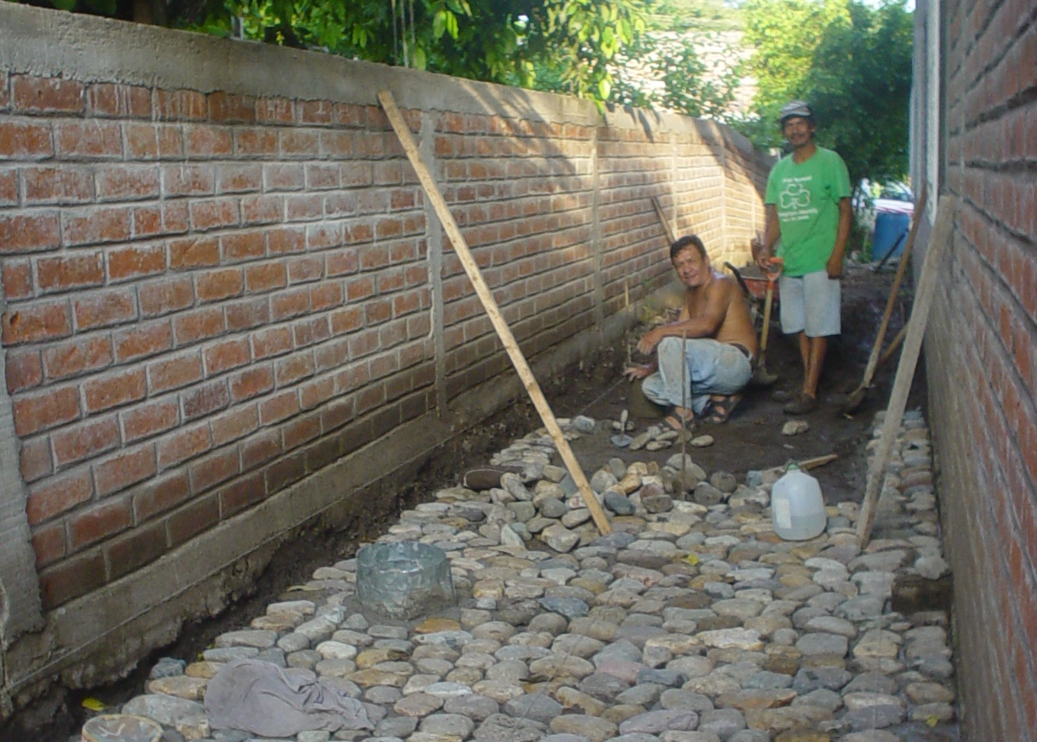
Remittance households hired paid labor more often
Notes:
Remittance capital has enhanced the ability of households to carry out improvements. Data on construction labor provide the clearest evidence of this. This is a major change -- more than half of non remittance households provide their own labor to carry out housing improvements and construction.

Slide 20
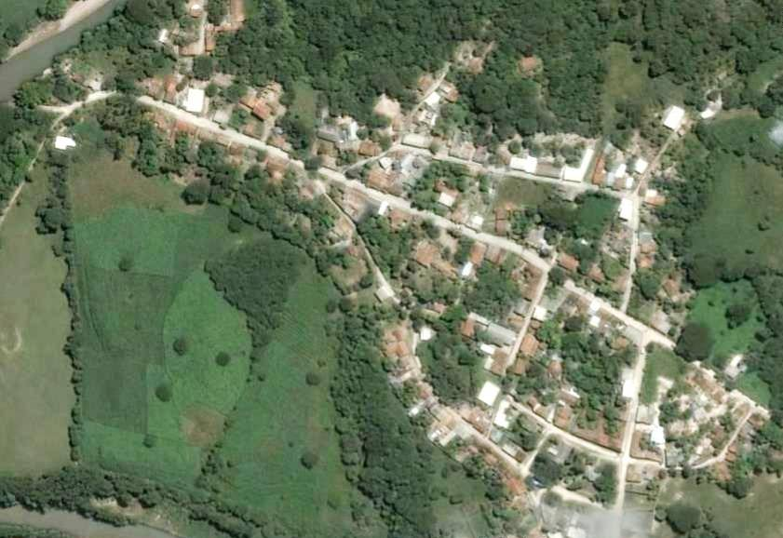
Remittance households were more likely to purchase land
Notes:
Remittance households are thus better positioned than non-R to access land, one of the most important inputs to housing, and one of the most expensive inputs in the San Jeronimo area.
Purchase process distinctive: In a majority of remitt hhold cases, a member of the remittance household purchased land for a migrant living abroad, what I call a ‘liaison’ purchase.

Slide 21
The impact of remittances – new homes
New homes represent the majority of funds spent on housing – 55%
NON-REMITTANCE HOUSEHOLDS
REMITTANCE HOUSEHOLDS
Notes:
Provides one big answer to research question #1 – how are remittances being used for housing?
New houses are the most powerful result of the greater spending power of remittance households.
A significantly greater percentage of remittance households have built new houses. These houses make up over half of remittance household spending.
This statistic provides some of the strongest evidence that remittances are producing beneficial impacts for families that receive them. Nearly one-third of these families are now living in a new house.

Slide 22
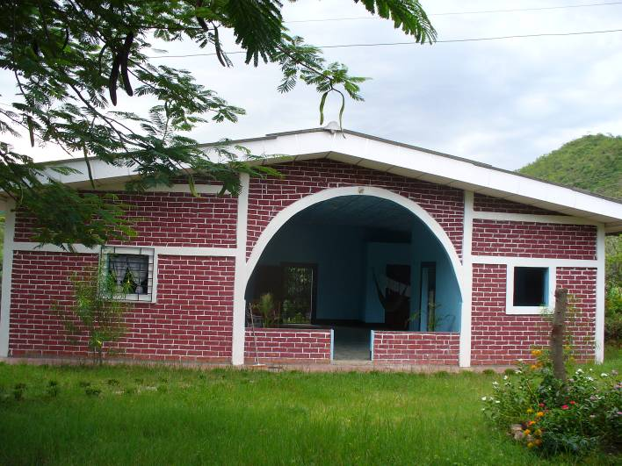
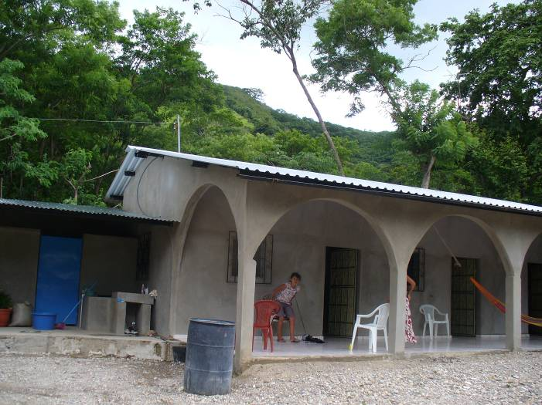
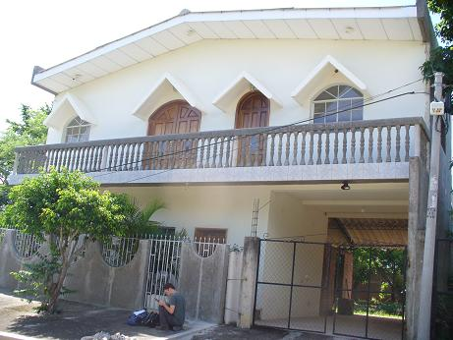
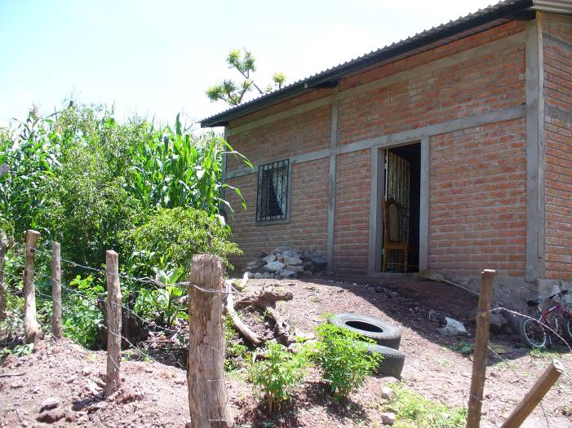
New homes are more likely to be made of brick, have a premium roof, and have high grade floors than existing homes.
Notes:
This finding can be seen in the physical form of the improvements that dot the landscape of the San Jeronimo area.
These new homes are changing the face of housing in the San Jeronimo area with the materials that they use.
There is a shift away from traditional materials and toward purchased, sometimes imported materials. The houses almost entirely of adobe and bahareque – only a quarter century ago.
Home designs ranged from the traditional to what might be called outlandish….

Slide 23
Improvement impacts
HOME ADDITIONS
NON-REMITTANCE HOUSEHOLDS
REMITTANCE HOUSEHOLDS
Notes:
This included adding a room, a kitchen, or a bathroom

Slide 24
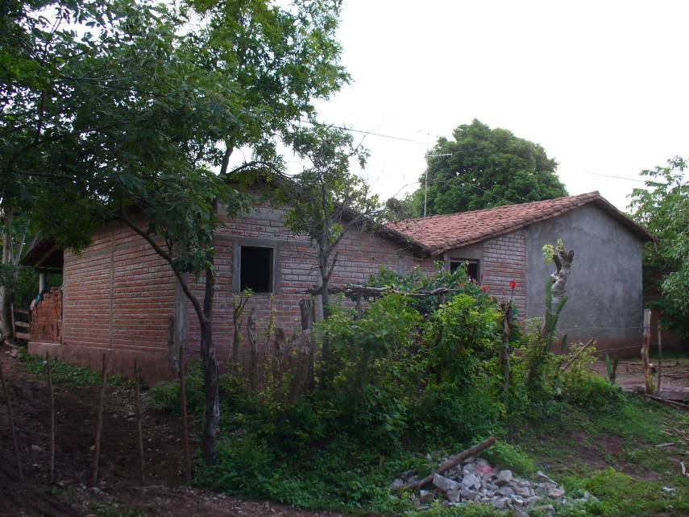
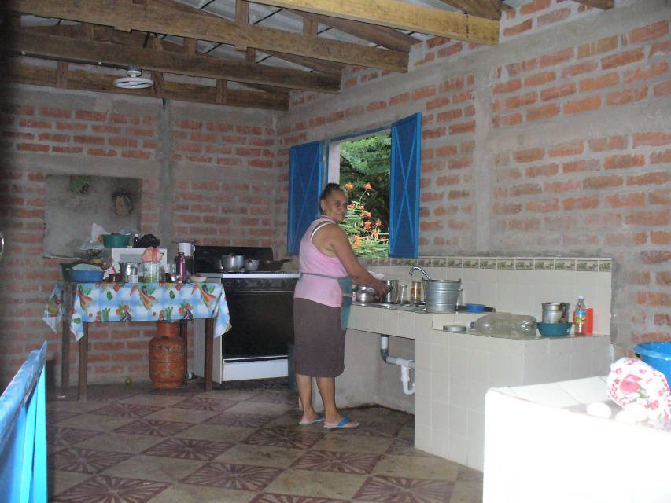
Expansion of house
Kitchen addition

Slide 25
CHANGES TO THE ROOF
NON-REMITTANCE HOUSEHOLDS
REMITTANCE HOUSEHOLDS

Slide 26
Roof comparison

Slide 27
CHANGES TO THE FLOOR
NON-REMITTANCE HOUSEHOLDS
REMITTANCE HOUSEHOLDS
Notes:
In a limited number of cases of improvements (about 30%) there was data on the before and after of improvements
Showed that a large # of remittance hholds had replaced a dirt floor. This seemed to be one of the first improvements that hholds made

Slide 28
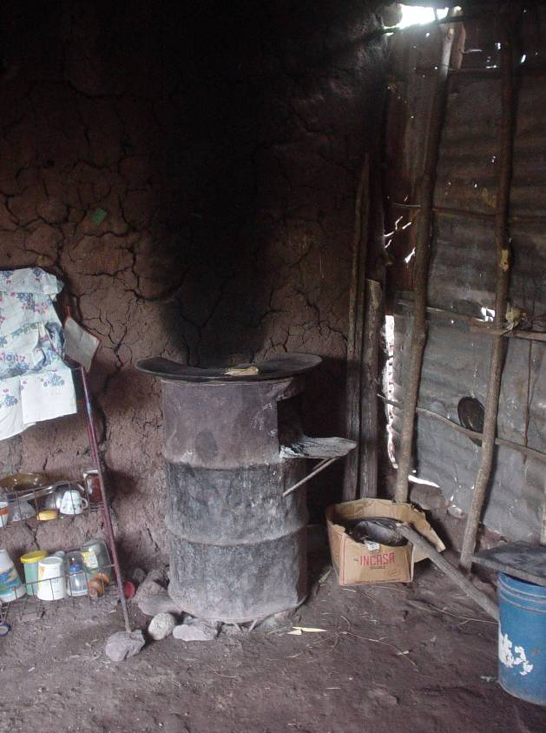
Floor improvements

Slide 29
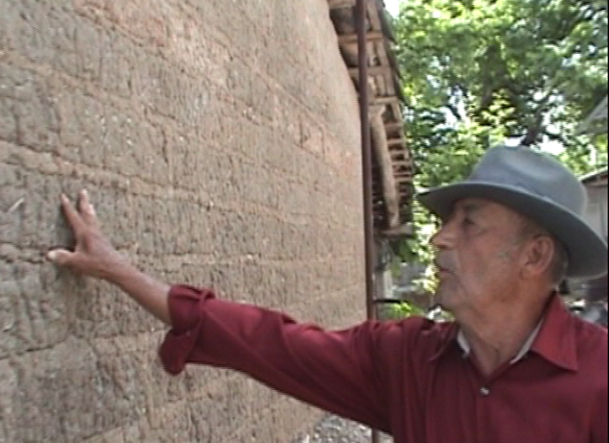
Local impacts: a short film about remittances and housing
SCENE 1: Transito, veteran mason
SCENE 2: Reyes, renovated her home
SCENE 3: Ana, built a new home

Slide 30
Conclusions
Analysis of remittances in their local context is critical to an understanding of how they are used.
Remittances have been used extensively for housing, serving as one of the primary forms of capital for housing improvements and construction in the study area.
Remittances have been integrated into and sometimes enhanced an informal system of housing production.
The impact: remittance spending on housing is producing real benefits and expanding shelter options for remittance-receiving households.
Notes:
I thought that I was going to encounter a number of reasons for why remittances were not being used for housing, given national #’s.
In contrast, I have found that they have a major impact on both the housing process and its outcomes.
Unlikely to uncover this result without research on a local and household level, by delving into the details of how remittances play a unique role in the local housing process.
This local perspective is especially important in cases where informal systems may hide remittance use patterns at first glance.
A basic question motivated this study --- are remittances used for housing purposes? The simple answer is yes – remittances extensively used for housing improvements in SJ.
A basic estimate indicates that nearly a quarter of remittances are used for housing.
This study concludes that remittances are serving as one of the primary forms of capital for housing improvements in the study area.
Remittances arrive in a context of housing need where non-remittance capital is generally in short supply. Remittances appear to have played a major role in filling this capital gap.
Remittances have not replaced existing self-help strategies for housing improvements and construction.
Remittances – which are by nature informal, family based resource flows – fit well into largely informal, family based system of housing production.
Although remittance households have shifted their approach somewhat, the strategies remain largely the same.
Remittances enhance households’ ability to help themselves, enabling them to access inputs to housing. Households still build with what they have, but with remittances they can do much more.
Remittance households live in better conditions. These capital flows are definitively improving the housing opportunities of remittance households.
If development is about improving opportunities for families in real, sustained ways, then remittances appear to be advancing goals of development one household at a time.

Slide 31
What are the potential implications for housing practitioners?
Remittances are a variable to consider when addressing housing needs in remittance-receiving communities
Both positives and negatives of informal systems of housing production could be fueled by remittance capital
Positive multiplier effects
Increasing rates of unoccupied houses
Notes:
Although the housing process is local, $ might be coming from 1,000s of miles away. Housing decisions may be made by someone on another continent. Also, different people are coordinating the process of housing improvements – less likely to be a traditional head of household, and more likely to be a woman. How much is being spent on housing and how the money and the process flows is being impacted by remittances, and this information is important to know as we formulate housing solutions in remittance-receiving locales.
This second implication could meant that both the positive and negative aspects of informal housing production could become bolder.
1) Unregulated construction, for example 2) keeping housing users out of the formal financial system
Local practices of building could be transformed by an infusion of migrant capital. (like in film with lamina) This could mean that local building techniques could fade out of existence
Creating housing oppties for some households as never before, but also a gap in opportunities between those who have a source of migrant capital and those who do not.
Households receiving remittances have a distinctive spending advantage that may be changing the market in locales like SJ. Land is a big example of this; masons are another
Many houses that are built in SJ are built for the future, not the present. They are incomplete, or completed but not occupied. 25% of the houses in the town sit empty. 2/3 owners abroad and vacant more than 5 years. What impact?
The idea of building a house is a powerful force in making the decision to emigrate.
If remittance capital remains or grows in its role as an almost indispensable tool for housing development, will migration be come to seen as a essential mechanism for improving the household’s housing conditions?

Slide 33
What are the potential implications for housing practitioners?
Remittances are a variable to consider when addressing housing needs in remittance-receiving communities
Both positives and negatives of informal systems of housing production could be fueled by remittance capital
Positive multiplier effects
Increasing rates of unoccupied houses
Potential for inequality in housing opportunities

Slide 34
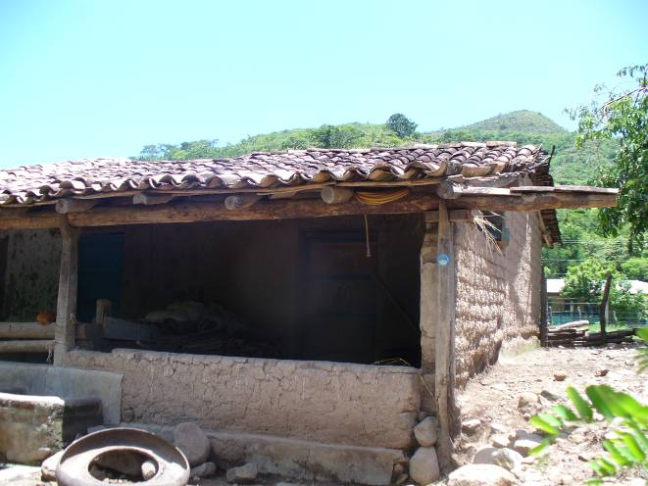
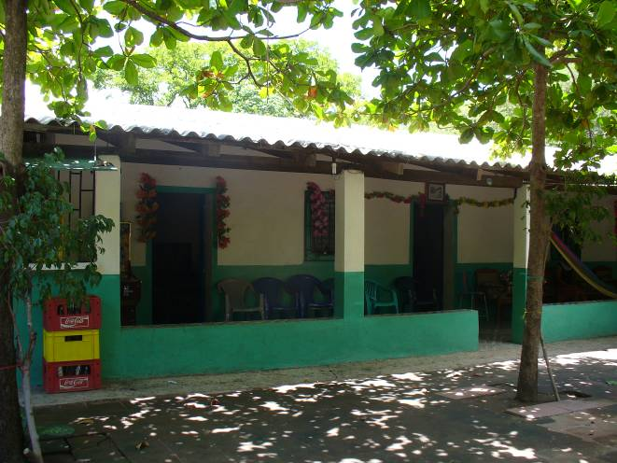
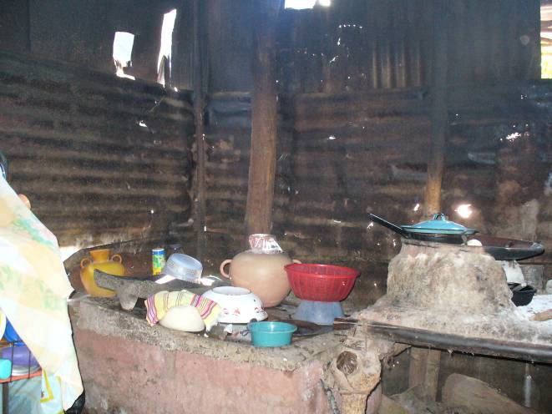
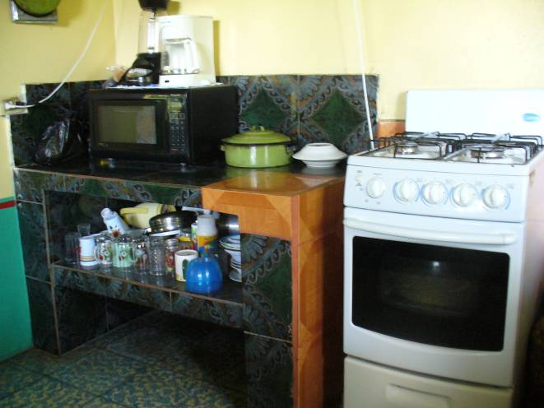
Houses on the same road
Kitchens in houses on same street

Slide 35
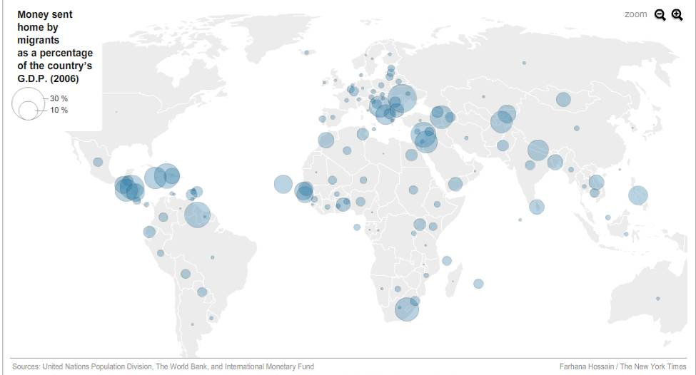
Potential reach of remittances as a housing development tool
Notes:
Though they come out a small Salvadoran village, these findings could give a glimpse of global phenomena.
Remittances represent one-third of capital flows to developing countries – formally estimated to be on the order of $240 billion dollars per year going to developing countries.
These flows of resources impact the lives of 100s of millions of people throughout the developing world.
If we look closely at other areas where remittances and informal housing systems intersect, remittances could also be playing a similarly instrumental role in the housing process and having significant impacts on housing outcomes.

Slide 36
THANK YOU
Brendan McBride
brendanmcb@gmail.com
Notes:
Across the world, we need to have more information about how remittances are being used for housing in local contexts.

