Slide 1
PPP Markets in Latin America
and the Caribbean
October 15, 2008
Ignacio Astorga, Skanska Infrastructure Development

Slide 2
Content
Company profile
Levels for policy support
The challenge of the Social Infrastructure PPP

Slide 3
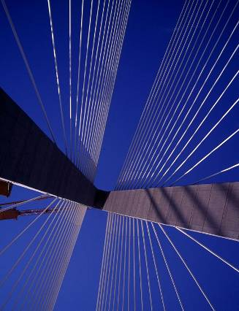
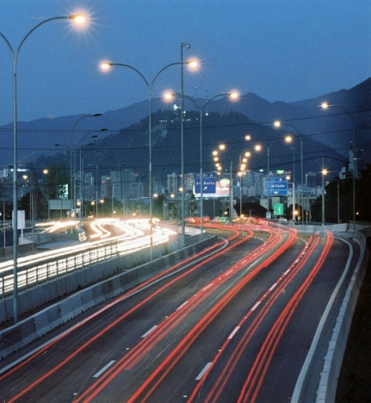
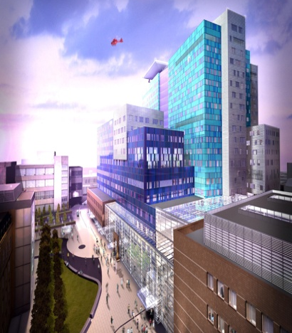
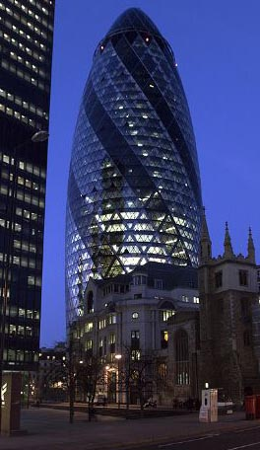
Company Profile
Puente Cooper
River, EEUU
Autopista Central, Chile
Barts and The London
Hospital, UK
Swiss Re, Londres UK
Founded in 1887 in Sweden
Revenue 2007: USD 21.700 MM.
60.000 employees

Slide 4
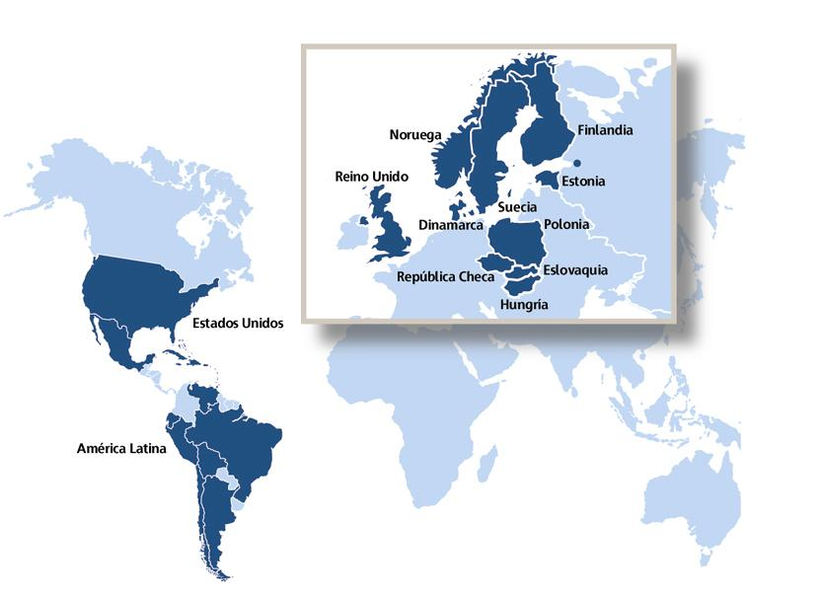
Company Profile
Ventas por área geográfica

Slide 5
Company Profile
Senior Executive Team
Financial Services
Staff Units
Support Areas
Construction &
Services
Residential
Development
Commercial
Development
Infrastructure
Development
Skanska Sweden
Skanska Residential
Development Nordic
Skanska Commercial
Development Nordic
Skanska Infrastructure
Development
Skanska Norway
Skanska Denmark
Skanska Commercial
Development Europe
Skanska Finland
Skanska Poland
Skanska Check Republic
Skanska UK
Skanska USA Building
Skanska USA Civil
Skanska Latin America

Slide 6

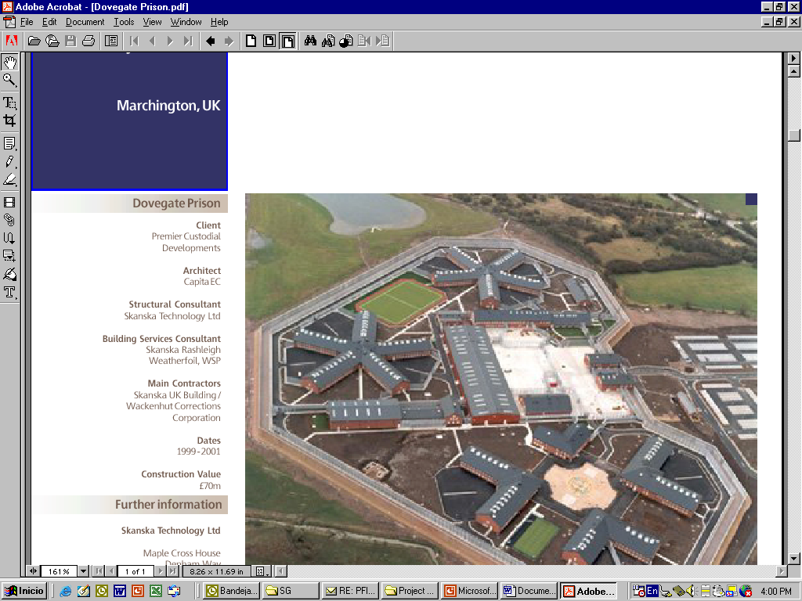
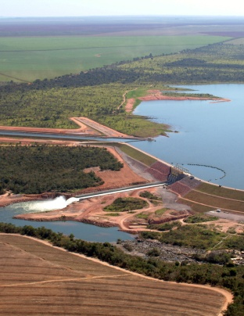
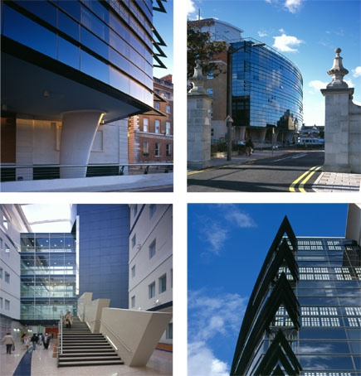
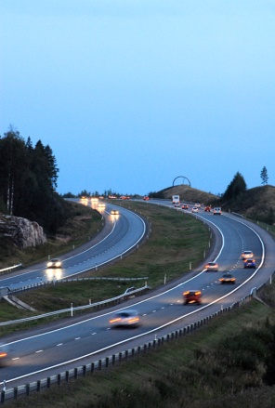
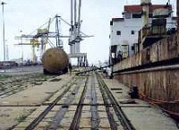
ID Projects
Company Profile
Helsinki - Lahti Motorway Finland
E18 Motorway Finland
E39 Motorway Norway
A1 motorway Poland
Waste Water Treatment Plant Russia (sold)
Manaus and Breitener
Thermal power plants, Brazil
Autopista Central, Chile
Ponte de Pedra Hydroelectric power, Brazil (sold)
M25, London, UK
Bristol BSF Schools, UK
Bexley Schools, UK
Midlothian Schools, UK
Barts & the London Hospitals, UK
Derby City General Hospital, UK
New University Hospitals, Coventry, UK
Central Nottinghamshire Hospitals, UK
Walsall Manor Hospitals, UK
Bridgend Prison, UK (sold)
King’s Hospital, UK (sold)
Maputo Port,
Mozambique (sold)
In bold sold projects

Slide 7
Levels for the Policy Support
External Environment
PPP Market
Project
MICRO
MESO
MACRO

Slide 8
Levels for the Policy Support
External Environment
MACRO
Political (stability and opening)
Economy (payment track record)
Legal stability
Public Exposure
Foreign investor friendly
Sustainability issues
  Environment
  Ethic
PPP Market
Project

Slide 9
Levels for the Policy Support
External Environment
MESO
PPP Regulatory Framework
(law, regulations, etc..) special
focus in payment and dispute
solution mechanism (clear
rules)
PPP as part of the national
investment system. (reduce the
political risk)
Project pipeline: investment
program (market attractiveness)
Prepared government client
(reduce potential conflict)
PPP Market
Project

Slide 10
Levels for the Policy Support
External Environment
MICRO
Transparent bid process (basic
requirement)- Code of Conduct
Clear governance scheme
(helps the development of the bid
and project)
Adequate balance between price
and quality variables (allows to
mobilize international experience)
Bid cost compensation (reduce
the entrance barriers)
Project size (represents a
threshold for our investments)
PPP Market
Project

Slide 11
The challenge for Social Infrastructure PPP

Slide 12
Some differences between models

Slide 13
Main Questions…
Why to use the SI PPP model?
  Technical
  Economical
  Political
What to include in the scope?
  Design
  Construction
  Equipment
  Operation
    Support services (Hard – Soft)
    Specific services (clinical, educational, other??)
Value for Money

Slide 14

Muchas Gracias
www.skanska.com/ppp

